Slide 1
PHYLUM PORFERIA

Slide 2
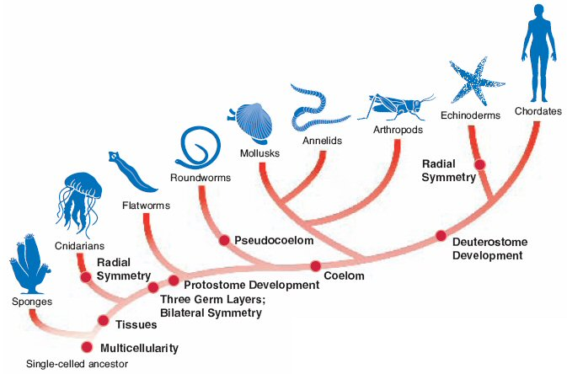

Slide 3
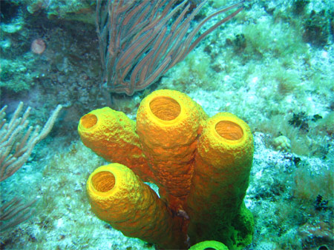
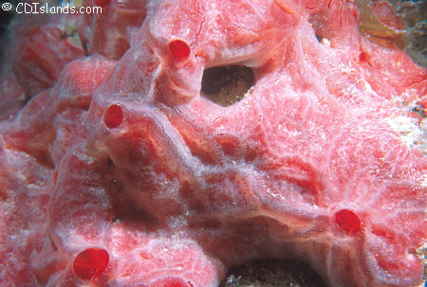
PORIFERA
Kingdom : Animalia
Phylum : Porifera
Porifera = “pore bearer”
Yellow barrel sponge
Pink lumpy sponge

Slide 4
Body Plan
Levels of Organization: Specialized Cells
Body Symmetry: Absent
Germ Layers: Absent
Body Cavity: None
Embryological Development: None
Segmentation: Absent
Cephalization: Absent

Slide 5
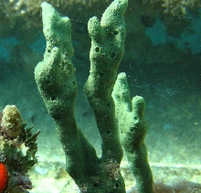
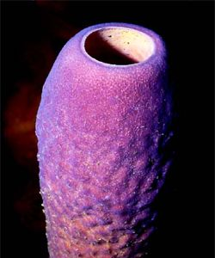
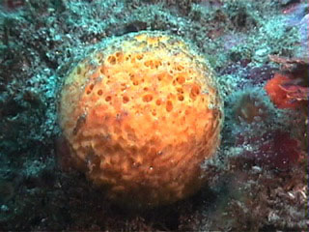
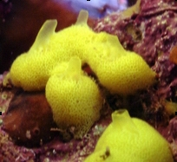
Characteristics
  Cluster of specialized cells

Slide 6
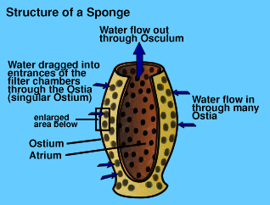
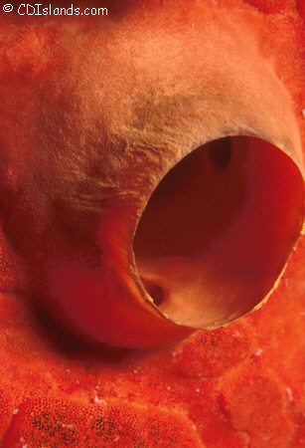
Characteristics
  Ostia – pores – many, water IN
  Oscula – large opening(s), one or few, move water OUT
osculum

Slide 7
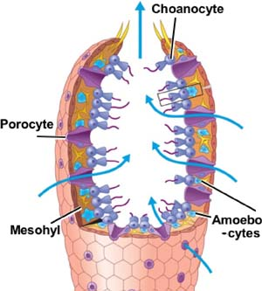
Characteristics
  C. Choanocytes – collar cells; have flagella to keep water moving
  D. Amoebocytes – transport food to layer of cells not on the surface

Slide 8
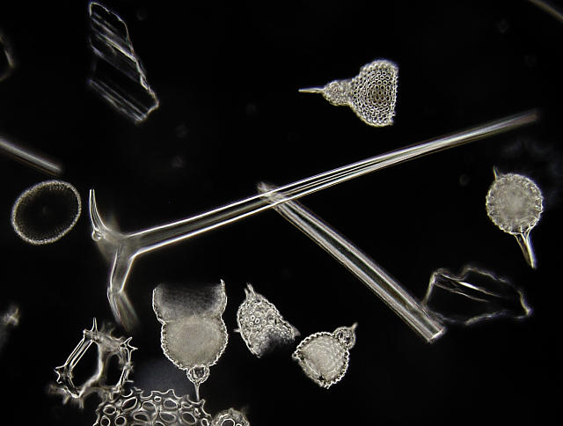
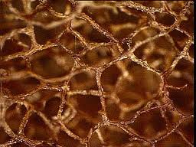
Characteristics
  E. Spicules – “skeleton” hard splinter-like; made of calcium carbonate (CaCO₃) or silica (Si)
F. Spongin – flexible protein
spicules
spongin

Slide 9
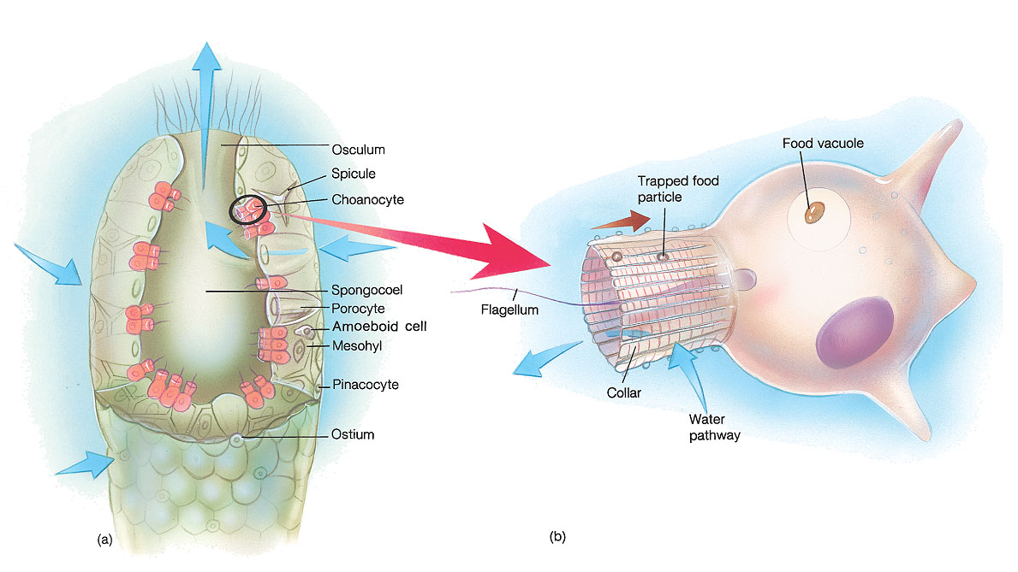
Characteristics
Composed of 3 layers
  outer layer of flattened contractile cells (pinacocytes)
  inner non-living mesoglea containing a variety of specialized cells
  collar cells (choanocytes) which capture food, etc. from water flowing through channels.

Slide 10
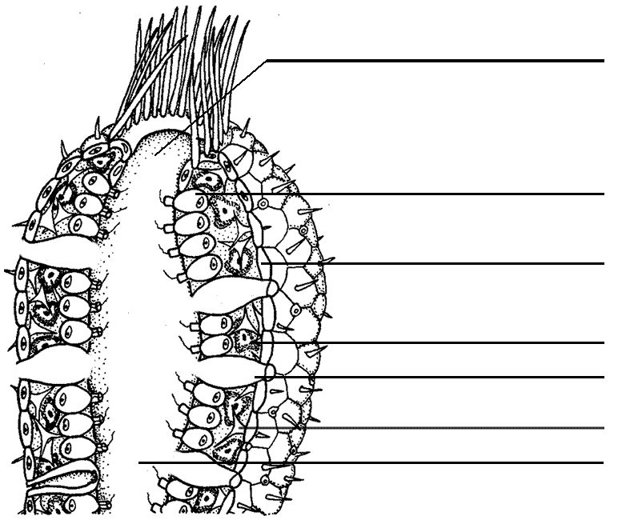
osculum
chanocyte
pinacocyte
amoebocytes
ostium
spicule
spongocoel

Slide 11
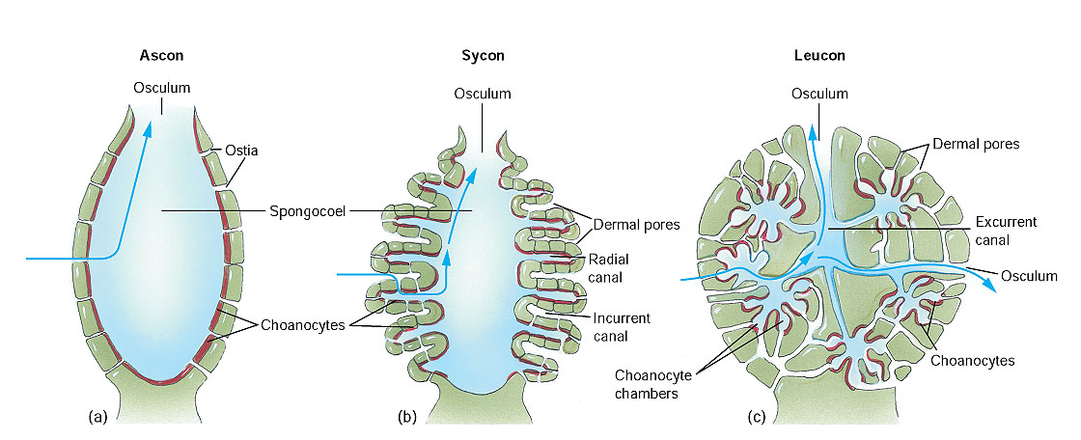
Syconoid
Asconoid
Leuconoid

Slide 12
Feeding
Heterotrophic - filter feeders
Food trapped by choanocytes
Intracellular digestion (within the cell)
No digestive tract
  Water & food goes in via ostia
  Choanocytes trap food in spongocoel
  Amoebocytes carry food to inner layer of cells
  Water out osculum
YouTube / Video Link

Slide 13
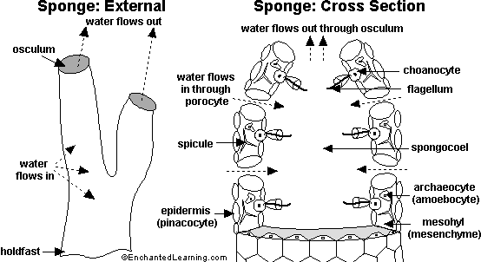

Slide 14
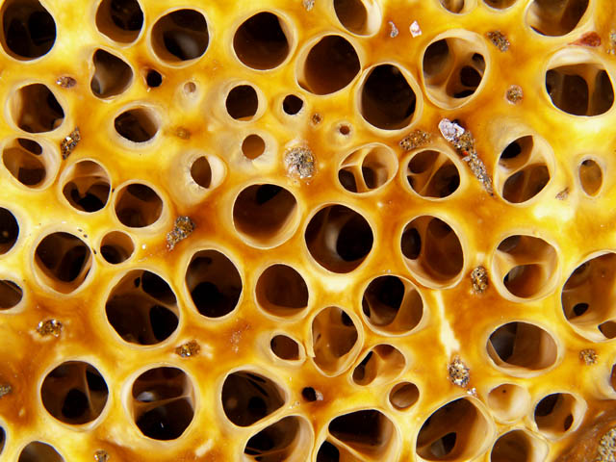
Respiration, Circulation, Excretion
Respiration, circulation, and excretion all happen via DIFFUSION.

Slide 15
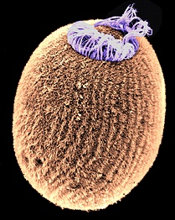
Response
NONE! No Nervous System
No cephalization (formation of a head)
Movement and Mobility
  - Larvae are free-swimming, use cilia
  - Adults are sessile (do NOT move)

Slide 16
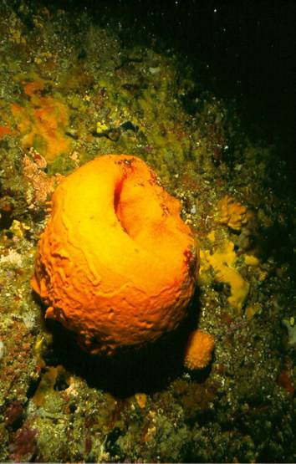
Reproduction
Sponges can reproduce both sexually and asexually.
ASEXUAL - using budding and gemmules formed in stress condition

Slide 17
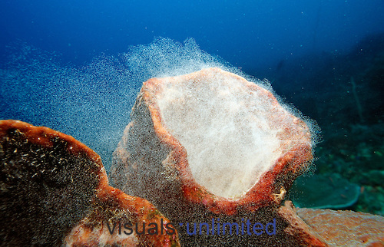
Reproduction
SEXUAL - using sperm and egg
  Monoecious = both sexes in same organism (hermaphrodites)
    Egg and sperm produced
    cross fertilization
  Dioecious = separate sexes
    Egg OR sperm produced

Slide 18
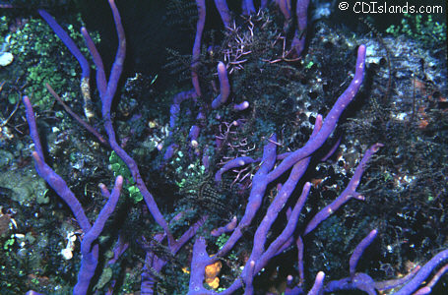
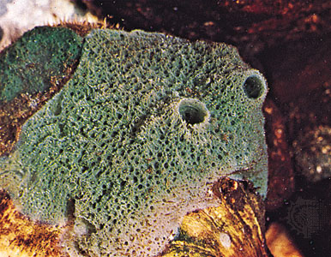
Habitat
Sponges live in aquatic environments.
  Marine
  Freshwater
Purple Rope sponge
Fresh-water Sponge

Slide 19
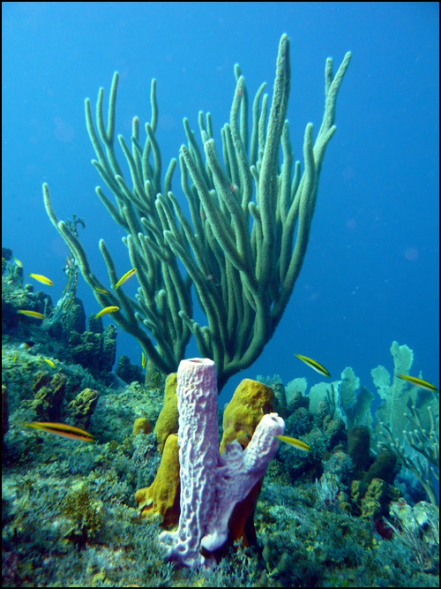
Role in Ecosystem:
Sponges play an essential role in coral reef diversity.
  Provide homes for some
  Provide food for others
  *Sponges are also being studied by scientists because they are immune to cancer.

Slide 20
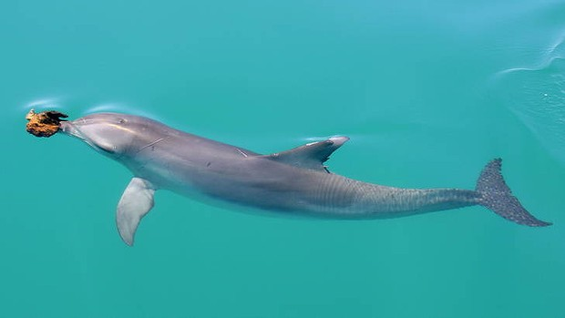
Role in Ecosystem:
  Sponges can also be used as a tool for higher-level mammals.
    Human use
    Dolphin use
  *Sponges are also being studied by scientists because they are immune to cancer.

Slide 21
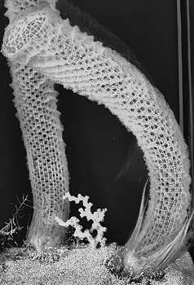
Classes
Class Calcarea
Glass Sponges
Demosponges
Homoscleromorpha

Slide 22
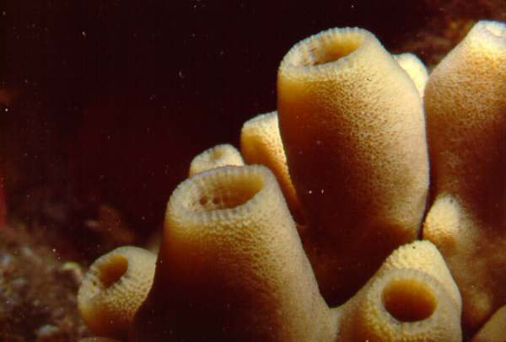
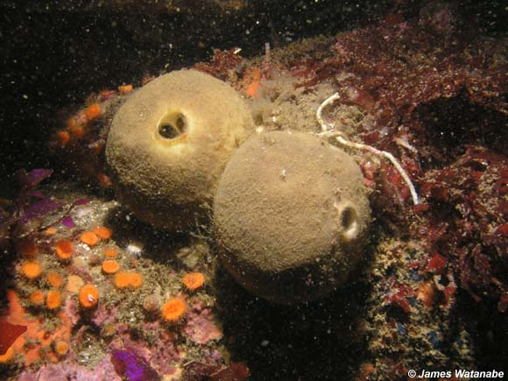
Classes Calcarea

Slide 23
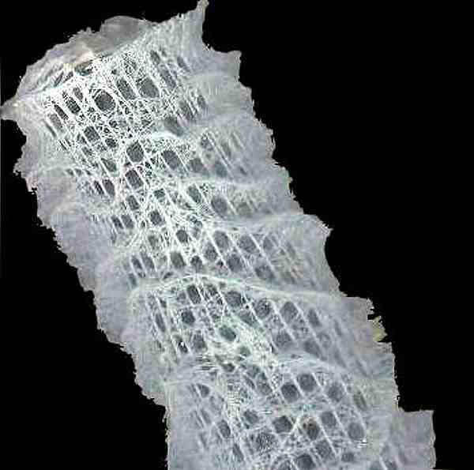
Glass Sponges

Slide 24
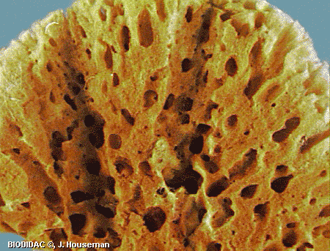
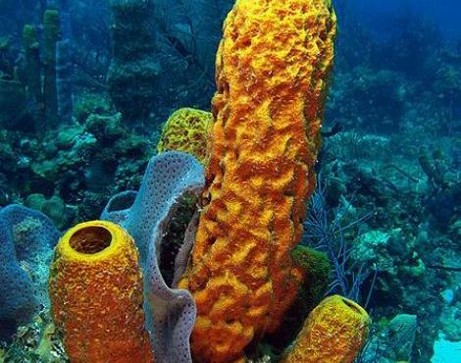
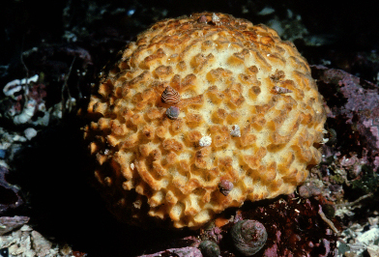
Demosponge

Slide 25
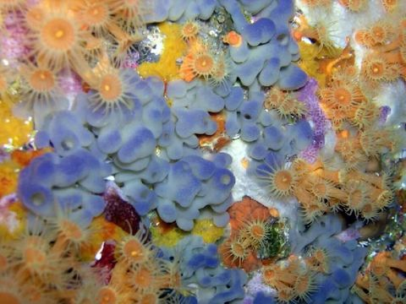
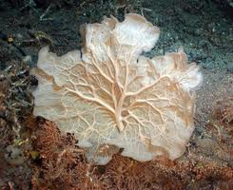
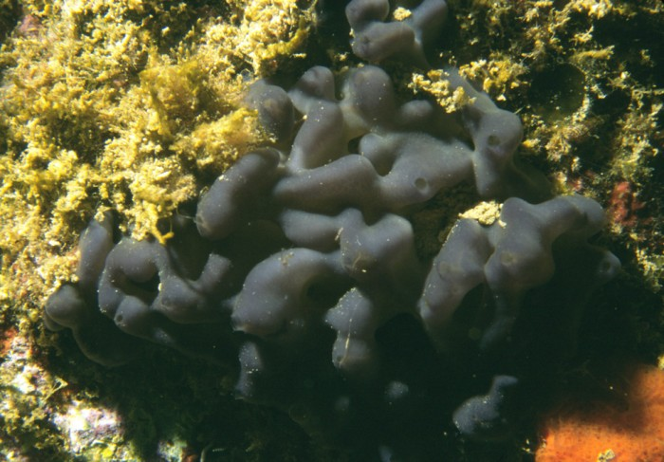
Homoscleromorpha

Slide 26
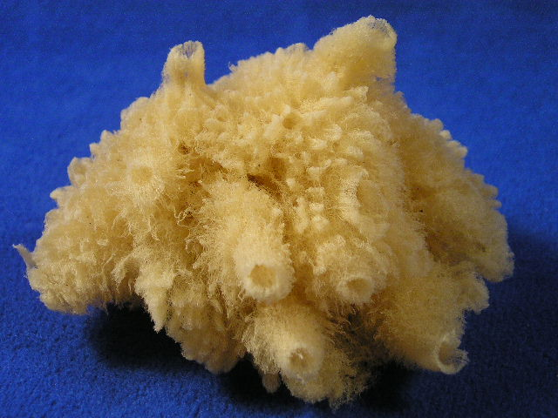
How deep would the oceans be if there were no sponges?

