Slide 1
PHYLUM MOLLUSKA

Slide 2
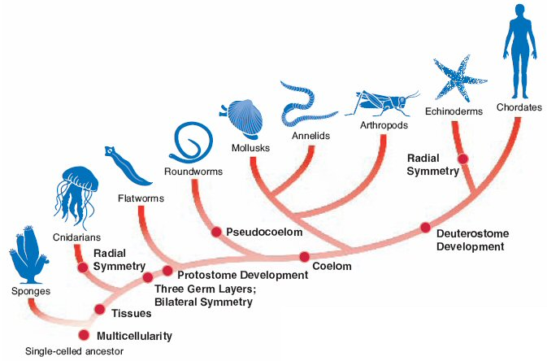

Slide 3
Number of Species
Arthropoda
Mollusca
Chordata
Platyhelminthes
Nematoda
Annelida
Porifera
Echinodermata
Other
Sarcomastigophora
Apicomplex
Ciliophora
Notes:
3

Slide 4
MOLLUSKA
Kingdom: Animalia
Phylum Molluska
Most mollusks are classified into three (of seven) classes.
  gastropods
  pelecypods (also called bivalves)
  cephalopods

Slide 5
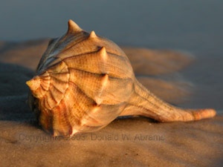
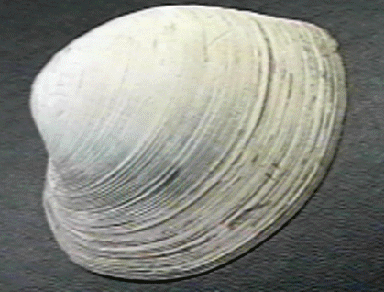
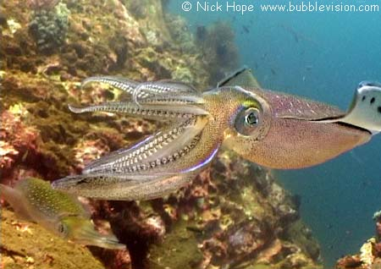
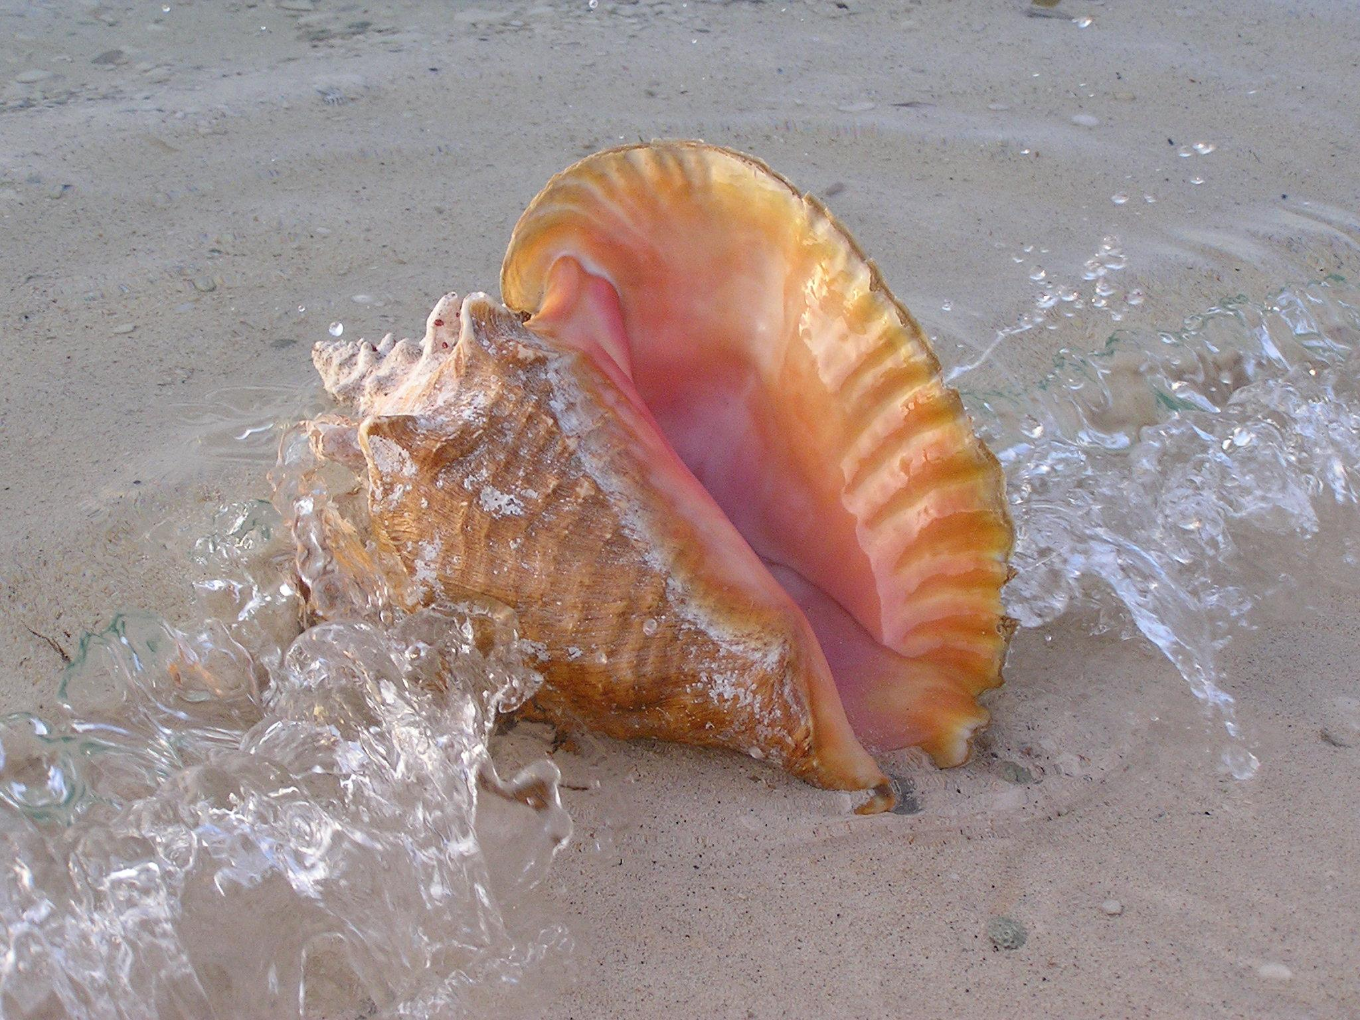
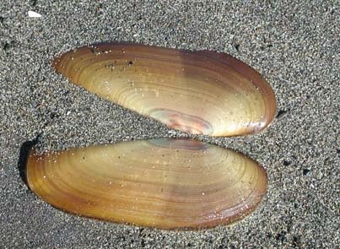
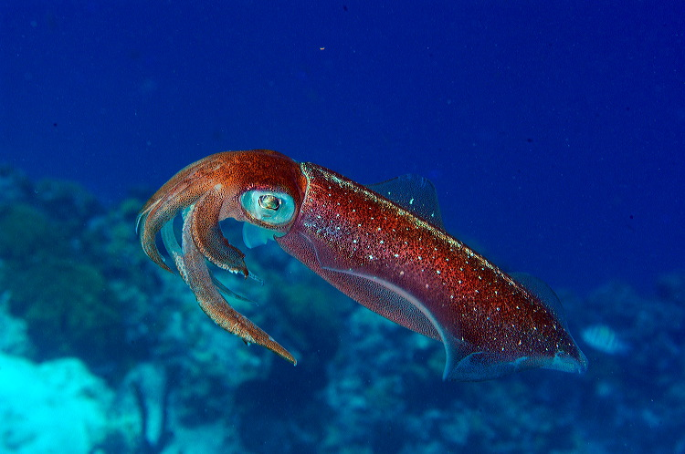
Classes

Slide 6
MOLLUSKA
50,000 -100,000 living species
35,000 extinct species
Largest Invertebrates = 1000 pounds
80% less than 5 cm
Most marine
Snails, slugs terrestrial
Moist habitat

Slide 7
Body Plan
Levels of Organization: Specialized Cells, Tissues, and Organs
Body Symmetry: Bilateral
Germ Layers: Three
Body Cavity: True Coelom
Embryological Development: Protostome
Segmentation: Absent
Cephalization: Present

Slide 8
Characteristics
Mollusks have a varied range of body structures, it is difficult to find defining characteristics to apply to all modern groups
All have soft bodies
Complete digestive tract
  A complete digestive tract has two openings: a mouth and an anus.

Slide 9
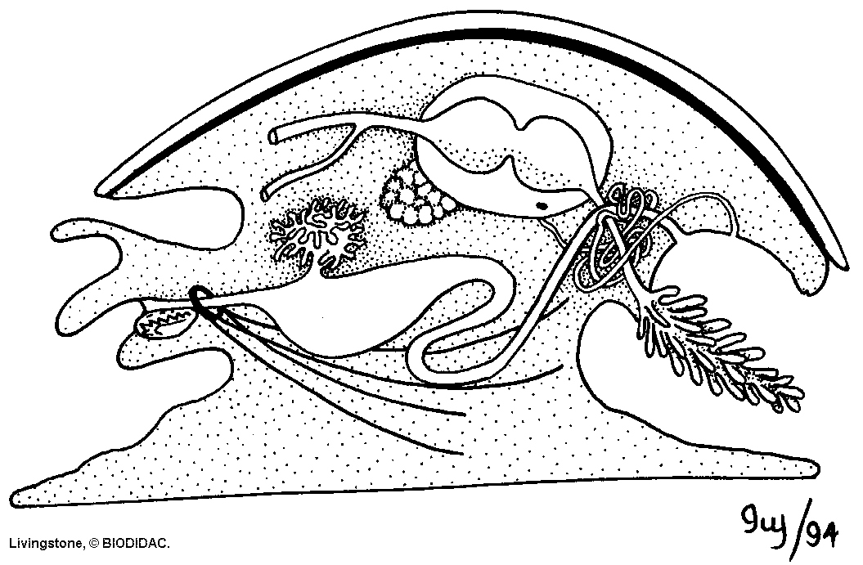
Characteristics
Mollusks share at least one of four features. “a generalized Mollusk”
  radula
  mantle
  ctenidia
  foot

Slide 10
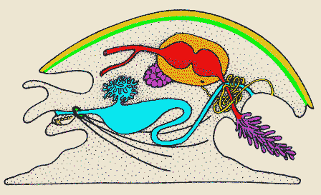
Characteristics
Pericardial cavity
Metanephridium
Gonad
Radula
Mantle
cavity
Ctenidium
Stomach and digestive gland
Foot
10
Notes:
10

Slide 11
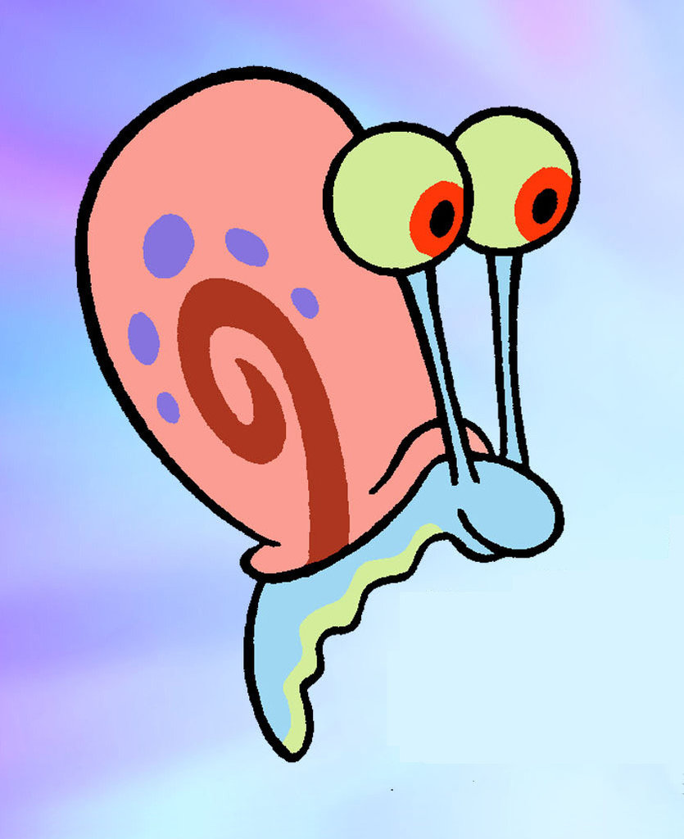
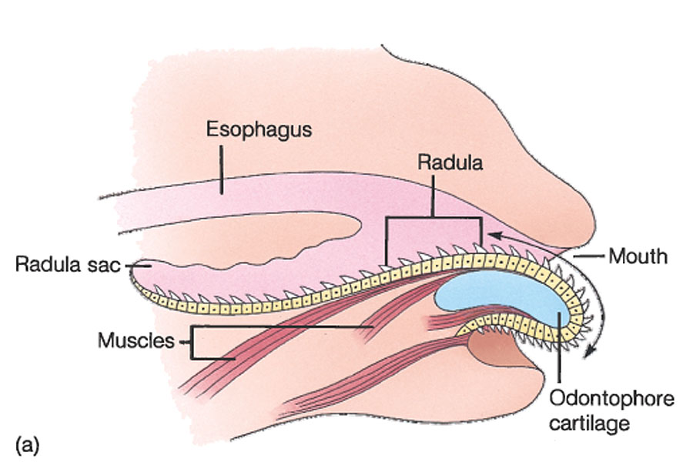
Feeding
Radula - a rasping organ used in feeding
Teeth are formed of chitin and can be replaced

Slide 12
Respiration, Circulation, Excretion
Have one pair of gills
  ctenidia
In organisms with OPEN CIRCULATION
coelom contains circulatory fluid (blood) = HEMOCOEL
Blood = HEMOLYMPH

Slide 13

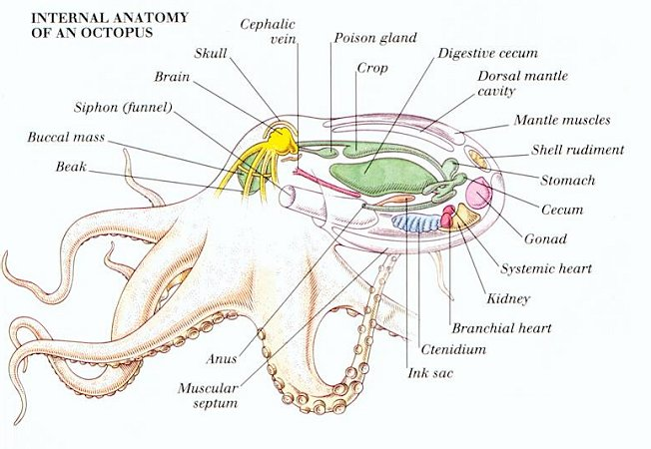
Response
Nervous System
Clusters of nerves or complete brain (Cephalapods)
Generally adapted for various forms of locomotion:
  gliding on a trail of mucous using a foot
  digging and anchoring into sediment (bivalves)
  forming tentacles (cephalopods)

Slide 14
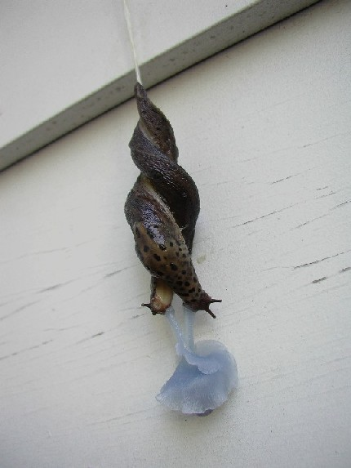
Reproduction
Mollusks have a variety of reproductive strategies.
  Most strategies involve sexual reproduction.
    Octopus dies
  Some species are hermaphrodites.
    snails
LEOPARD SLUG
http://www.youtube.com/watch?v=iCKug2iu0JQ

Slide 15
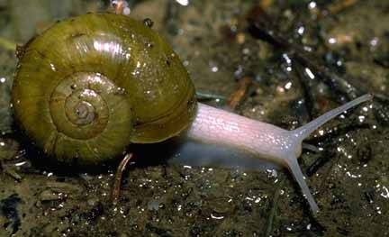
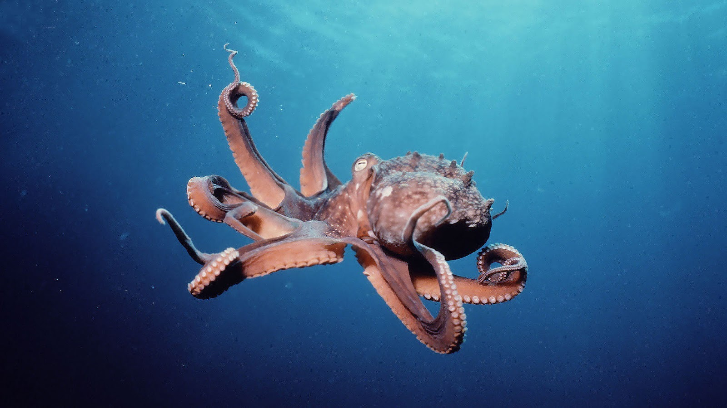
Habitat
Mostly marine with the exception of gastropods (snails)
  Require humid environments

Slide 16
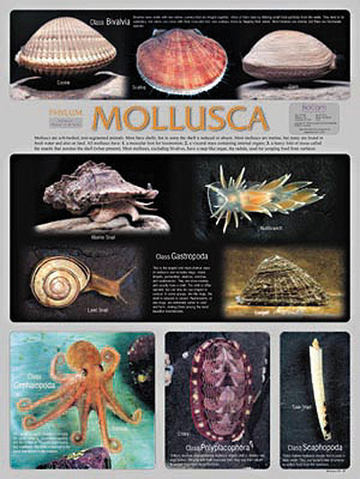
Classes
Gastropoda
Bivalvia
Cephalopoda
Aplacophora
Polyplacophora
Monoplacophora
Pleistomollusca

Slide 17
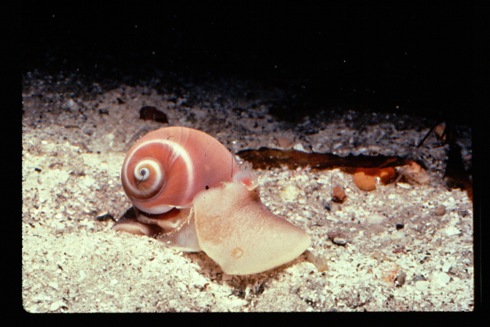
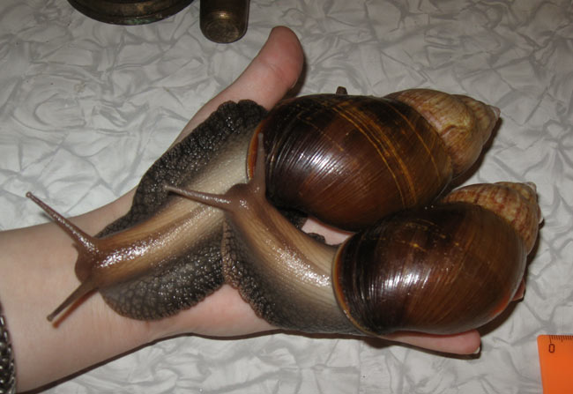
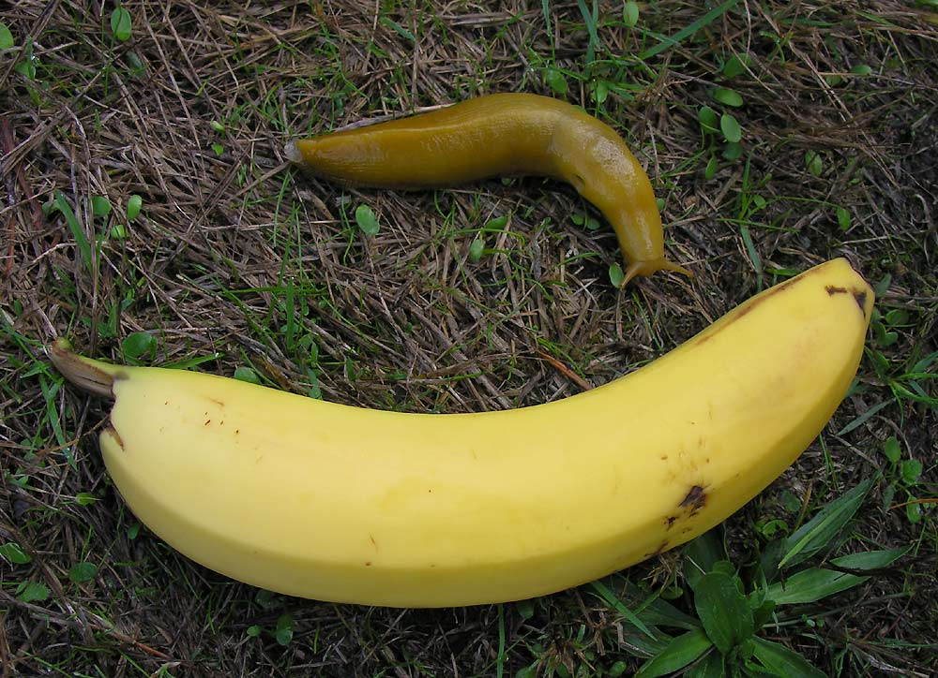
Class Gastropoda
“Stomach Foot”
Ex: snails, whelks, abalone, nudibranchs (shell-less)
BANANA SLUG – THINK SANTA CRUZ

Slide 18
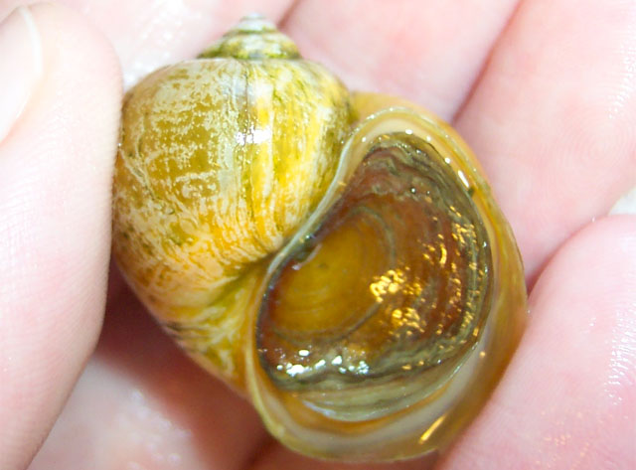
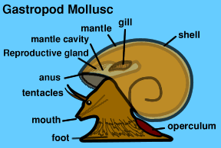
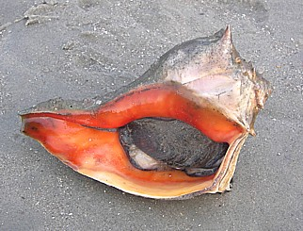
Class Gastropoda
Single spiral valve (shell)
Operculum – covers opening
75% all mollusks in this class

Slide 19
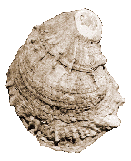
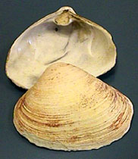
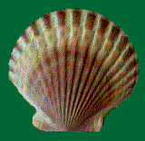
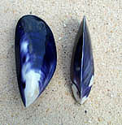

Class Pelecypoda
“Bivalves” (2 Shells)
Hinged by ligaments and adductor muscles
Ex: clams, oysters, scallops, mussels

Slide 20
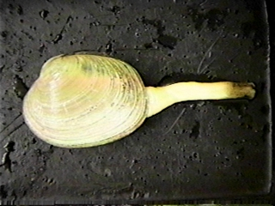
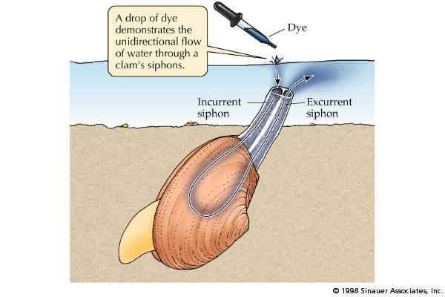
Class Pelecypoda
Sessile & benthic; no head; no radula
Body lies completely inside the mantle cavity
Filter Feeders
  Incurrent Siphon
    Water, Food & O₂ In
  Excurrent Siphon
    Water & Waste Out
  - Trap food on gill mucus

Slide 21
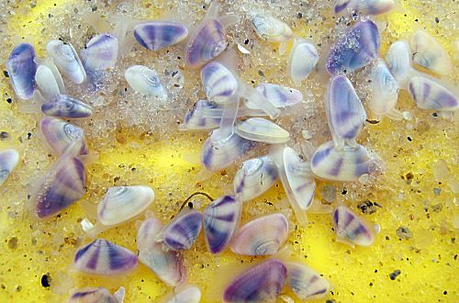
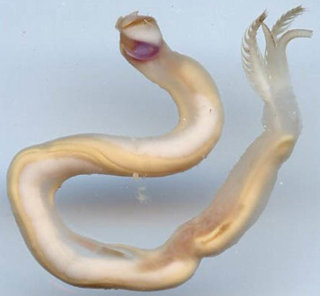
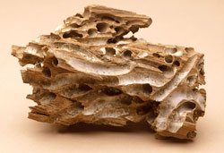
Burrowing Bivalves
Clams
  Hatchet shaped foot adapted for burrowing
Shipworm
  Worm-like bivalves that burrow into wood
SHIPWORM

Slide 22
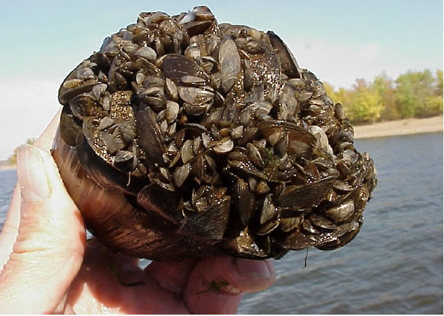
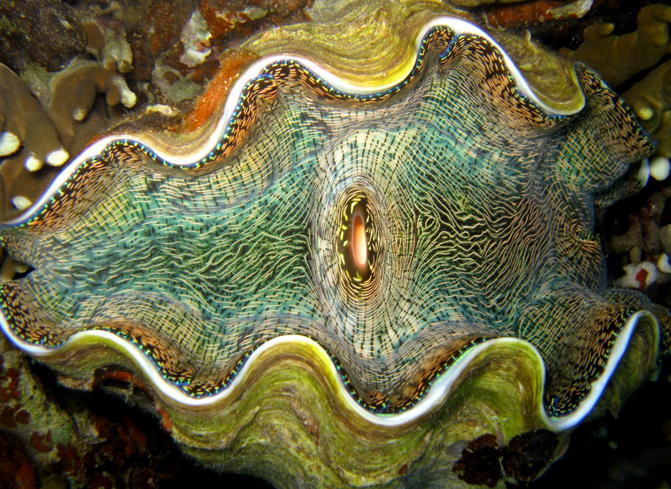
Non-Burrowing Bivalves
Mussels
  Byssal threads secreted to hold mussel in positon
Scallops
  Motile Bivalve that uses jet propulsion to move
Oysters
  Secrete cement substance that adheres to a substrate
ZEBRA MUSSEL
GIANT CLAM

Slide 23
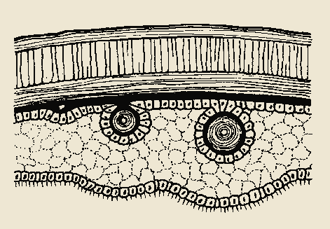
Pearl Formation
Shell
Developing pearl
Epithelium
Irritant (sand) lodged between shell and mantle
Layers of calcium carbonate secreted around foreign material
Notes:
23

Slide 24
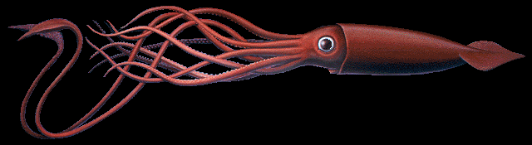

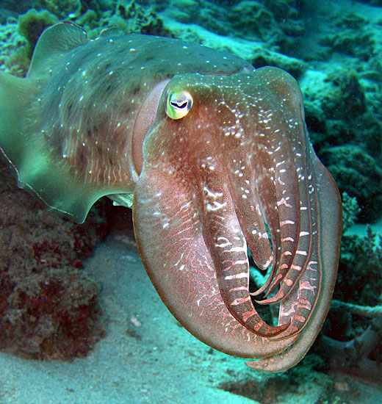
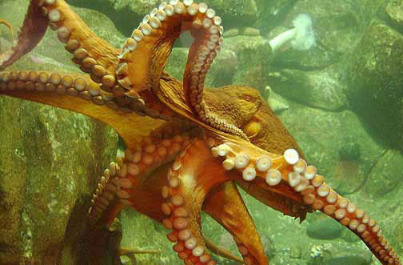
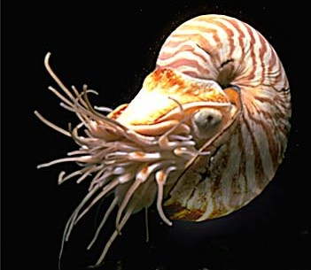
Class Cephalopoda
Ex: squid, octopus, nautilus, cuttlefish

Slide 25
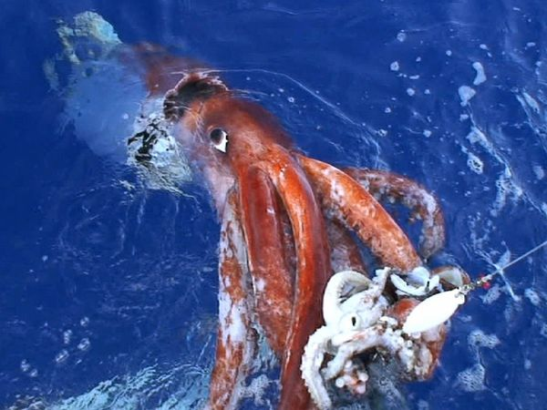

Slide 26
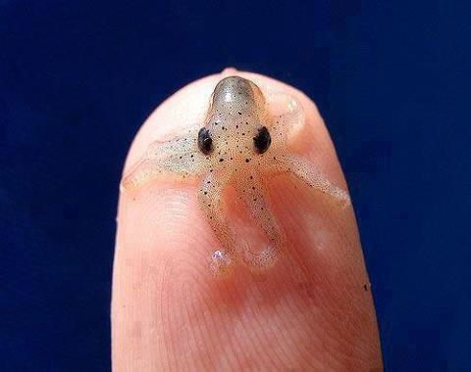
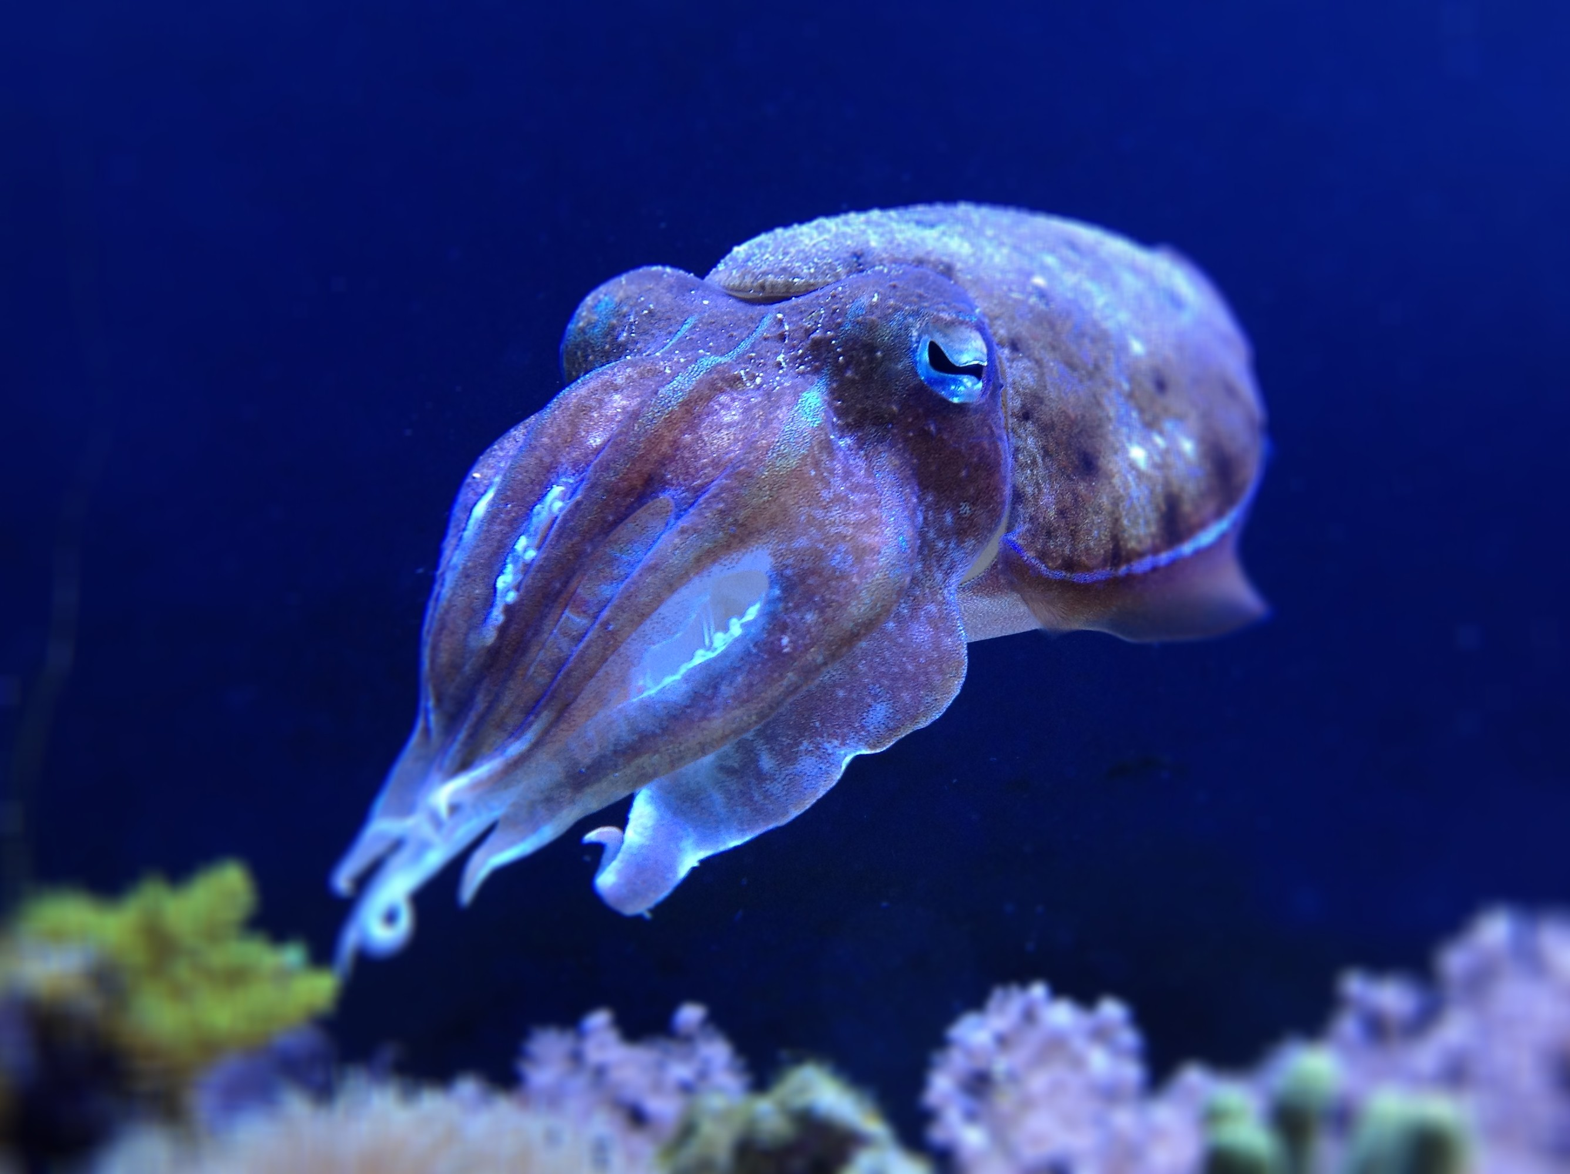
Class Cephalopoda
Reduced shell; internal support cartilage or chitin pen
Complex Nervous System (Brain)
Well Developed Eyes
Foot Modified Into Tentacles/Arms w/suckers

Slide 27
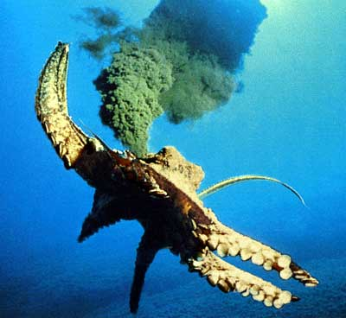
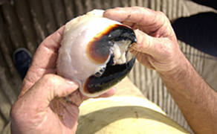
Class Cephalopoda
Locomotion via Jet Propulsion (suck in water & spit)
Changes Colors via Chromatophores
Carnivores - Have beak-like jaws & poisonous bite
Ink Gland for protection

