Slide 1
The WORMS
Kingdom Animalia
Various Phyla
  Platyhelminthes (Flatworms)
  Nematodes (Roundworms)
  Annelid (Earthworms)

Slide 2
THE FLATWORMS

Slide 3
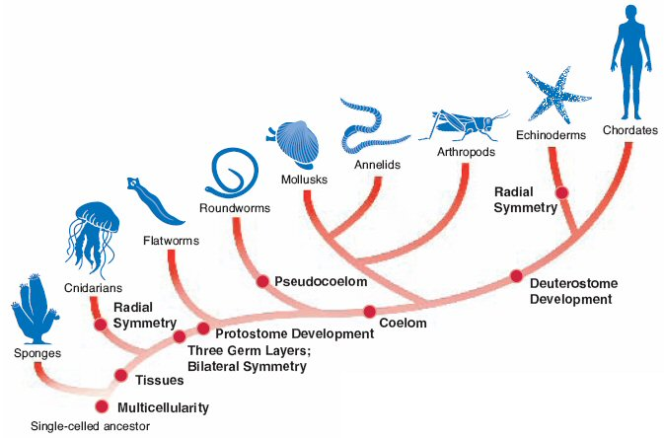

Slide 4
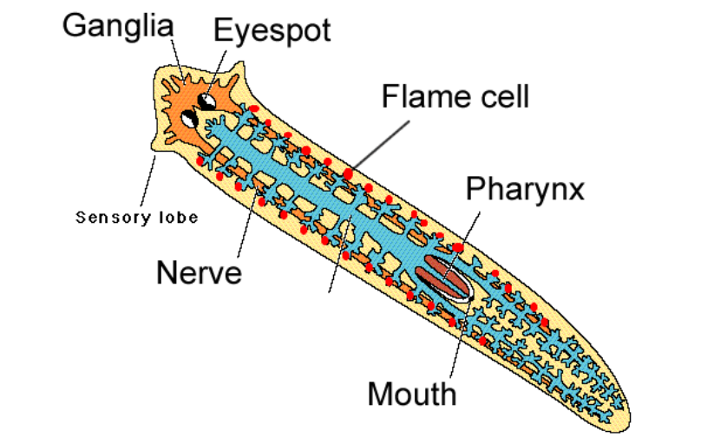
Platyhelminthes
FLATWORMS

Slide 5
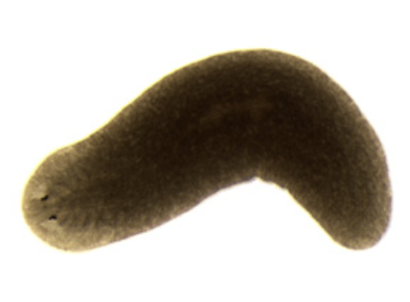
Body Plan
Levels of Organization: Specialized Cells, Tissues, and Organs
Body Symmetry: Bilateral
Germ Layers: Three
Body Cavity: Acoelom
Embryological Development: Protostome
Segmentation: Absent
Cephalization: Present

Slide 6
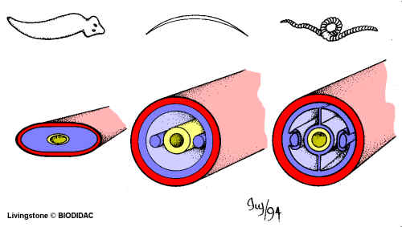
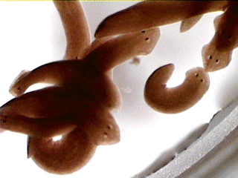
Characteristics
Flatworms have a brain, eyespot, and pharynx.
They have intestine to help breakdown food. Wastes leave via diffusion (no anus)
    Flame cells help release excess water

Slide 7
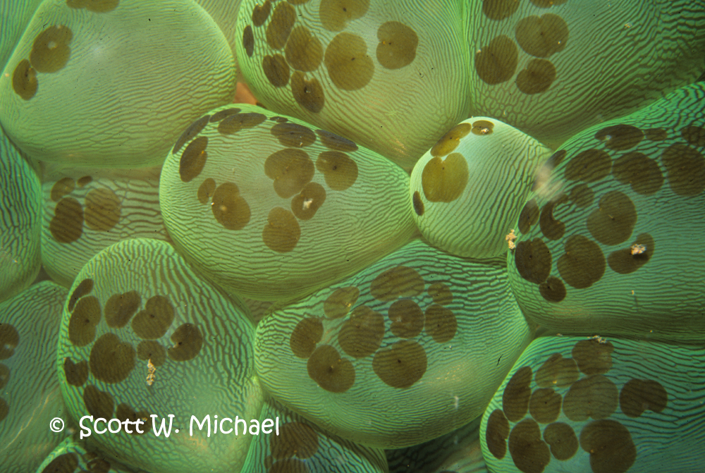
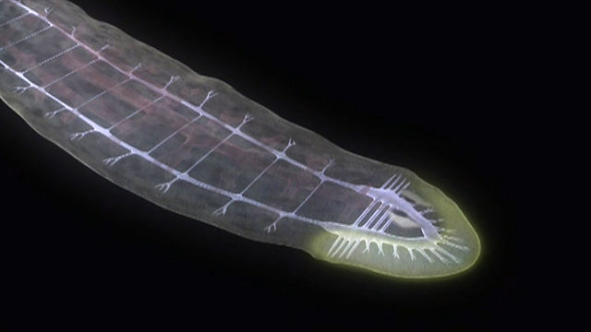
Feeding
Two kinds of flat worm feeders:
  Free-living - carnivores or scavengers; they have a digestive cavity, mouth and pharynx
  Parasites – feed on blood, tissues or pieces of cells from within a HOST

Slide 8
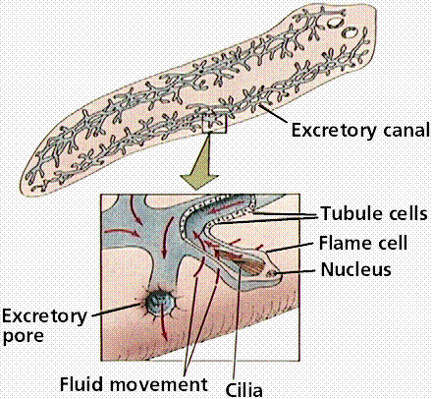
Respiration, Circulation, Excretion
No body cavity = no specialized circulatory and respiratory organs.
Thin bodies allow for materials to diffuse (respiration, excretion, etc)
Flame Cell – specialized cells that remove excess water

Slide 9
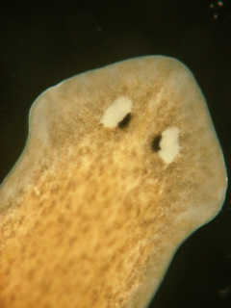
Response
Ganglia – group of nerve cells that control the body (like a brain)
Eyespot – group of cells that can detect light (like an eye)

Slide 10
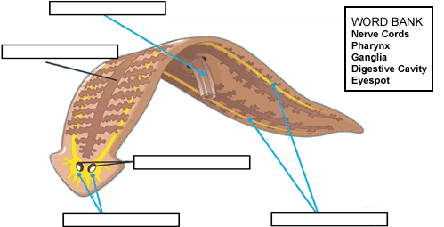
digestive cavity
pharynx
ganglia
eyespot
nerve cords

Slide 11
Reproduction
Sexual Reproduction – most flatworms are hermaphrodites (have both male and female sex organs)
Asexual Reproduction by fission – flatworms can split in two and regenerate
http://www.youtube.com/watch?v=wn3xluIRh1Y

Slide 12
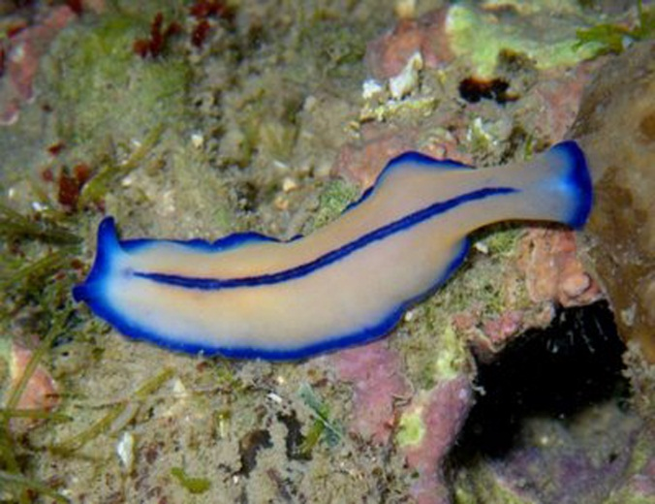
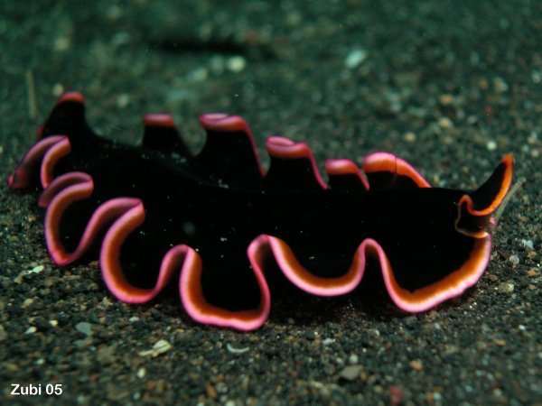
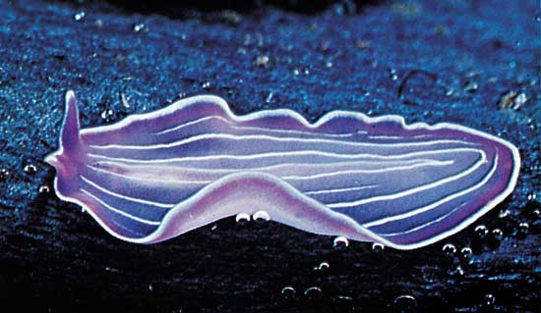
Habitat
These animals can be found in the sand of ponds and rivers.
Flatworms are confined to watery environments.

Slide 13
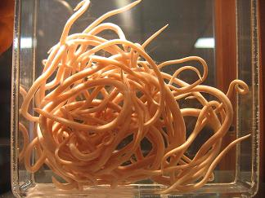
THE ROUNDWORMS

Slide 15
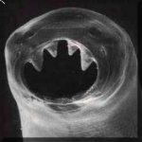
Nematod
ROUNDWORMS
Kingdom: Animalia
Phylum: Nematoda
12,000 species known
  500,000 possible

Slide 16
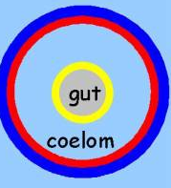
Characteristics
Unsegmented worms
Pseudocoelom ("false coelom")
  body cavity contains organs
Digestive tract with 2 openings:
  mouth & anus

Slide 17
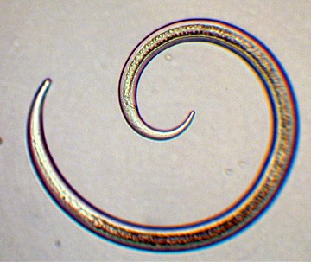
Body Plan
Levels of Organization: Specialized Cells, Tissues, and Organs
Body Symmetry: Bilateral
Germ Layers: Three
Body Cavity: Pseuodocoelom
Embryological Development: Protostome
Segmentation: Absent
Cephalization: Present

Slide 18
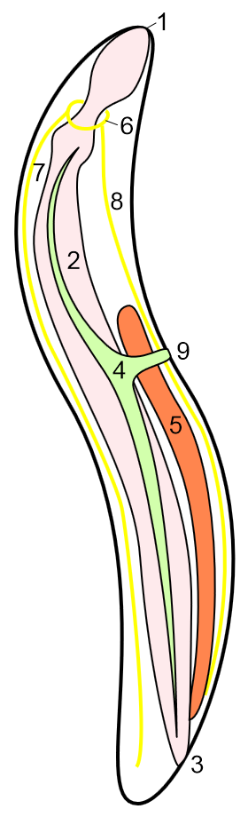
1 mouth opening
2 intestine
3 cloacal opening
4 organ of excretion
5 testis
6 circumpharyngeal ring of nervous system
7 dorsal trunk of nervous system
8 ventral trunk of nervous system
9 excretion pore

Slide 19
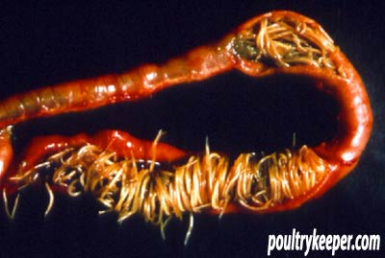
Feeding
Free-living – predators
Parasites – humans and animals

Slide 20
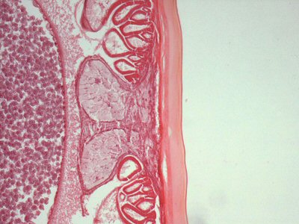
Respiration, Circulation, Excretion
Nitrogenous waste is excreted in the form of ammonia through the body wall, and is not associated with any specific organs.
In many marine nematodes, one or two unicellular 'renette glands' excrete salt through a pore on the underside of the animal, close to the pharynx.

Slide 21
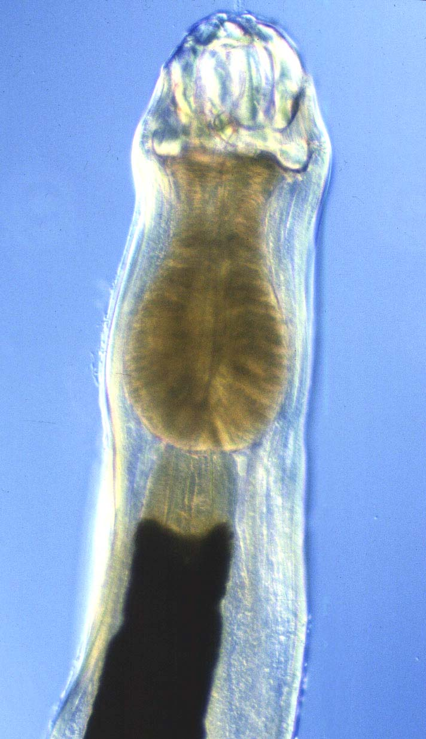
Response
Four peripheral nerves run the length of the body on the dorsal, ventral, and lateral surfaces.
Each nerve lies within a cord of connective tissue
A circular nerve ring surrounding the pharynx serves as the brain.

Slide 22
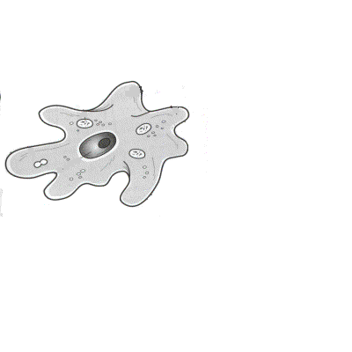
Reproduction
Sexual reproduction, separate sexes (male & female)
Fertilization takes place when males use special copulatory spines to open the females' cloacal opening and inject sperm.
The sperm are unique in that they lack flagella and move by pseudopodia, like amoebas

Slide 23
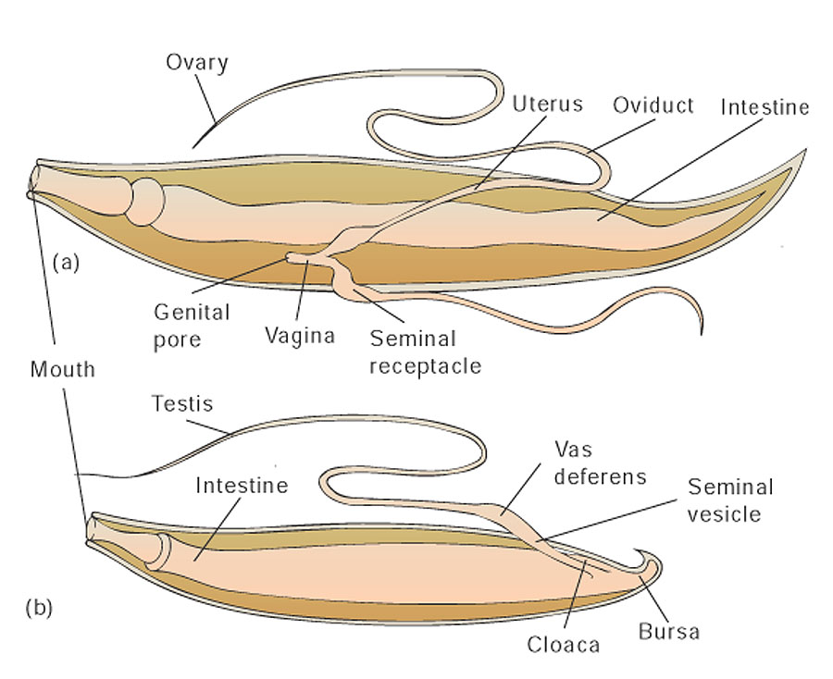

Slide 24
Habitat
Found everywhere
  Soil
  Oceans
  Polar ice
  Hot springs
Parasites of nearly all plant and animal species!

Slide 25
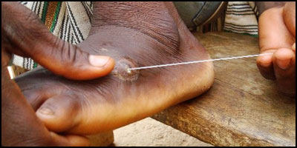
Nematods as Parasites

Slide 26
Pinworms
Adult Pinworms live in intestine
Females crawl out through anus at night and lay 15,000/day eggs on skin
Intense itching causes host to scratch
Eggs under fingernails and on hands are spread back to self or to others when objects/food are touched
26

Slide 27
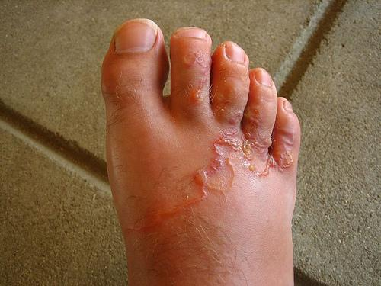
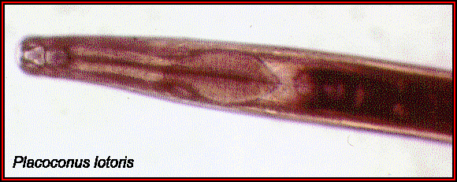
Hookworms
Hookworms live in intestines
Anterior end hooks
Feed on blood
Cause anemia
27

Slide 28
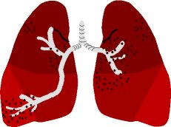
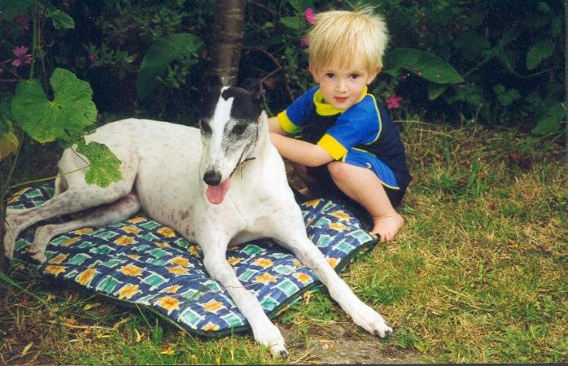
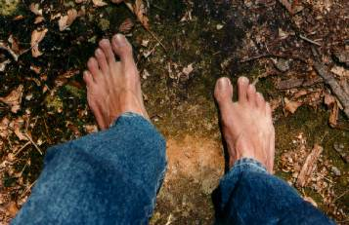
Hookworm Life Cycle
Larvae are coughed
up & swallowed;
Return to intestines;
mature & mate
Larvae enter body by burrowing
through skin on feet & travel to lungs
Adult worms live in
intestine and feed on blood
Eggs leave body in feces
and hatch as larvae in soil
28

Slide 29
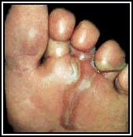
Hookworms
PROBLEMS caused by migrating larvae
Cause intense reaction in skin at site
Infect 40 million people worldwide
29

Slide 30
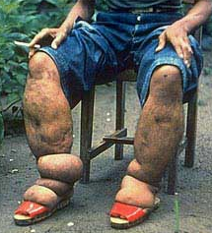
Filarial Round Worms
Cause Elephantiasis
Adult worms live in lymph nodes causing blockage so fluid back ups
30

Slide 31
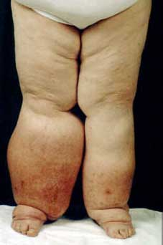
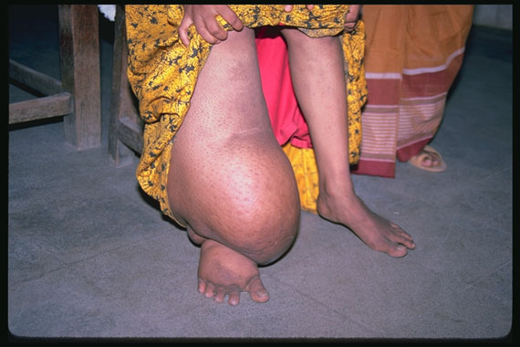
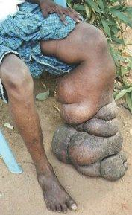
ELEPHANTIASIS
Adult worms can
grow to 4” long

Slide 32
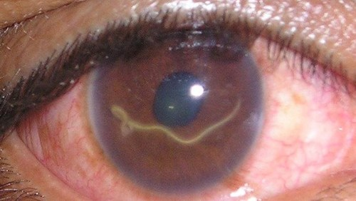
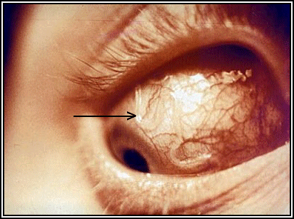
Loa Loa Worm
Humans are infected with larvae when bitten by loa fly
Larvae mature & crawl around under skin (especially near face)
Adults mate and produce larvae which can be picked up by another fly and transmitted to another person

