Slide 1
PHYLUM CNIDARIA

Slide 2
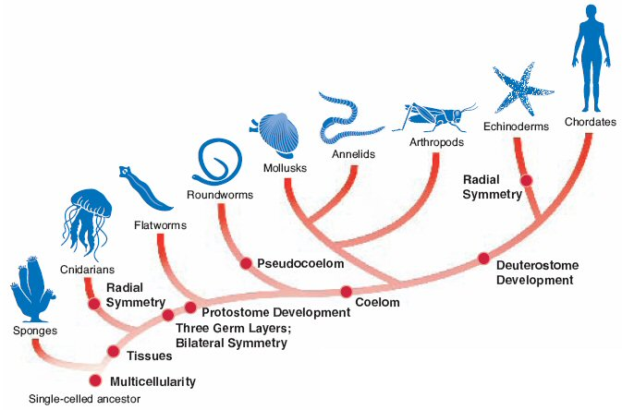

Slide 3
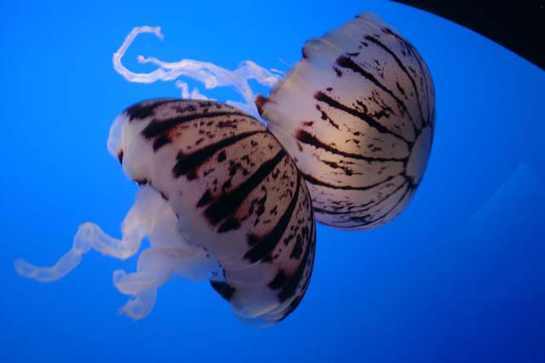
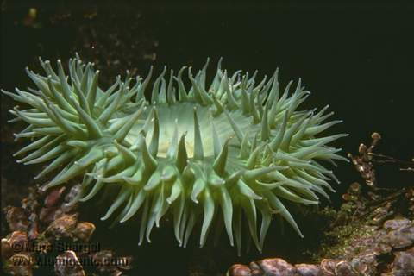
CNIDARIA
Kingdom: Animalia
Phylum: Cnidaria or Coelenterata
Cnidarians are the oldest existing animals that have specialized tissues.

Slide 4
Body Plan
Levels of Organization: Specialized Cells and Tissues
Body Symmetry: Radial
Germ Layers: Two
Body Cavity: Acoelom
Embryological Development: None
Segmentation: Absent
Cephalization: Absent
You Tube / Video Link

Slide 5
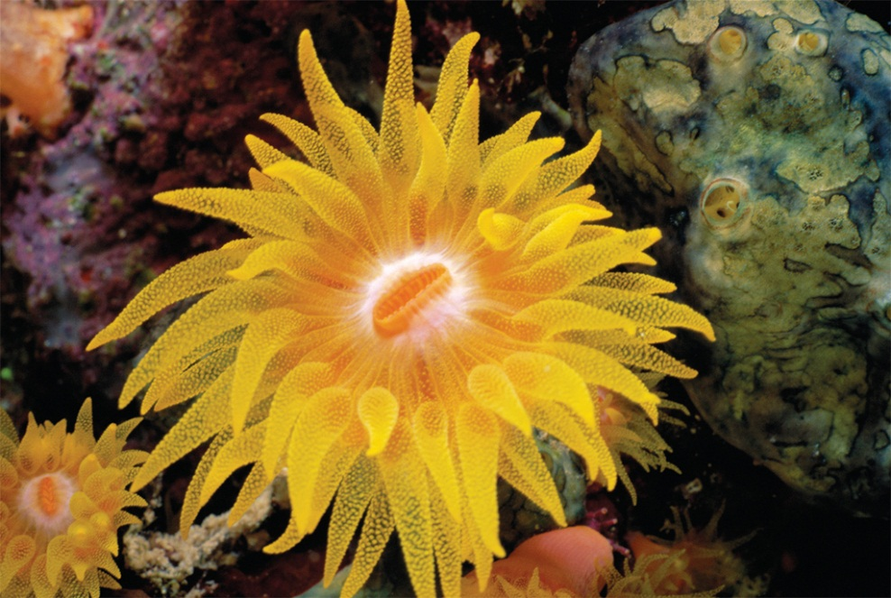
Characteristics
Polyps
In the polyp form of a coral, the tentacles and mouth face upward.

Slide 6
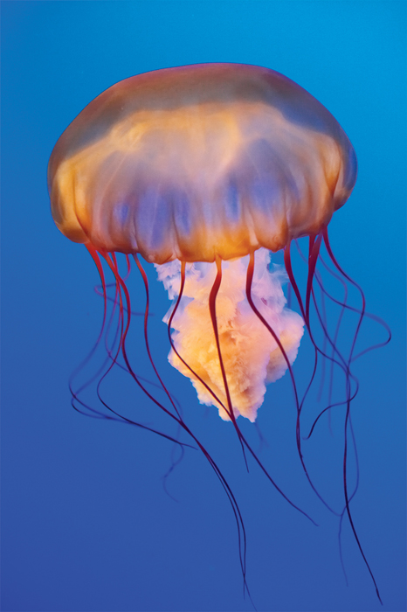
Characteristics
Medusa
In the medusa form of a jellyfish, the tentacles and mouth face downward.

Slide 7
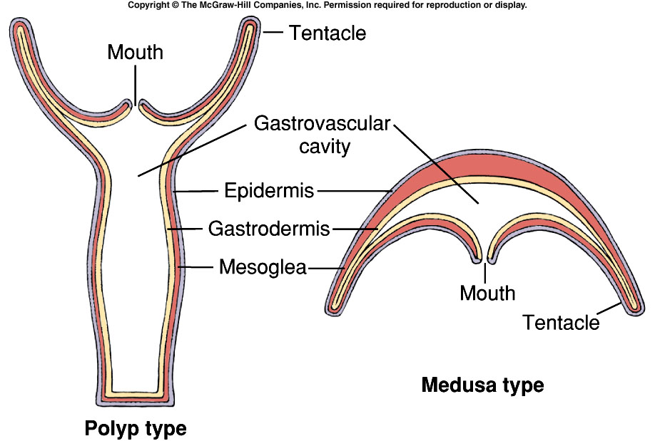

Slide 8
Characteristics
Cnidarians are made up of two tissue layers separated by mesoglea.
  Outer Layer (ectoderm)
    Protection
  Inner Layer (endoderm)
    Digestion
The outer tissue layer has three cell types.
  contracting cells (movement and propulsion)
  nerve cells
  cnidocytes (which contain nematocysts)

Slide 9
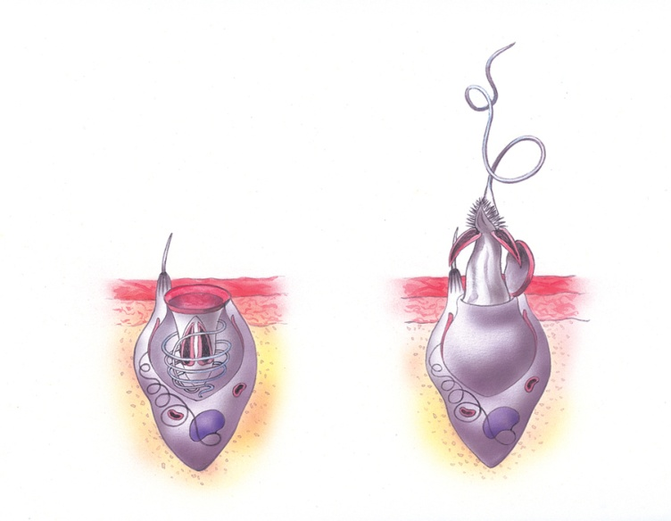
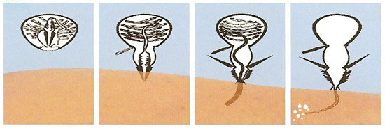
Characteristics
Nematocysts (Stinging Cells)
  Tiny, harpoon-like
  On tentacles
  Poison & immobilize prey.
Fires in milliseconds
  One of the fastest processes in nature
Vinegar neutralizes Jellyfish stings! So use that FIRST should you get stung…have urine be a second option.
discharged
nematocyst
barbs
coiled
nematocyst

Slide 10
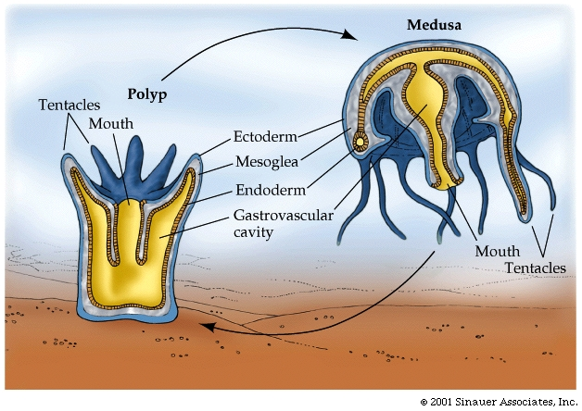
Feeding
Gastrovascular Cavity
  Inner body layer where digestion takes place via enzyme release.

Slide 11
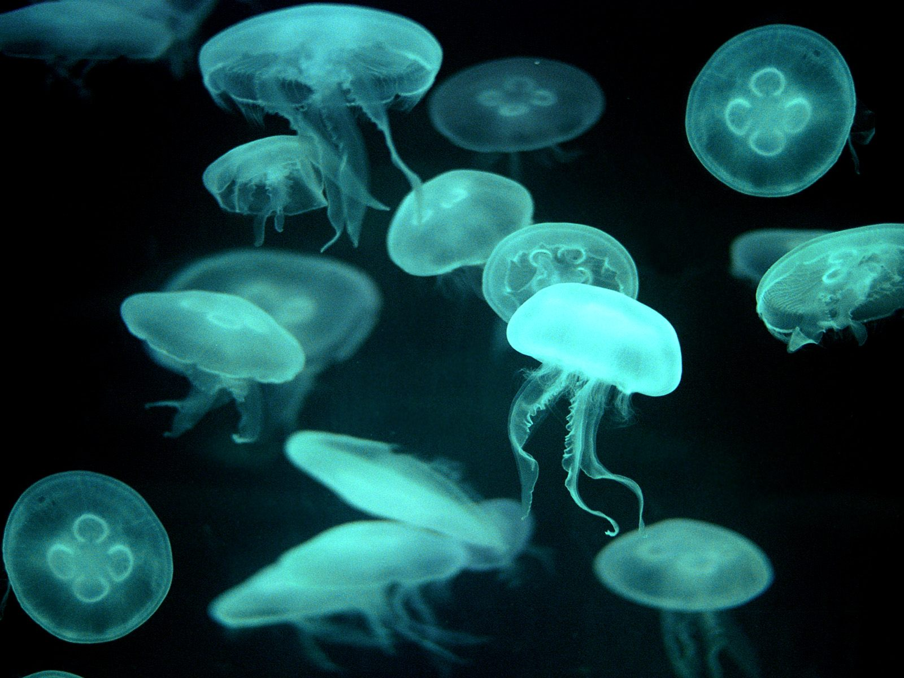
Respiration, Circulation, Excretion
No respiratory organs.
  cnidarians use the two cell layers to absorb oxygen/expel carbon dioxide via diffusion
No circulatory system.
MOON JELLIES

Slide 12
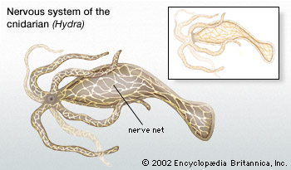
Response
Nerve Net
  Conducts nerve impulses from all parts of the body
  No Brain (Control Center)
  Contractions of muscle-like cells in the tentacles and bodies

Slide 13
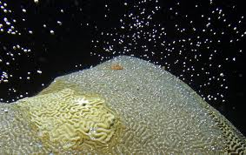
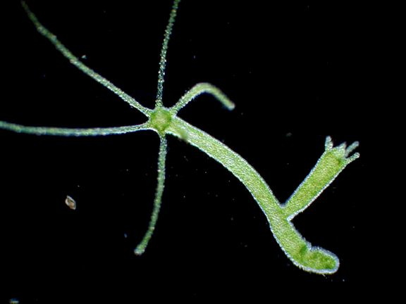
Reproduction
Cnidarians can reproduce sexually or asexually.
  Sexual: gametes released
    Planktonic larva settles
  Asexual: Polyp then grows & forms buds that become tiny medusa that pop off
CORAL SPAWNING
HYDRA BUDDING

Slide 14
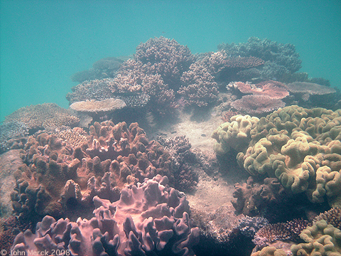
Habitat
Found in both marine and freshwater ecosystems.
YouTube / Video Link

Slide 15
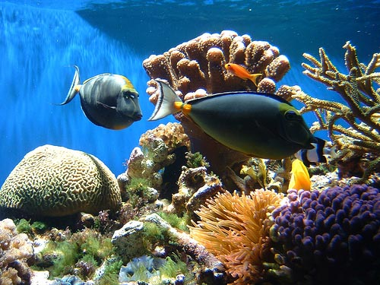
Role in Ecosystem
Coral Reefs
Formed over thousands of years from successive layers of coral skeleton deposits (calcium carbonate forms underwater mountains of coral animal skeletons)

Slide 16
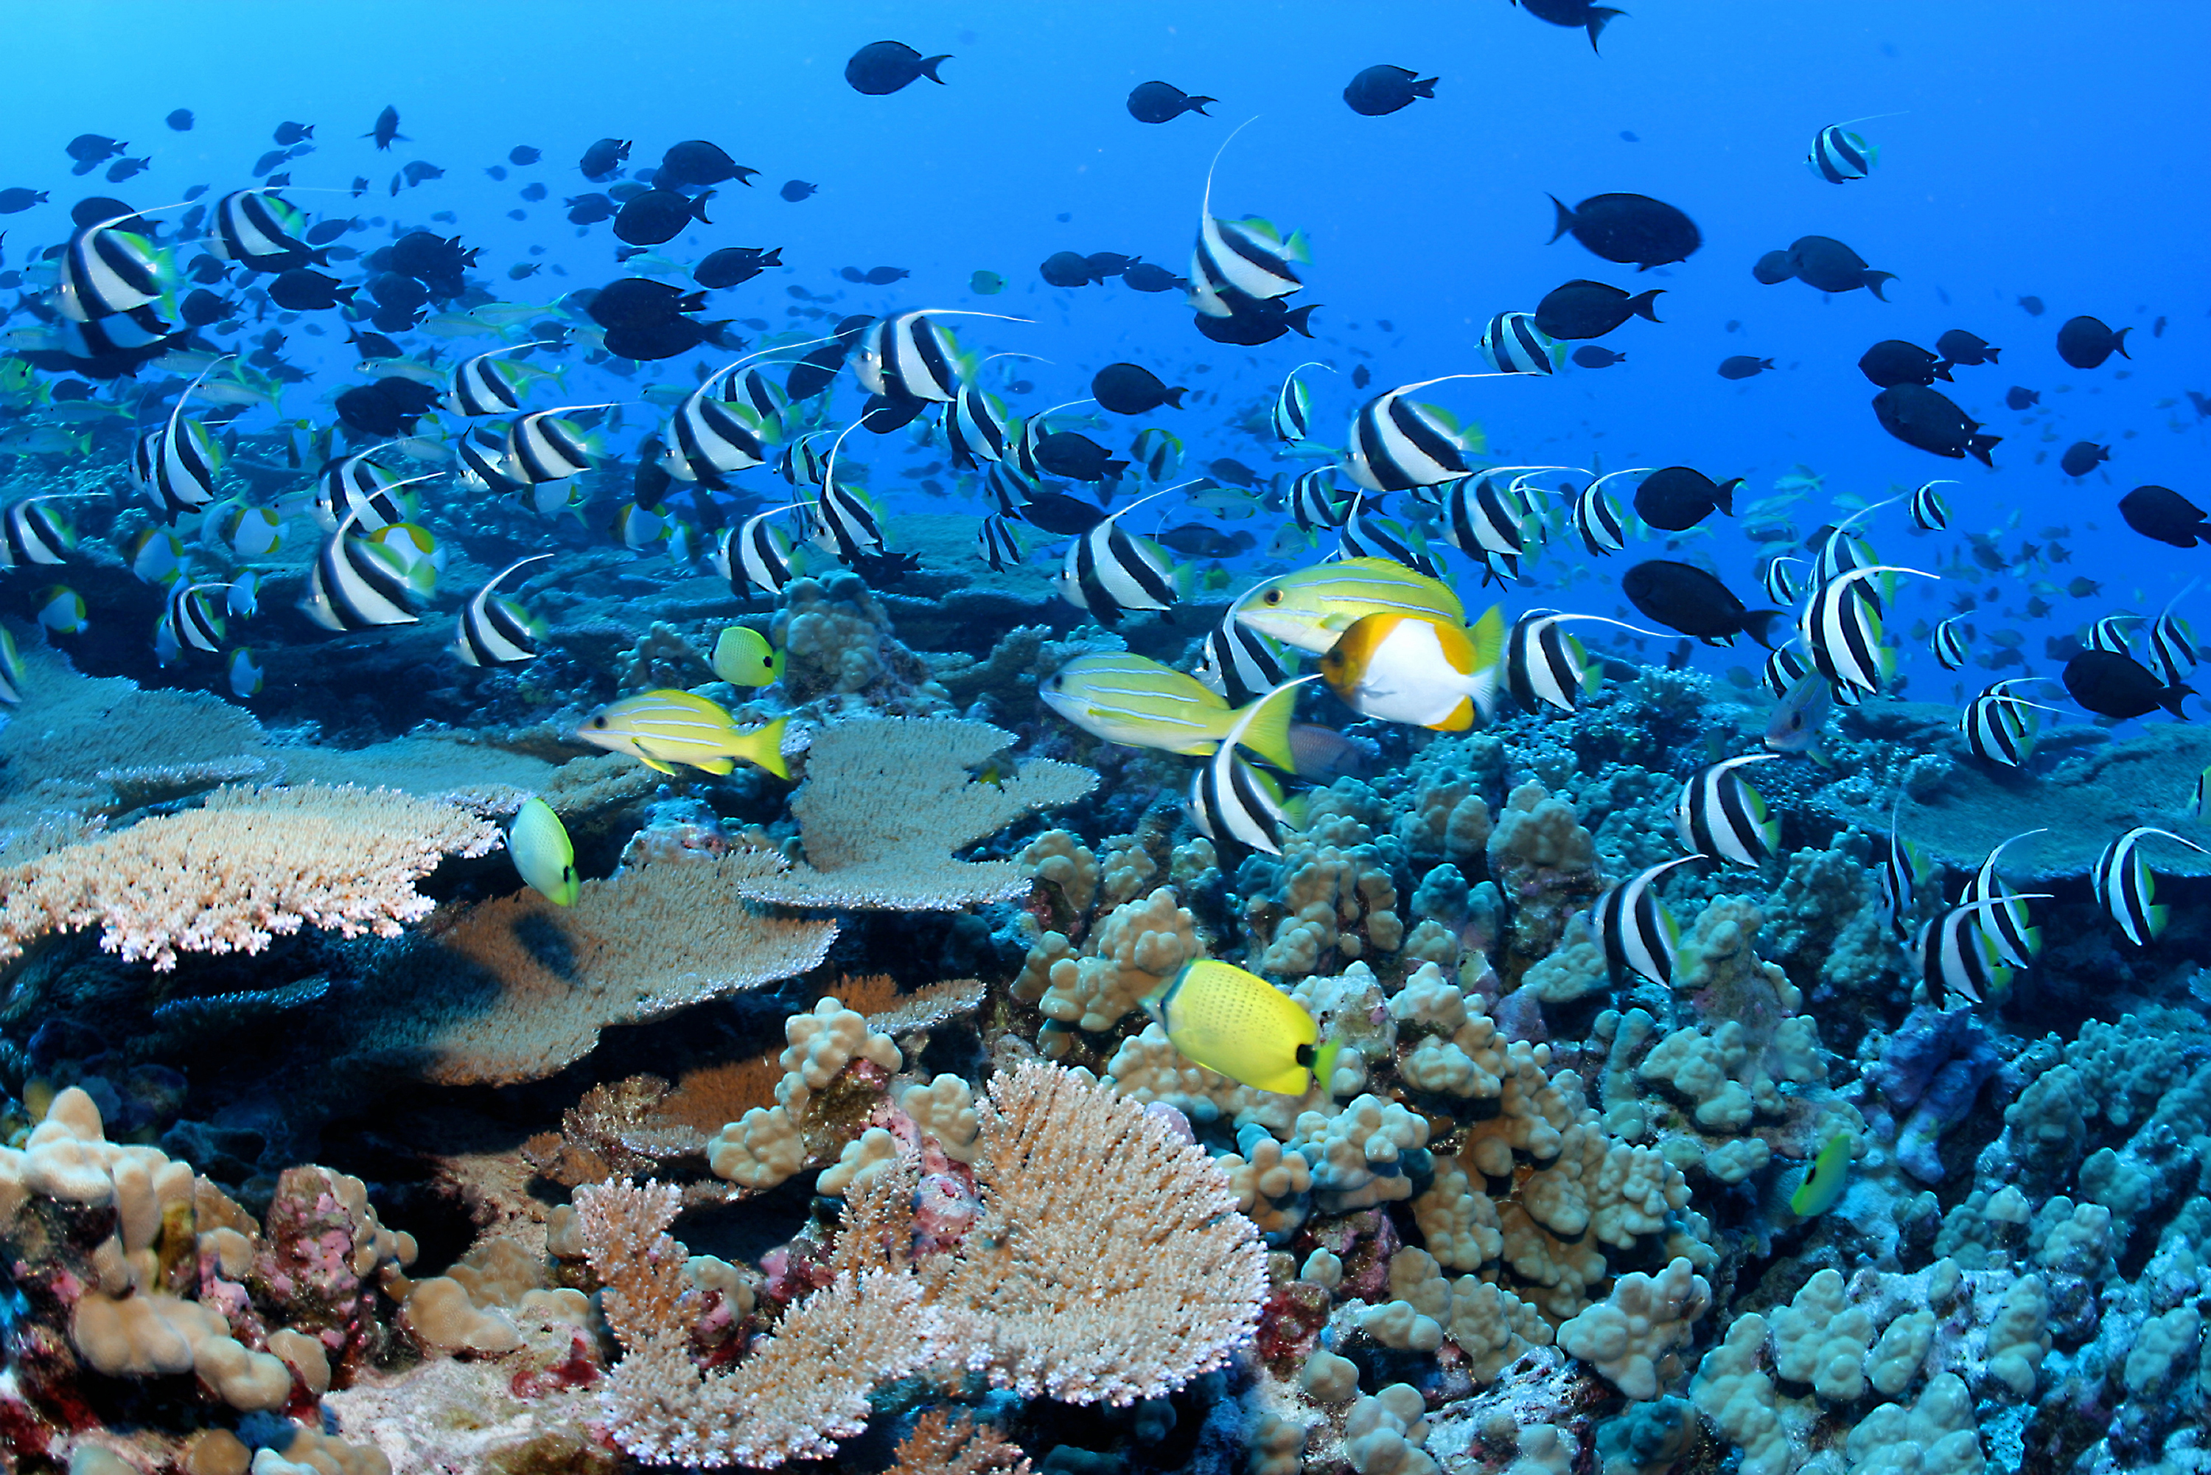
Role in Ecosystem
The underwater equivalent of the amazon jungle- very high species diversity and biomass

Slide 17
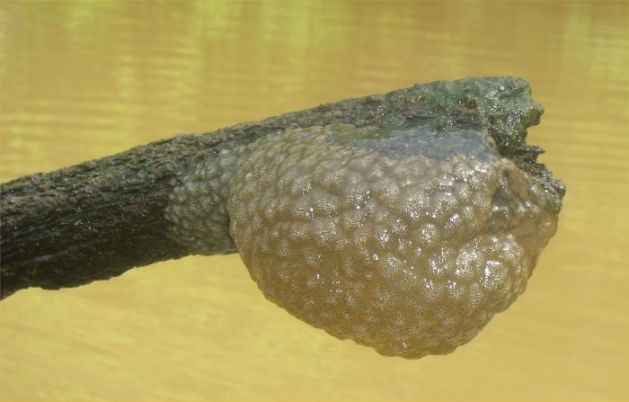
Role in Ecosystem
Reefs contain sponges, several cnidarians or ctenophores, fish, many types of worms we’ve not discussed, not to mention bryozoans, protists, bacteria, etc etc..
BRYOZOANS

Slide 18
Classes
The four major cnidarian classes are defined by their dominant body form.
  Hydrozoa
  Scyphyzoa
  Cubozoa
  Anthozoa

Slide 19
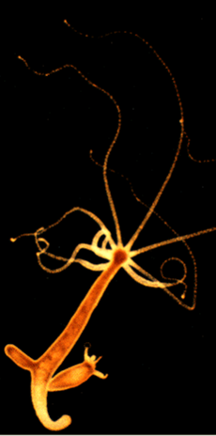
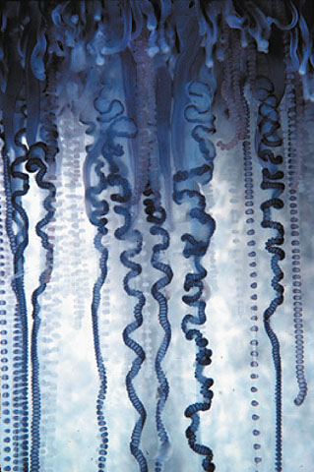
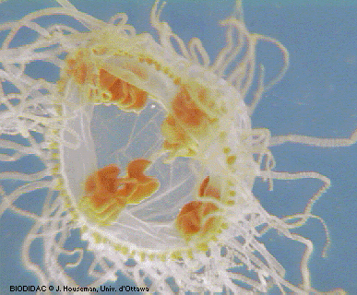
Hydrozoa
Both freshwater and marine

Slide 20
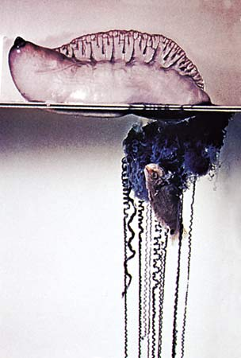
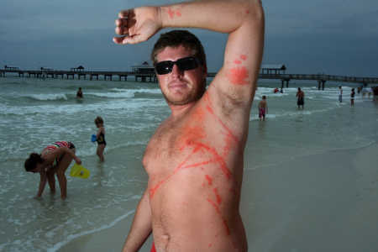
Portuguese Man O War

Slide 21
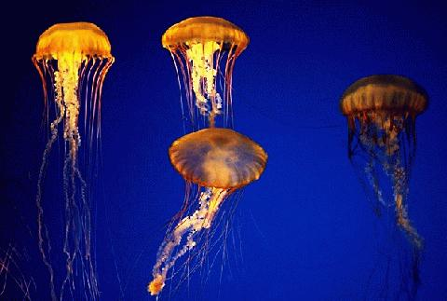
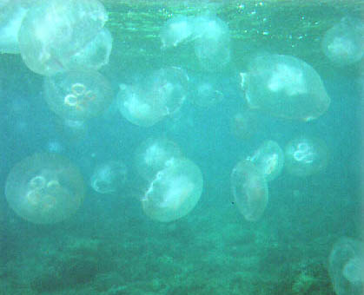
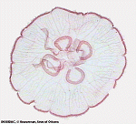
Scyphyzoa
Marine only, long tentacles

Slide 22
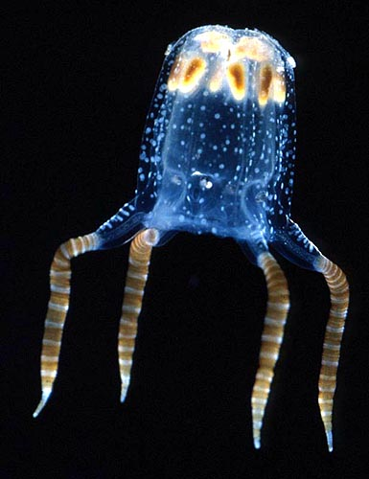
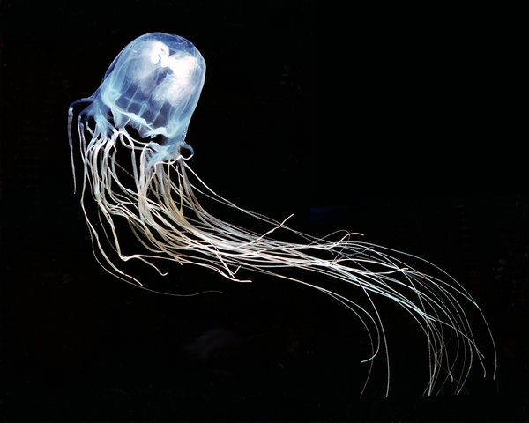
Cubozoa
BOX JELLYFISH
Cube shaped bodies, strong nematocysts

Slide 23
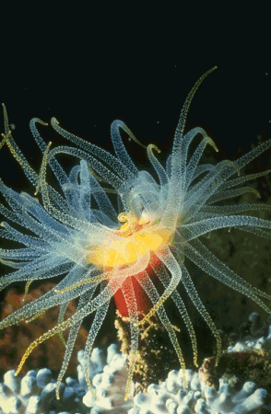
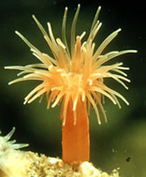
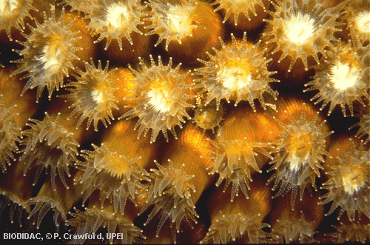
Anthozoa
Medusa stage absent

