Slide 1
PHYLUM CHRODATA

Slide 2
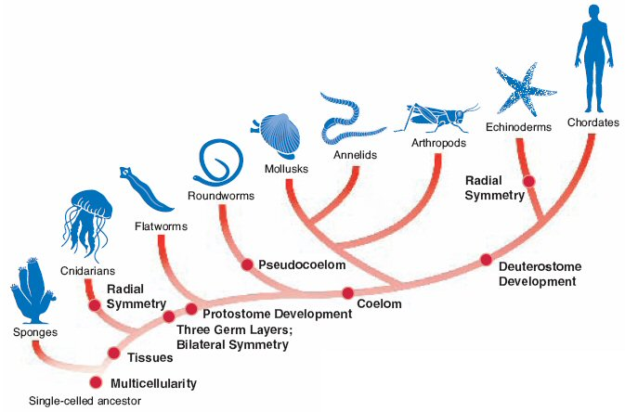

Slide 3
Chordates
Kingdom Animalia
Phylum Chordata

Slide 4
Body Plan
Levels of Organization: Specialized Cells, Tissues, Organs, Organ Systems
Body Symmetry: Bilateral
Germ Layers: Three
Body Cavity: True Coelom
Embryological Development: Deuterostome
Segmentation: Present
Cephalization: Present

Slide 5
Characteristics
  They have a dorsal, hollow nerve cord and a notocord
  Pharyngeal pouches (become gills)
  Tail - extends beyond anus
Most chordates are vertebrates
  (SUBPHYLUM VERTEBRATA)
http://www.youtube.com/watch?v=HB9MpBT2Ac0

Slide 6
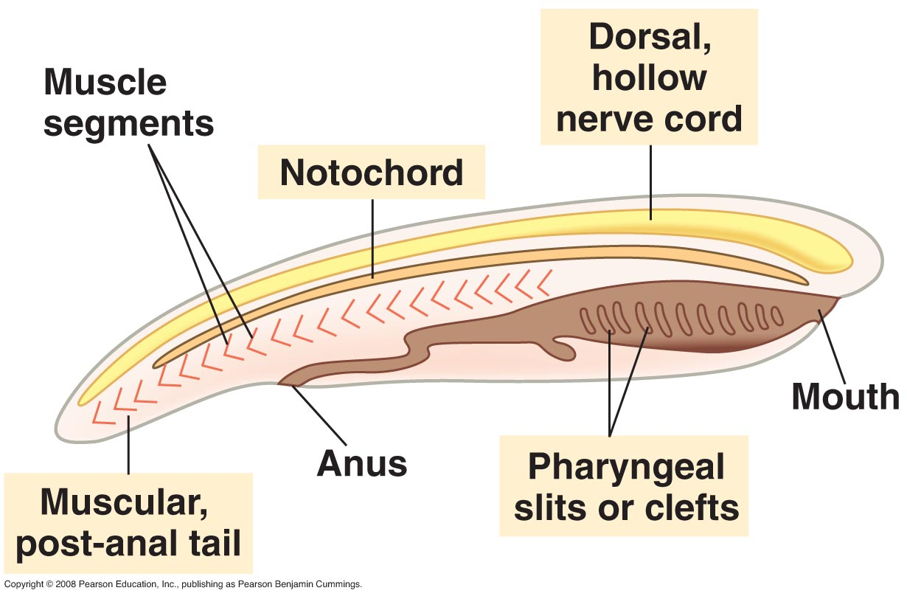
Characteristics

Slide 7
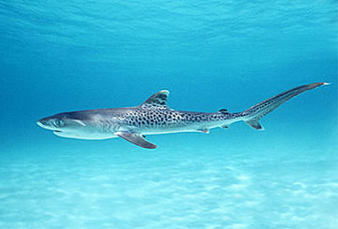
Feeding
From filter feeding ancestors to active predators
  Mobility
  Oxygen capture
  Digestion
  Circulation
  Nervous system
7

Slide 8
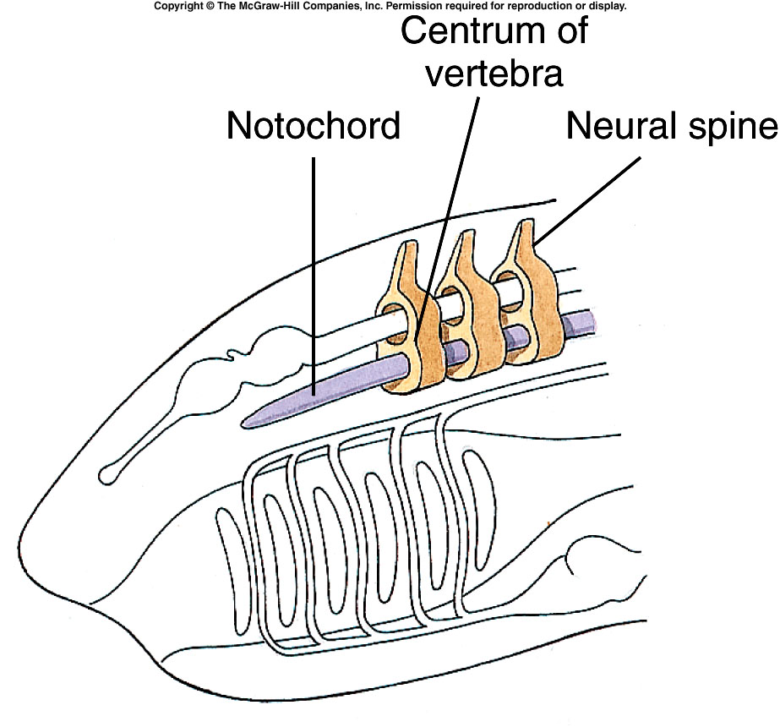
Skeletal Changes
Skeleton becomes stronger to work with bigger muscles
Allows more rapid movement
8
Notes:
Fig. 23.p477

Slide 9
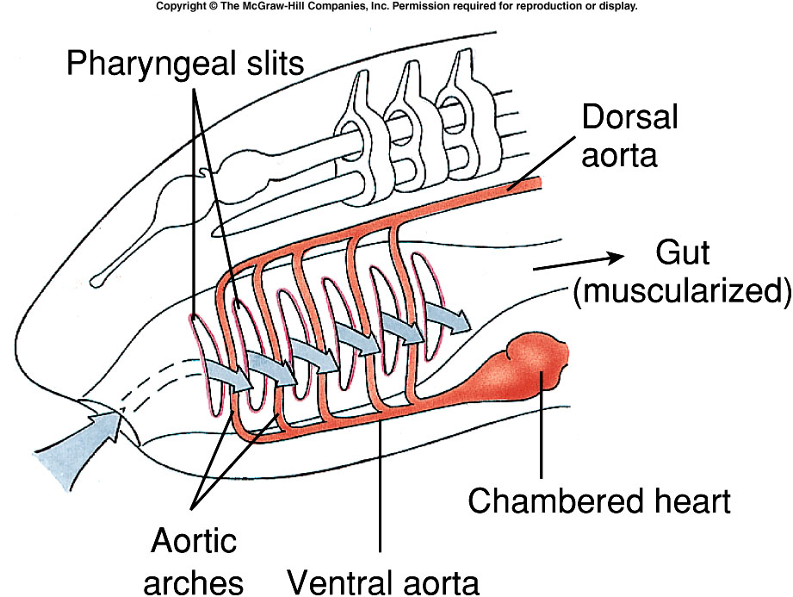
Oxygen Capture
Gill slit and muscular pharynx will move more water over gills
  More oxygen is extracted from water
9
Notes:
Fig. 23.p478a

Slide 10
Circulation
Stronger heart to circulate blood faster
10
Notes:
Fig. 23.p478a

Slide 11
Digestion
Digest more food
  Muscularized gut
  Digestive glands
    Liver
    Pancreas
11
Notes:
Fig. 23.p478a

Slide 12
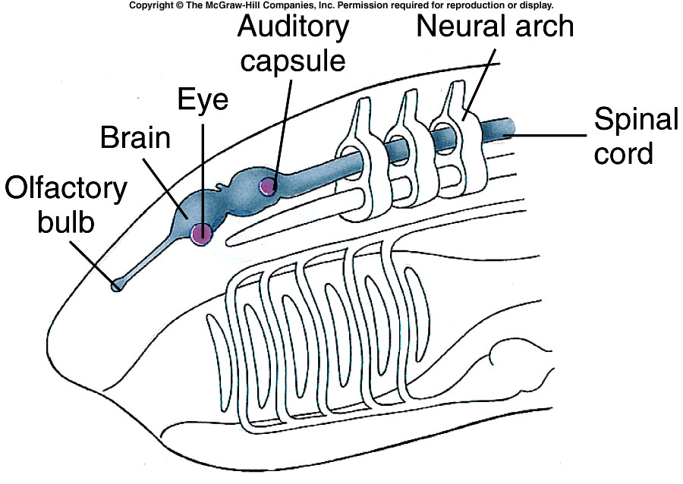
Nervous System
More complex for better
  Motor control of body to capture food
  Sensory detection of the animals environment
  Integration centers (brain)
12
Notes:
Fig. 23.p478b

Slide 13
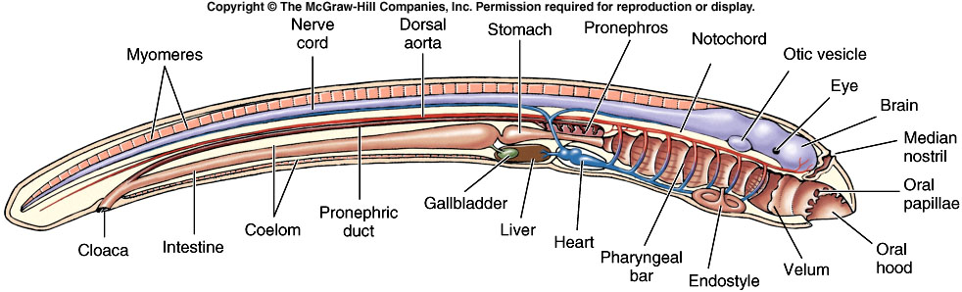
Nervous System
Hindbrain
Forebrain
Midbrain
13
Notes:
Fig. 23.14

Slide 14
Subphyla
Phylum. Chordata
  Subphylum. Urochordata
  Subphylum. Cephalochordata
  Subphylum. Vertebrata

Slide 15
Urochordata
Animals that take in and filter water through an incurrent and excurrent siphon.
  Feeding
  Respiration
Most adult tunicates are sessile and attached to rocks or similarly suitable surfaces on the ocean floor.

Slide 16
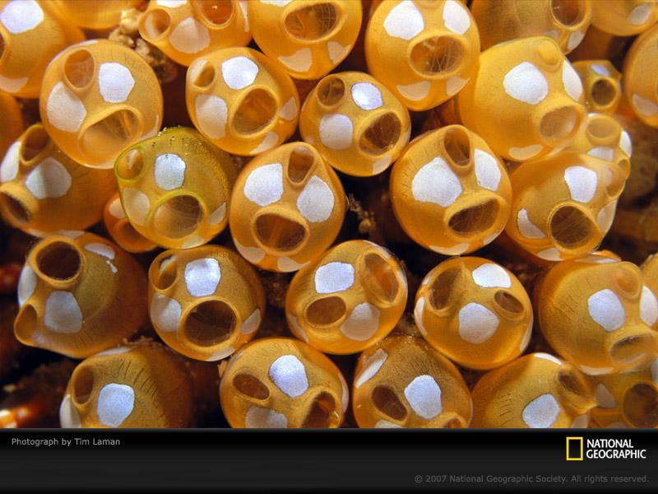
Chordates that are NOT vertebrates:
Sea Squirts or Tunicates
http://www.youtube.com/watch?v=e8jM94pNssc

Slide 17
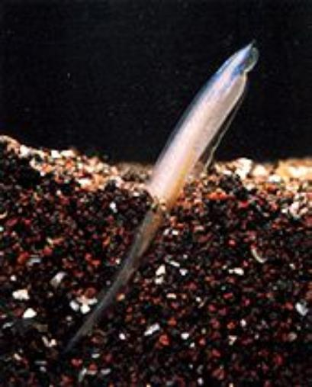
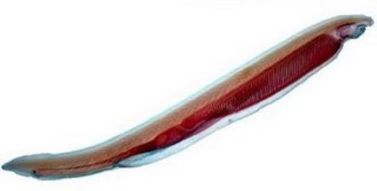
Cephalochordata
Lancelet

Slide 18
Vertebrates
Animals with a backbone or vertebral column (endoskeleton)
Have spinal cord - dorsal, hollow nerve cord
Front end of spinal cord develops a brain

Slide 19
Vertebrates
Jawless Fish (lamprey, hagfish)
Cartilage Fish (sharks, rays…)
Bony Fish (salmon, catfish, goldfish…)
Amphibians (frogs, salamanders…)
Reptiles (lizards, turtles…)
Birds (sparrows, hawks…)
Mammals (humans, whales, cats..)

