Slide 1
PHYLUM ARTHROPOD

Slide 2
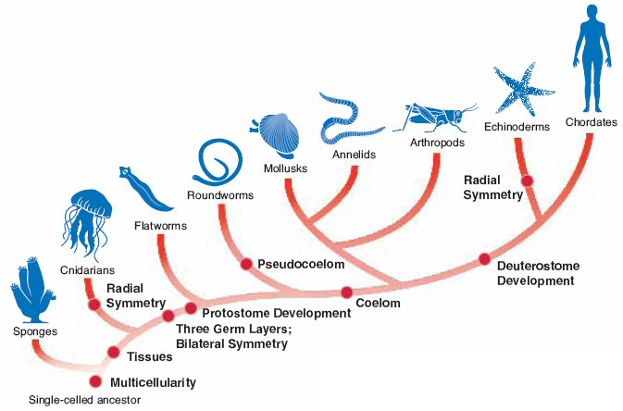

Slide 3
Number of Species
Arthropoda
Mollusca
Chordata
Platyhelminthes
Nematoda
Annelida
Porifera
Echinodermata
Other
Sarcomastigophora
Apicomplex
Ciliophora
Notes:
3

Slide 4
ARTHROPODA
Kindgom Animalia
Phylum Arthropoda
  Arthropod means "jointed foot" - all arthropods have jointed appendages
Largest phylum (75% all animals)
  Number of species
  Diversity
  Distribution
  Longevity

Slide 5
Body Plan
Levels of Organization: Specialized Cells, Tissues, and Organs
Body Symmetry: Bilateral
Germ Layers: Three
Body Cavity: True Coelom
Embryological Development: Protostome
Segmentation: Present
Cephalization: Present

Slide 6
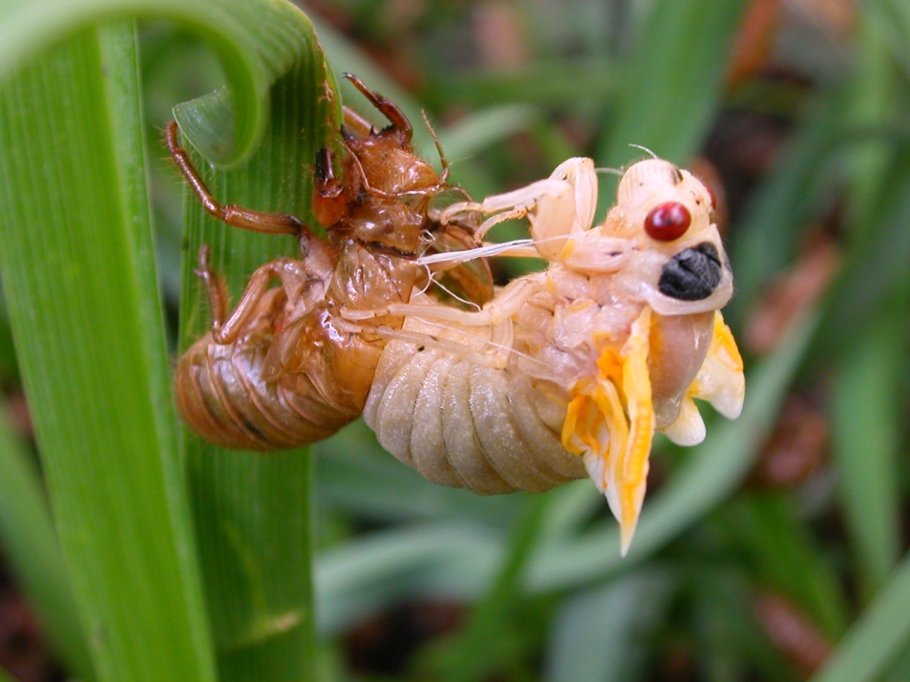
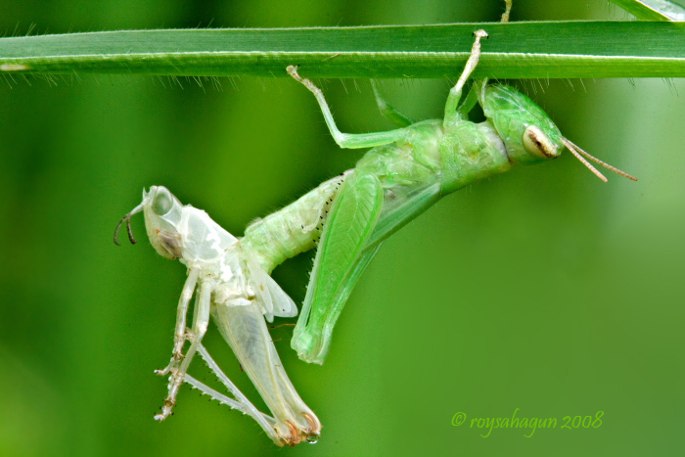
Characteristics
Exoskeleton (skeleton on outside)
  Epicuticle: outer layer
    Water proof
  Procuticle: inner layer
    Made of chitin
Ecdysis (Molting)

Slide 7
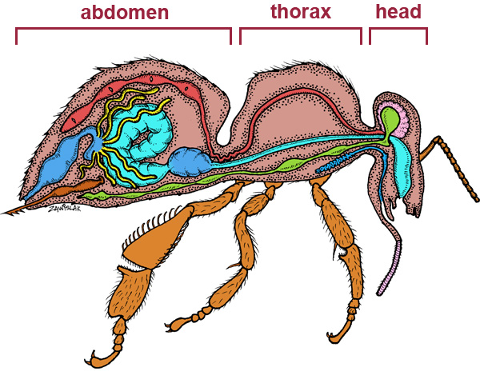
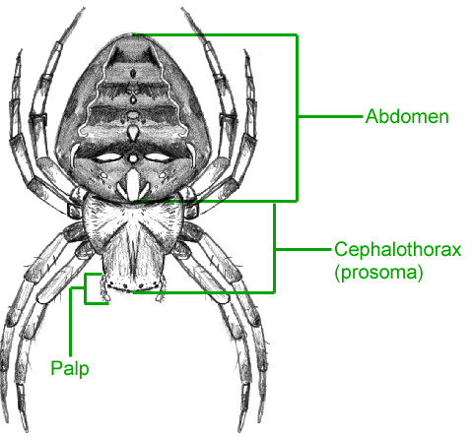
Characteristics
Segmented bodies (obvious in larvae)
Adults have fused segments
  Head
  Thorax
  Abdomen
Some have a fused head and thorax -- the cephalothorax

Slide 8
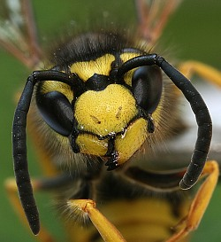
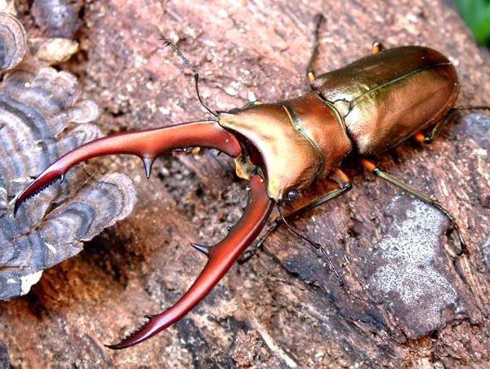

Feeding
Complete digestive tract
Mandibles used for feeding
GIANT STAG BEETLE

Slide 9
Respiration, Circulation, Excretion
Have a hemocoel – and a heart like pump that runs the lengh of the body
Respiration using spiracles and trachae
Wide variety of respiratory systems.
  Small species use simple diffusion
  Crustacea usually have gills that are modified appendages.
  Arachnids have book lungs.

Slide 10
Response
Paired main nerve cords running along their bodies below the gut.
Cords form a pair of ganalia from which sensory and motor nerves run to other parts of the segment.
Connected by commissures (relatively large bundles of nerves), which give arthropod nervous systems a characteristic "ladder-like" appearance.

Slide 11
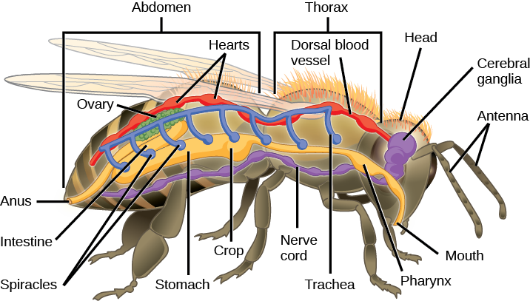

Slide 12
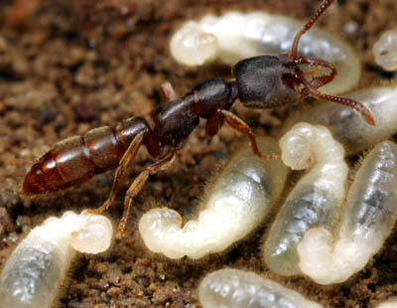
Reproduction
A few arthropods are hermaphroditic
  Barnacles
Individuals of most species remain of one sex all their lives.
Metamorphosis ( egg - larva - adult)

Slide 13
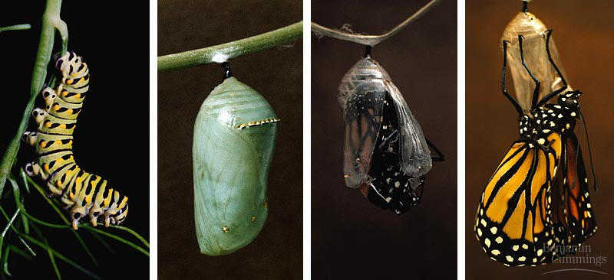

Slide 14
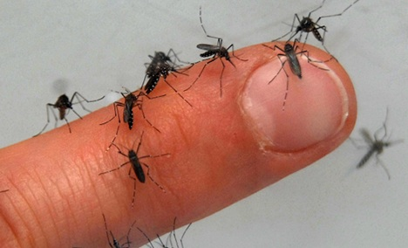
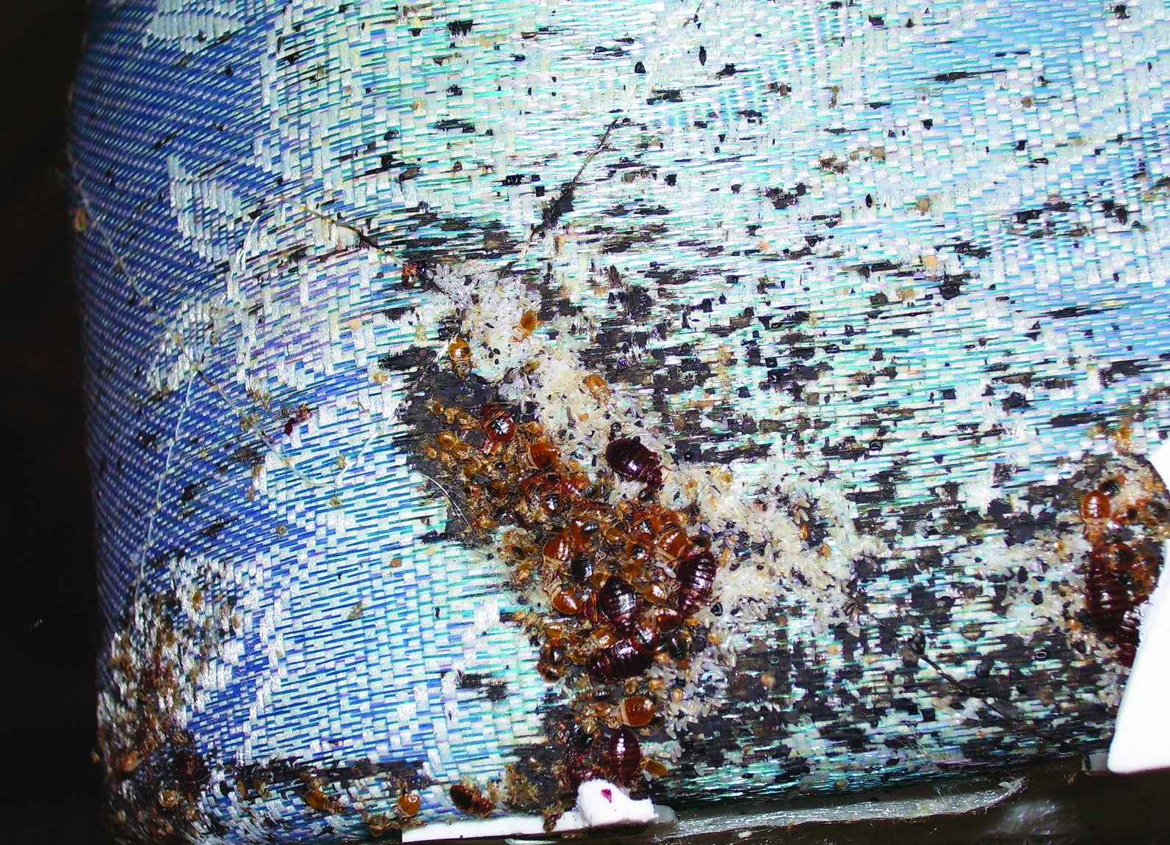
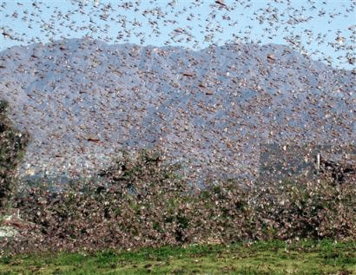
Habitat
AHH they’re literally everywhere.

Slide 15
Subphylum
Chelicerates
  spiders and scorpions
Crustaceans
  lobsters, crabs, shrimp, crayfish
Uniramia
  insects, millipedes, centipedes

Slide 16
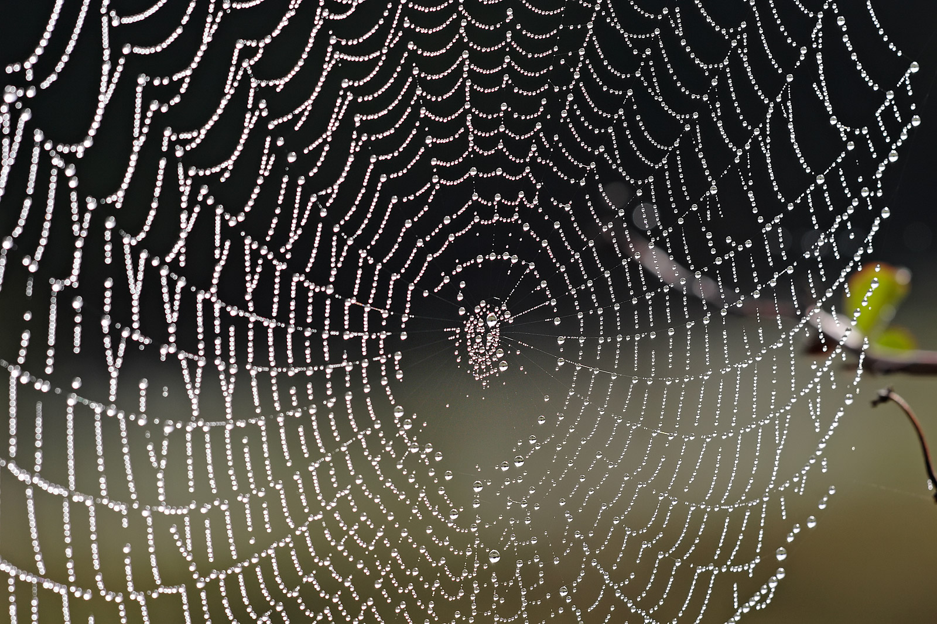
Chelicerates
Includes Class Arachnida - spiders, ticks, scorpions, mites and horseshoe crabs
Have a cephalothorax (fused head and thorax) and abdomen
Spinnerets in spiders make webs
No antenna

Slide 17
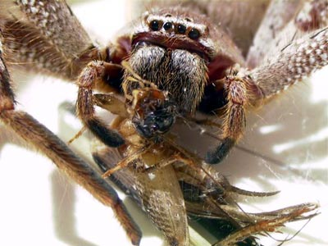
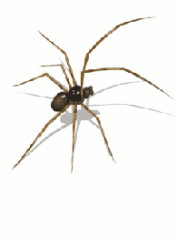
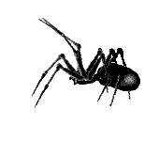
Chelicerates
Have 6 pairs of jointed appendages:
Chelicerae - claws or fangs (1 pair) - (spiders have venom)
Pedipalps - used for feeding, sensing, transferring sperm (1 pair)
Walking legs - movement (4 pairs)
http://www.youtube.com/watch?v=G7fyLA_GGc4
VIDEO LINK

Slide 18
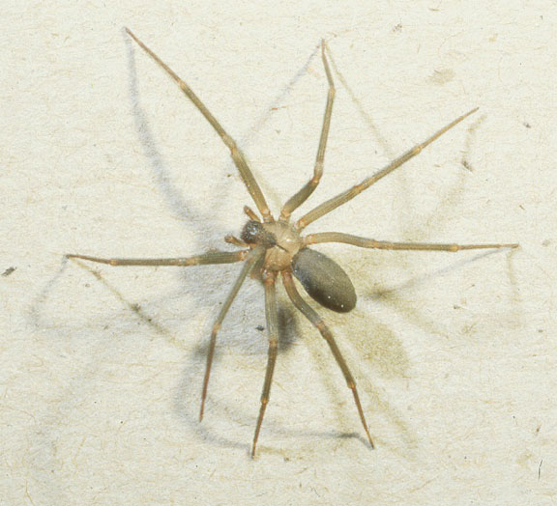
Loxosceles reclusa
Fiddle back spider
  Brown recluse
  Brown
  Violin
Necrotoxin

Slide 19
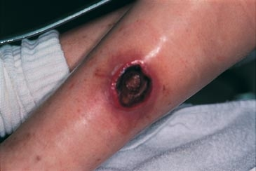
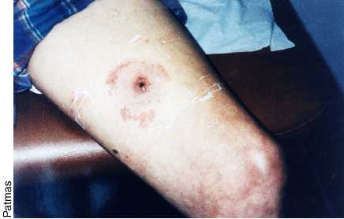
Loxosceles reclusa
The gradual necrosis of tissue

Slide 20
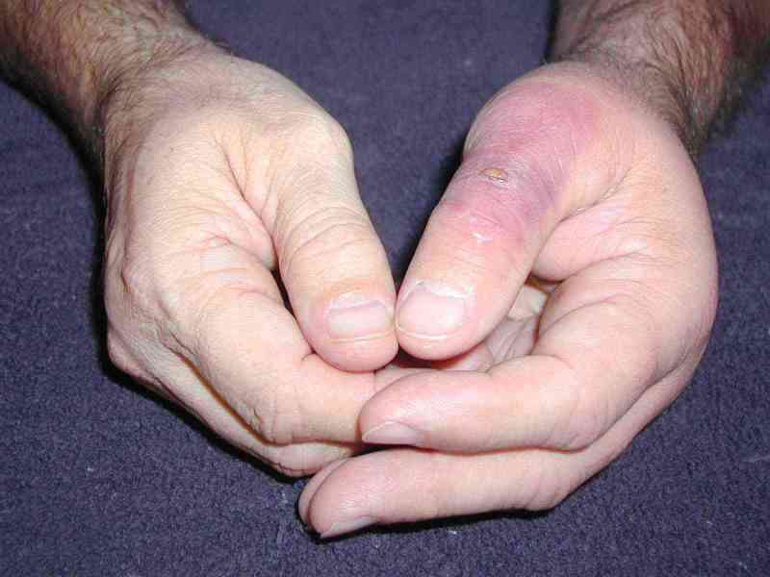
Day 3

Slide 21
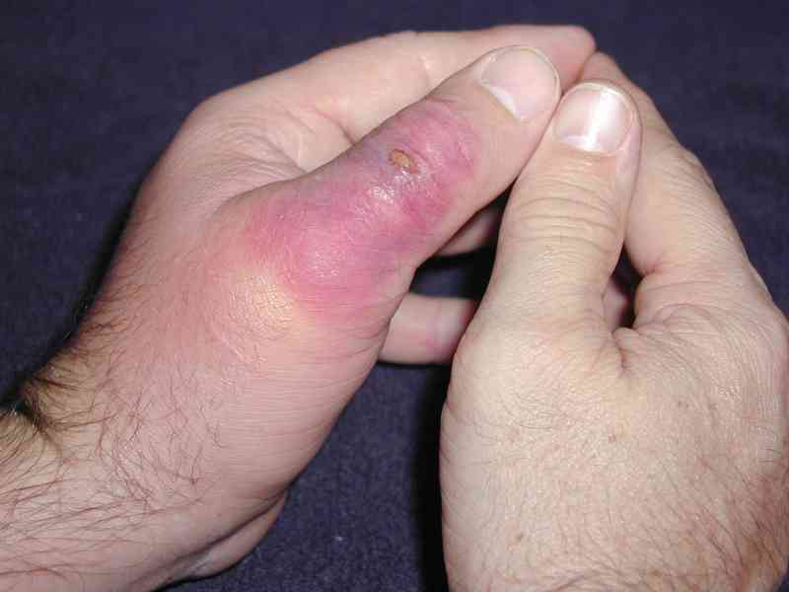
Day 4

Slide 22
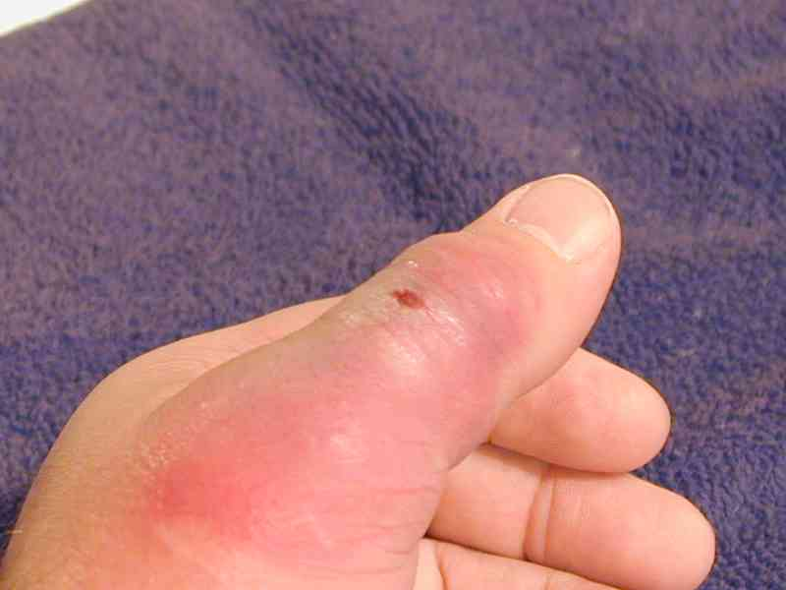
Day 5

Slide 23
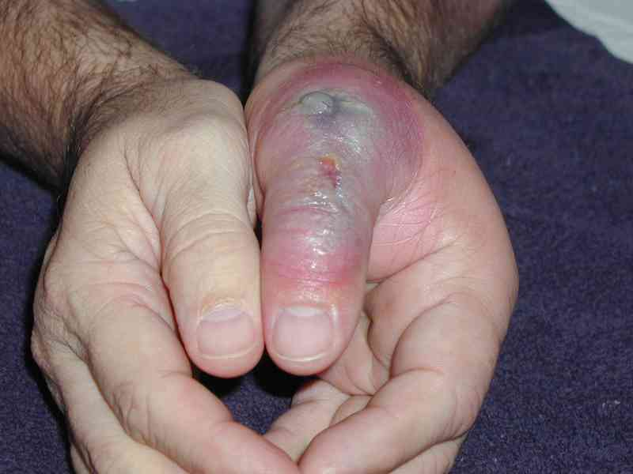
Day 6

Slide 24
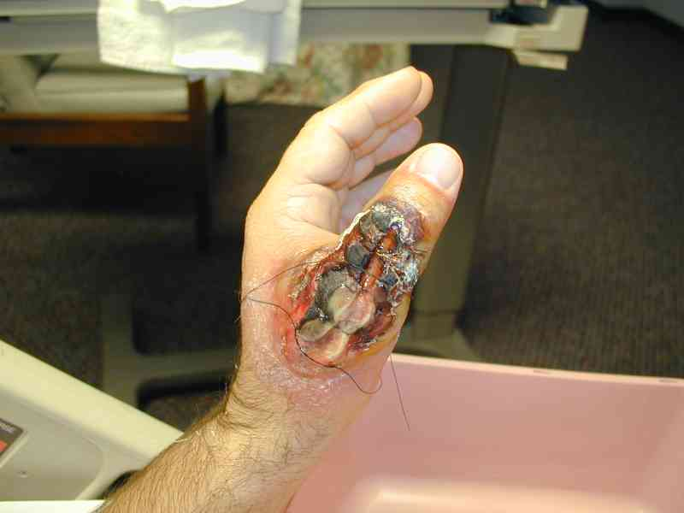
Day 9

Slide 25
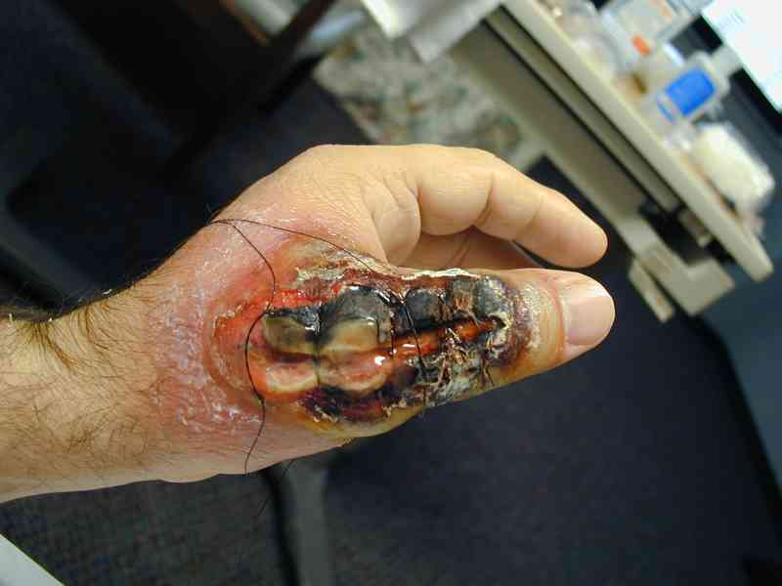
Day 10

Slide 26
Crustacea
Marine members include shrimp, lobster, barnacles, & crabs
Terrestrial crustaceans called isopods (pillbugs or rollypollys)
Freshwater members include crayfish and daphnia
All have mandibles for chewing or tearing
Have cephalothorax and abdomen
Lobsters and large custraceans are called Decapods
Barnacles are sessile (don't move)
Have 10 pairs of jointed appendages
Breathe through gills

Slide 27
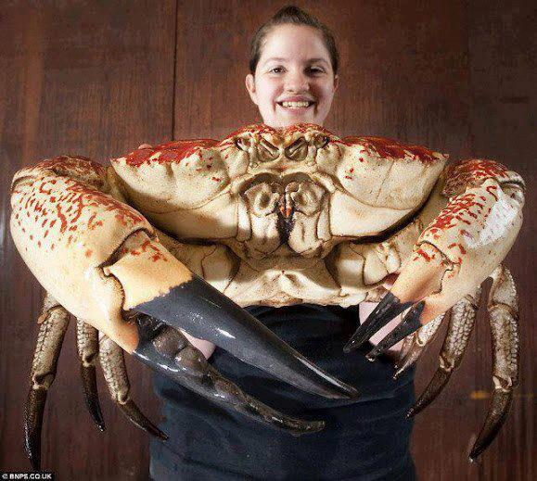
MONSTER TASMANIAN KING CRAB

Slide 28
Uniramia
Includes 3 classes:
  Chilopoda (centipedes)
  Diplopoda (millipedes)
  Insecta

Slide 29
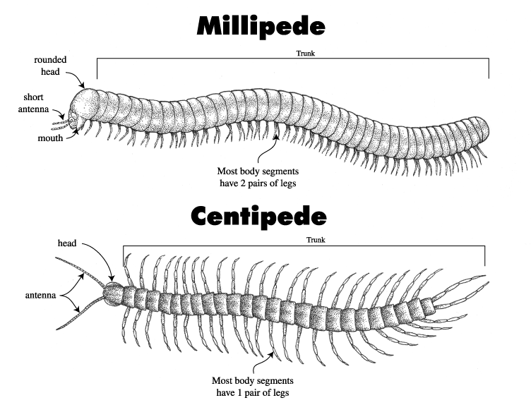
Uniramia
Centipedes
  Name means “100 legs”
    Predators, poisonous
    1 pair of legs per segment
Millipedes
  Name means “1000 legs”
    Herbivores
    2 pair of legs per segment

Slide 30
CLASS INSECTA

Slide 31
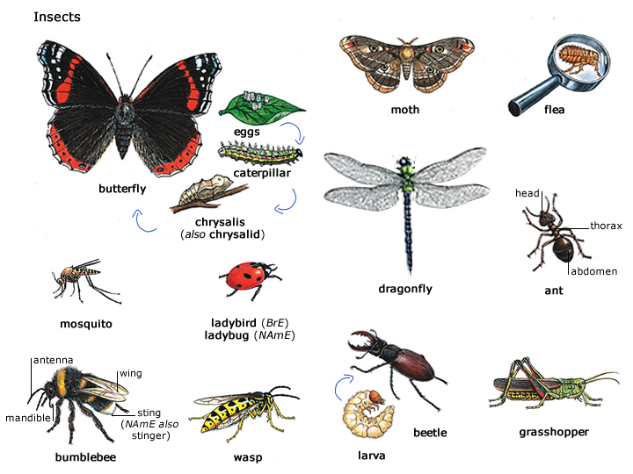
Class Insecta
Insect Characteristics
  3 pairs of legs
  1 pair of antennae
  3 body segments (head, thorax, abdomen)

Slide 32
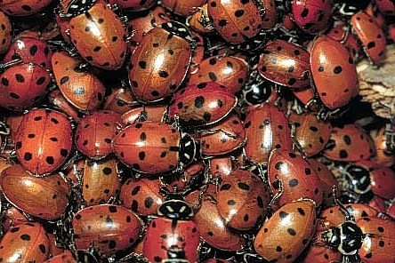
Most Abundant and Diverse
1,000,000+ species identified
  May be as many as 30,000,000
More than all other animals combined

Slide 33
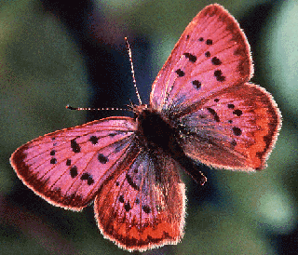
Distribution
Air
land
In the soil
Parasites
  Plants
  Animals
Freshwater
Not marine???

Slide 34
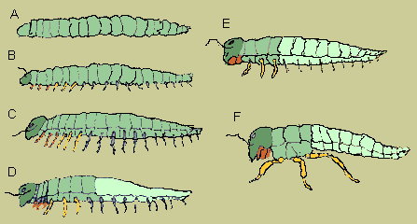
Evolution

Slide 35
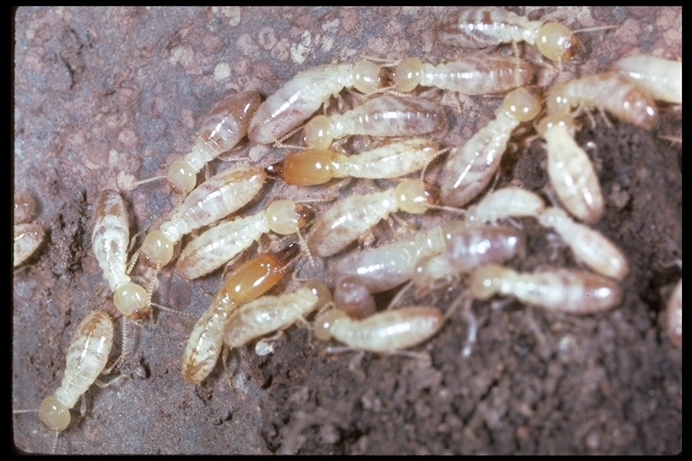
Social Insects
Live in colonies
Queen
King
Soldiers
Workers

Slide 36
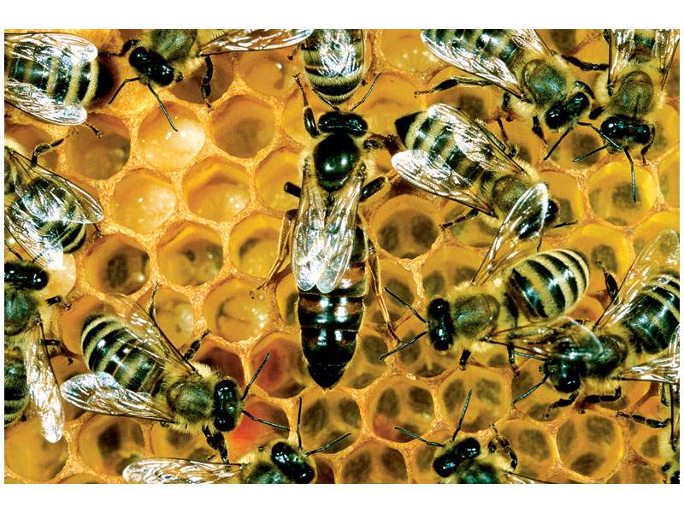
Notes:
Figure: FG31-18
Title:
Honeybee society.
Caption:
Out of thousands of females in a honeybee colony, only one bee, the queen, is likely to bear offspring. Each colony is composed of numerous female worker bees, a small number of male drones—whose sole function is to mate with a queen—and the queen bee herself. Shown is a group of workers surrounding a queen in a North American hive.

Slide 37
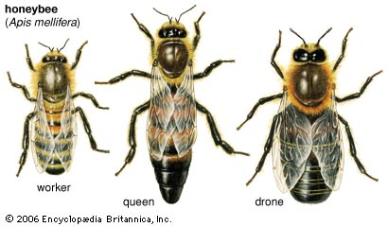
About Bees
Queen
  Lays eggs
  Queen substance
Worker
  Builds hive
  Takes care of eggs
  Attends to queen
  Royal jelly
Drone
  Fertilizes queen

Slide 38
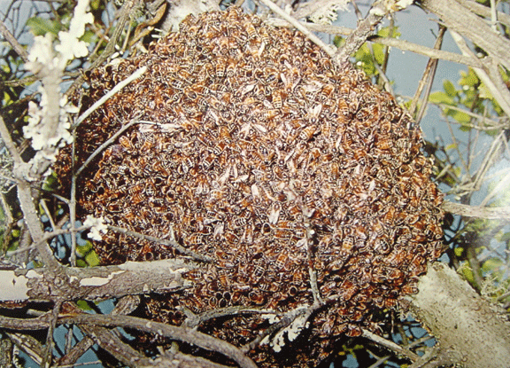
About Bees
New queen
Leaves with part of the hive to start a new colony
She’ll fly high, whoever can keep up is admitted to her colony!

Slide 39
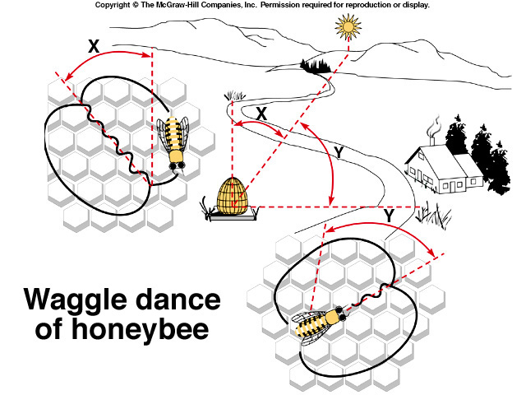

Slide 40
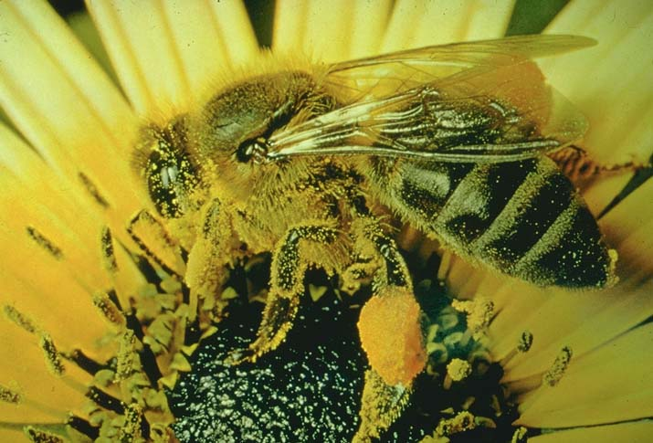
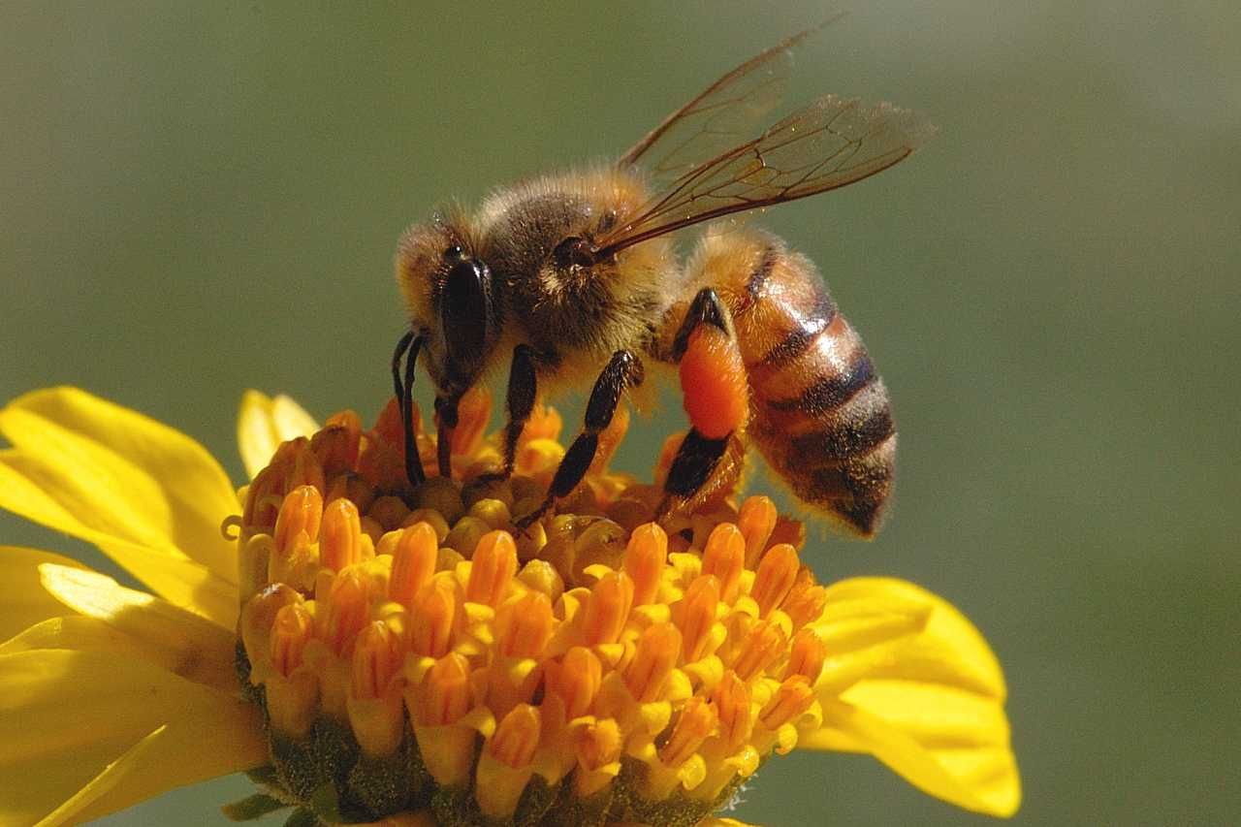
Beneficial Insects
Honey bee
  Honey
  Pollinates crops

Slide 41
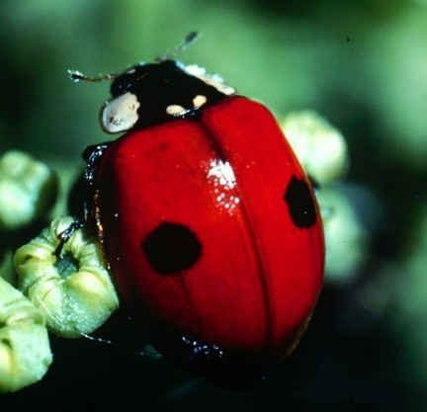
Beneficial Insects
Lady bug
Eats harmful insects

Slide 42
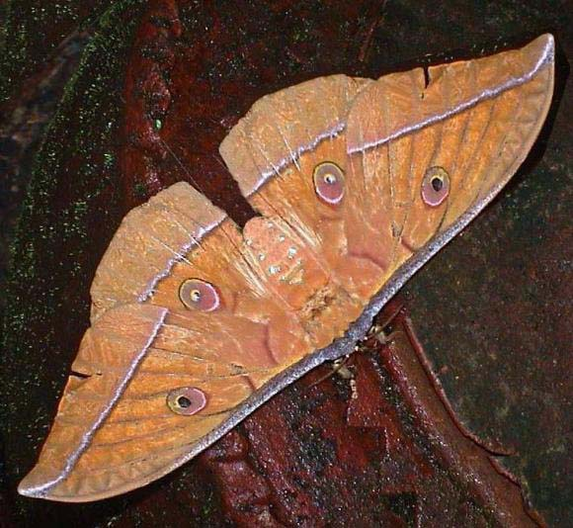
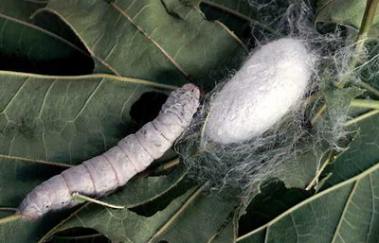
Beneficial Insects
Silkworm moth
Lava produces silk

Slide 43
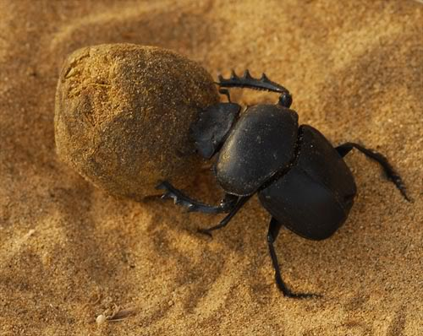
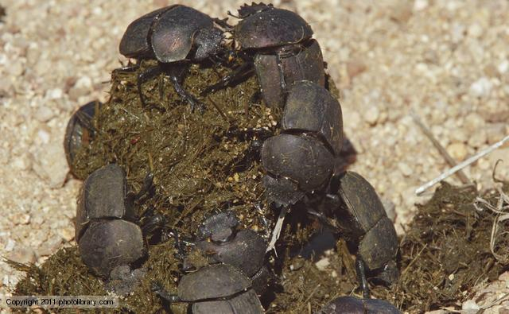
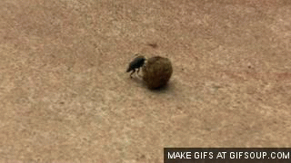
Beneficial Insects
Breakdown dung

Slide 44
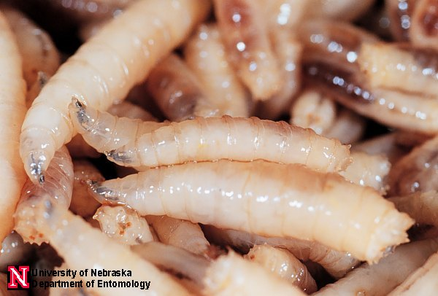
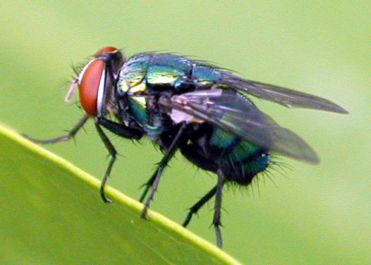
Beneficial Insects
Blow fly
Decompose dead bodies

Slide 45
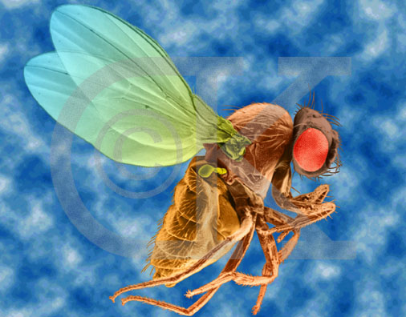
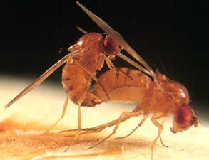
Beneficial Insects
Drosophila
Genetics research

Slide 46
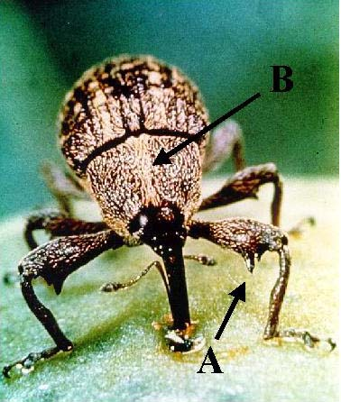

Harmful Insects
Boll weevil
Destroys cotton

Slide 47


Harmful Insects
Mosquitos
Vector
  Malaria
  Yellow fever
  Encephalitis
  West Nile virus

Slide 48



Harmful Insects
Flea
Vector for
  Plague

Slide 49


Slide 50

Harmful Insects
Rat flea
Vector for plague

Slide 51


Order Odonota
Dragon flies
Damsel flies
Two pair of large wings

Slide 52



Order Orthoptera
Grasshopper
Cockroach
Praying mantis
Cricket

Slide 53

Order Dermaptera
Earwigs
Forceps-like cerci
Short wings

Slide 54

Order Isoptera
Termites
White
Broad waist
Winged and wingless

Slide 55

Order Homoptera
Cicada
Aphids
Leaf hoppers
Roof-like wings

Slide 56

Order Hemiptera
True bugs
Front wing
  Basal portion is leathery
  Apical portion of wing is membranous

Slide 57

Order Coleoptera
Beetles
350,000+ species
Hard front wings meet midline
Back wings membranous

Slide 58


Order Lepidoptera
Butterflies
  Knobbed antennae
Moths
Scales on wings
Larva are catepillars
BLUE MORPHO BUTTERFLY

Slide 59


Order Diptera
Flies
Mosquitoes
One pair of wings

Slide 60


Order Hymenoptera
Bees
Wasps
Ants
Four membranous wings
Narrow waist

Slide 61

Order Anoplura
Lice
No wings
Single claw
Sucking mouth parts
parasites

Slide 62

Order Siphonaptera
Fleas
Flattened laterally
Spines on legs and body
Parasites

