Slide 1
PHYLUM ANNELID

Slide 2
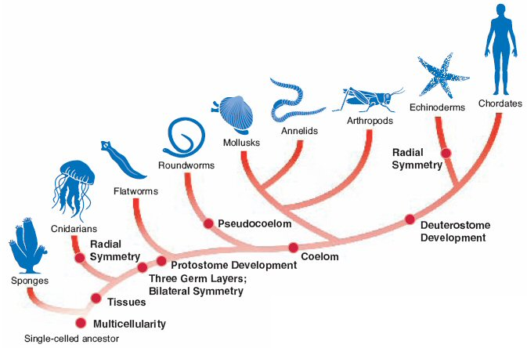

Slide 3
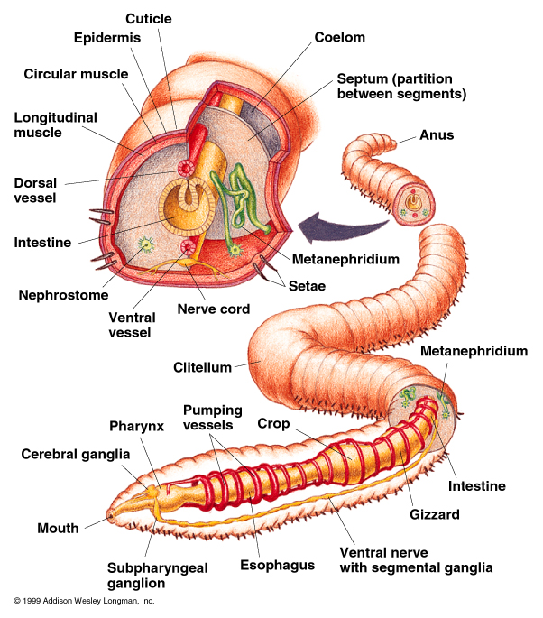
Annelid
Kingdom: Animalia
Phylum: Annelida
Annelid means “little rings”

Slide 4
Body Plan
Levels of Organization: Specialized Cells, Tissues, and Organs
Body Symmetry: Bilateral
Germ Layers: Three
Body Cavity: True Coelom
Embryological Development: Protostome
Segmentation: Present
Cephalization: Present

Slide 5
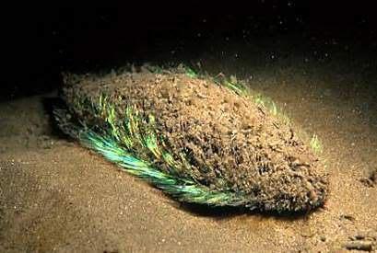
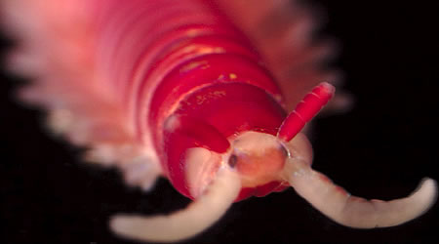
Characteristics
Segmented Worms
Body segments separated by septum
  Septum = internal wall
Some have bristles called setae
Have closed circulatory system
Have well-developed nervous system (brain)
Sexual reproduction, some are hermaphrodites
SEA MOUSE

Slide 6
Feeding
Some annelids have a “pharynx”
Some are filter feeders use "crowns" of palps covered in cilia that wash food particles towards their mouths.
Some have sticky pads in the roofs of their mouths to capture prey.
Leeches often have an eversible proboscis, or a muscular pharynx with two or three teeth

Slide 7
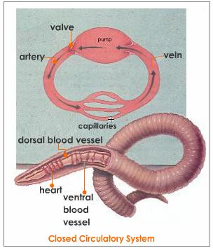
Respiration, Circulation, Excretion
Respiration via skin diffusion
Closed circulatory system
  Have vessels and a pump
Nephridia for each segment (metamere)
  Excretory structures

Slide 8

Response
Nervous system – ganglia = brain; lateral nerve cords.
Moves using waves of peristalsis.

Slide 9
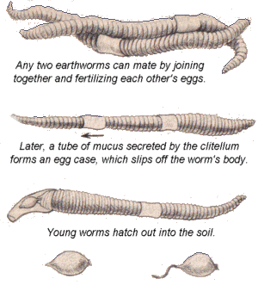
Reproduction
Asexual Reproduction
  Polychaetes can reproduce asexually by budding.
Sexual Reproduction
  Some hemaphrodites

Slide 10
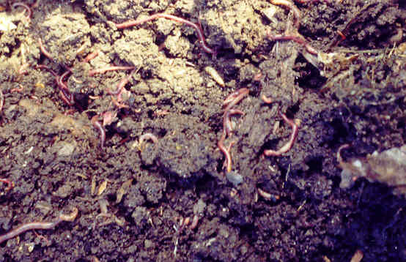
Role in Ecosystem
Earthworms' contributions to soil fertility. Some burrow while others live entirely on the surface.
  The burrowers loosen the soil so that oxygen and water can penetrate it
  The worms produce soil by mixing organic and mineral matter
  They accelerate the decomposition of organic matter and make it more quickly available to other organisms, like plants

Slide 11
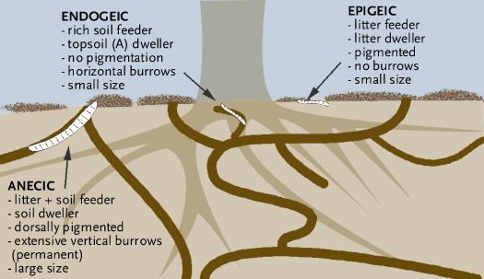

Slide 12
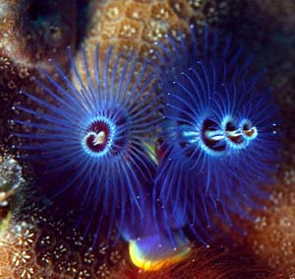
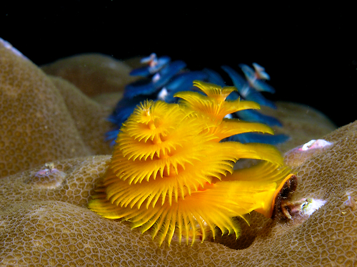
Role in Ecosystem
Earthworms are also important prey for birds; in some cases conserving earthworms may be essential for conserving endangered birds.
Marine annelids may account for over one-third of bottom-dwelling animal species round coral reefs and in tidal zones.
Burrowing species increase the penetration of water and oxygen into the sea-floor sediment, which encourages the growth of populations of aerobic bacteria and small animals alongside their burrows.
CHRISTMAS TREE WORM

Slide 13
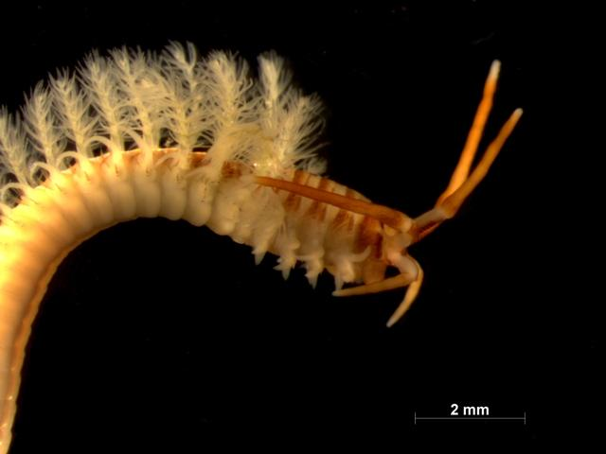
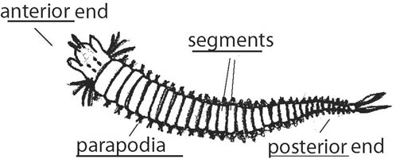
Class Polycheatea
Polychaetes (about 12,000 species) have multiple chetae ("hairs") per segment. Polychaetes have parapodia that function as limbs, and nuchal organs ("nuchal" means "on the neck") that are thought to be chemosensors.

Slide 14
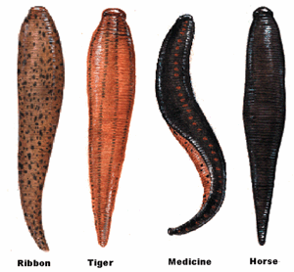
Class Clitellata
Clitellates (about 10,000 species) have few or no chetae per segment, and no nuchal organs or parapodia. Have clitellum.
  Oligochaetes ("with few hairs"), which includes earthworms.
  Hirudinea, whose name means "leech-shaped" and whose best known members are leeches

Slide 15
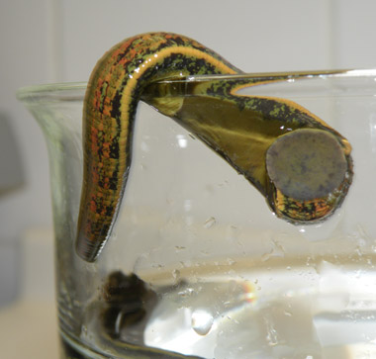
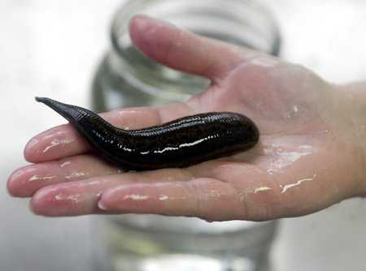
http://www.youtube.com/watch?v=cePKpt5nOJ0
LEECH

