Slide 1
Amphibians

Slide 2
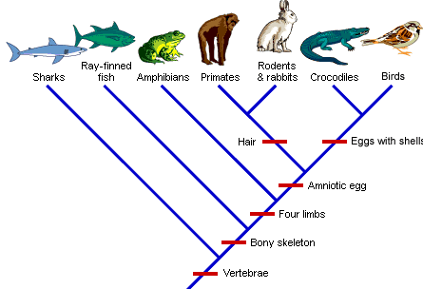

Slide 3
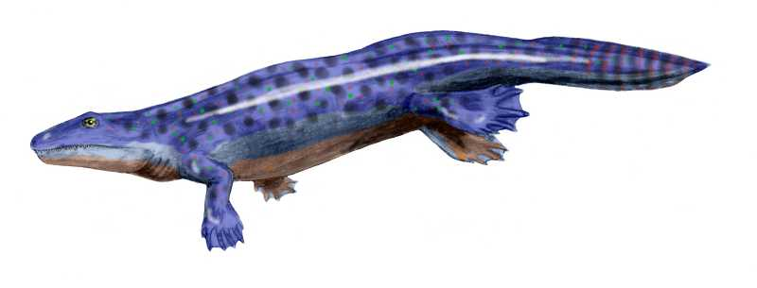
Ancestor
Amphibians – evolved from lobe-finned fish
Ichthyostega presents rudimentary amphibian features (different from fish)
  Girdles (pelvic and pectoral) = skeletal bones connecting the central skeleton to the bones of the appendages
  Other skeletal strengthening: rib cage and cranium
Ichthyostega still retained a caudal fin and scales

Slide 4
Evolution of Amphibian
Ancient and modern amphibians have features that enhance their survival on land but also limit this existence.
Most amphibian evolution took place when Earth was warm, humid, and swampy (350 mya).
Insects were abundant.
No pressure to develop into a truly terrestrial animal.

Slide 5
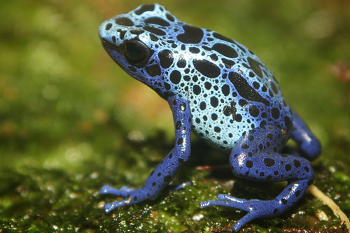
Characteristics
Live on land and water
  Reproduce in water
Skin with mucoid secretions
  Respiration
No scales, feathers or hair
Heart with 3 chambers
  2 atria
  1 ventricle
One cervical vertebra
Ectothermic (Piokelothermic)

Slide 6
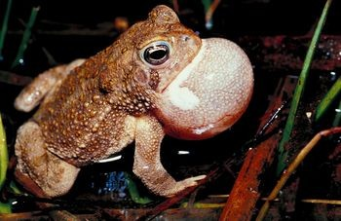
Adaptations to Live on Land
Gills are usually lost
Lungs function
Breathe through skin, mouth and lungs
Secrete mucus
  Prevent dehydration
  Aids in respiration

Slide 7
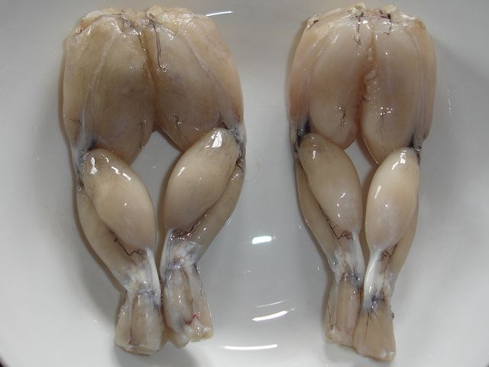
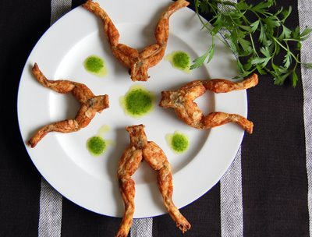
Adaptations to Live on Land
Well-muscled appendages, supported by a central and peripheral skeleton
Skeleton
  Fins evolve into limbs
  Vertebral column supports body underneath it
    Air is not as buoyant as water

Slide 8
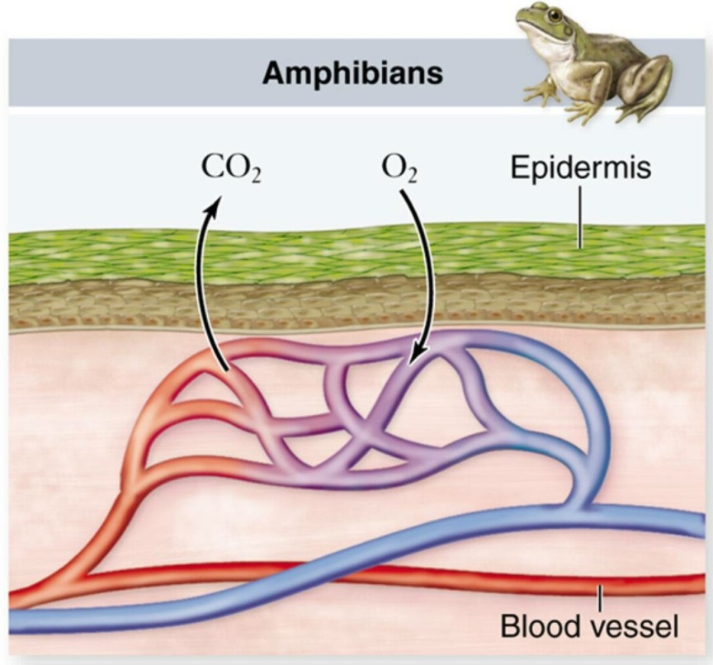
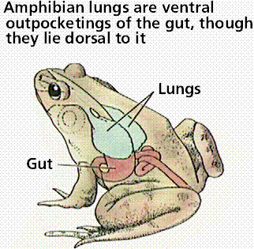
Respiration
Further development of lungs
Skin highly vascularized, other site of gas exchange, and maintains water balance

Slide 9
Circulation
Circulatory system now includes a 3-chamber heart
  Increased pressure to peripheral arteries
  Atrium separated by septum, but still one ventricle
  More efficient but still mixing of oxygenated/deoxygenated blood
All of these features serve to increase the mobility of amphibians

Slide 10
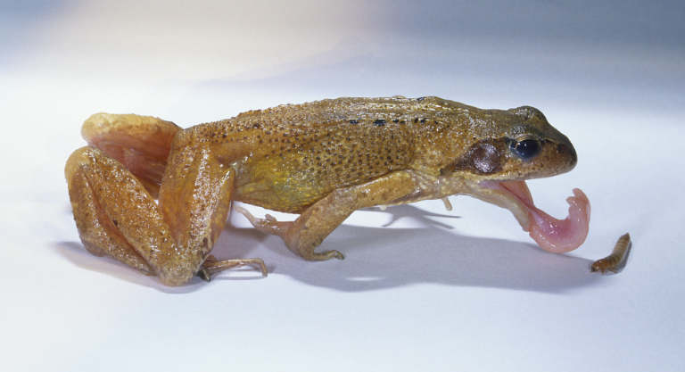
Digestion/Excretion
Many amphibians catch their prey by flicking out an elongated tongue.
Some use inertial feeding to help them swallow the prey, repeatedly thrusting their head forward sharply causing the food to move backwards in their mouth by inertia.
Swallow their prey whole without much chewing so they possess voluminous stomachs.
Anenzyme chitinase produced in the stomach helps digest the chitinous cuticle of arthropod prey.

Slide 11
Reproduction
http://www.youtube.com/watch?v=IAF5N-HwgOc
Must reproduce in the water since eggs would dry up on land
Aquatic larval stage more closely related to fish than terrestrial animals

Slide 12
Orders
Apoda (Gymnophiona) - Caecilians
Caudata (Urodela) - Salamanders
Anura (Salientia) - Frogs and toads

Slide 13
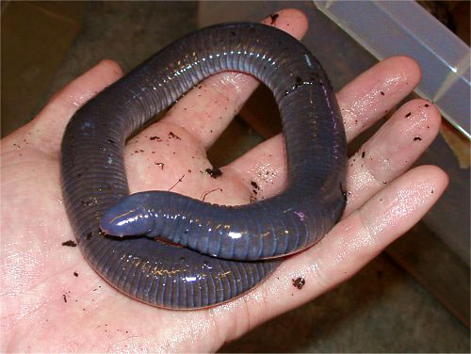
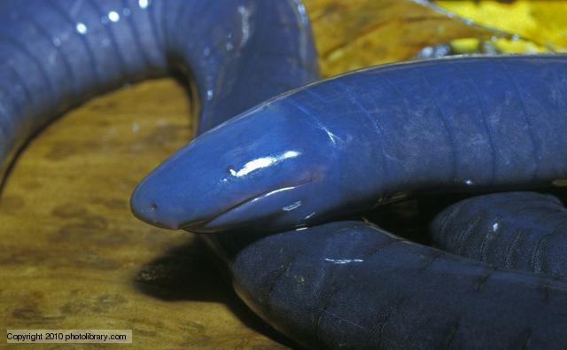
Order Apoda
Caecilian
Name means “No legs”
Skin glands
Live in tropics
Tiny eyes if present (most are vestigial, covered by skin)
Chemosensory tentacles on head in front of eyes used to locate food
Internal fertilization; some species bear live young while others lay eggs

Slide 14
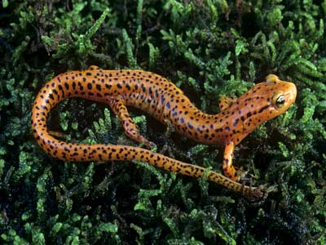
Order Caudata
Salamanders
Name means “bearing a tail”
Four legs
Most closely resemble amphibian tetrapod ancestor
Primarily live in Northern Hemisphere (abundant in cool, moist forests, only 1 type tropical)
Generally (semi) terrestrial as adults
http://www.youtube.com/watch?v=MjAiWnzU2aE

Slide 15
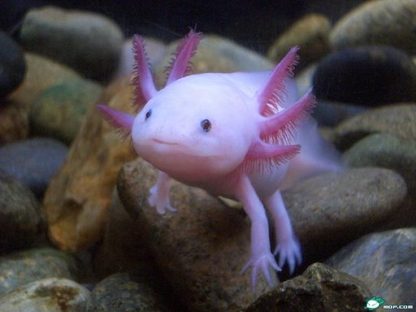
Order Caudata
Most pass through larval stage
  few days to a few years
  some species never metamorphose (axolotl)

Slide 16
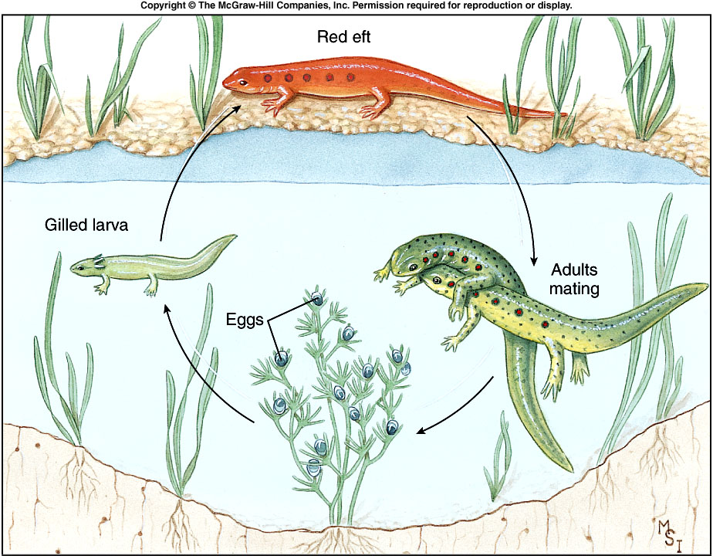
16
Notes:
Fig. 25.8

Slide 17
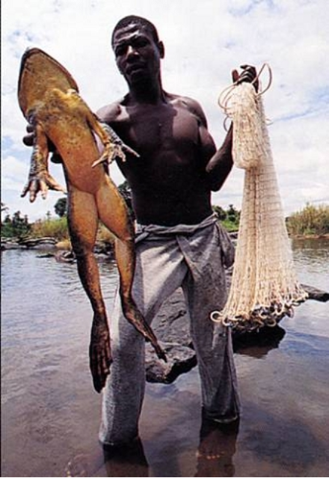
Order Anura
Frogs and toads
No tail in adult
Webbed feet
Most successful, diverse, evolutionarily divergent of the living amphibians
Jumping locomotion allowed exploitation of new terrestrial niches
Live in almost any climate (except high latitudes in Arctic, Antarctic, some oceanic islands, some extremely dry deserts)
Many deposit eggs in water; get free-swimming tadpoles
Others lay terrestrial eggs
Some carry their eggs with them

Slide 18
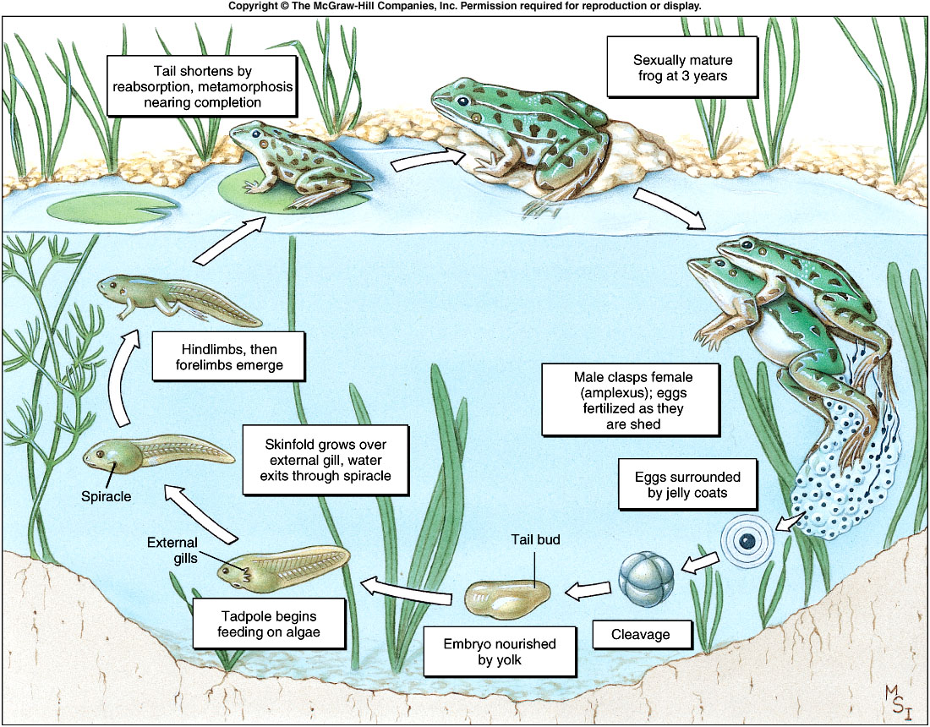
18
Notes:
Fig. 25.26

Slide 19
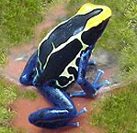
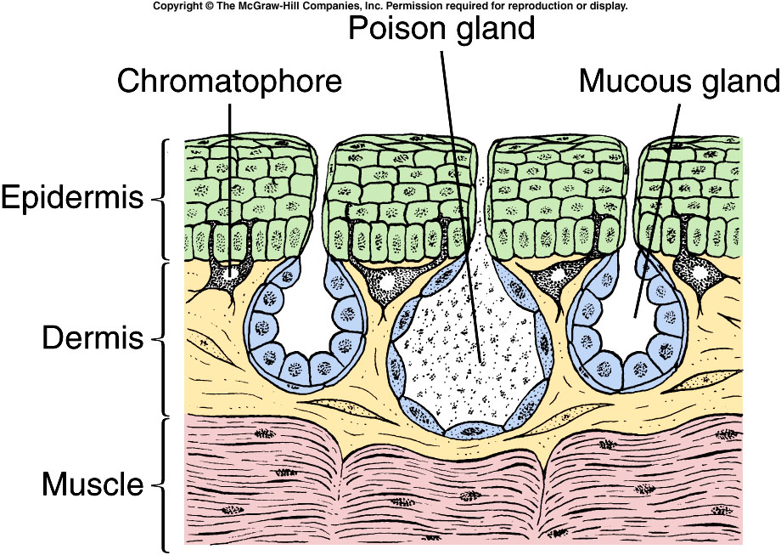
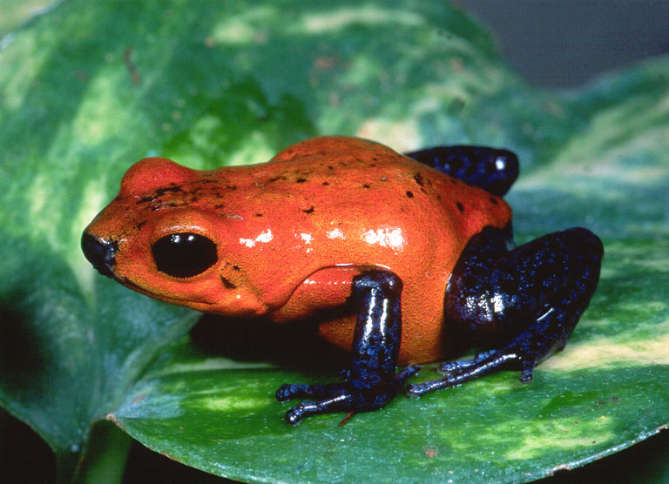
Poison Dart Frog

