Slide 1
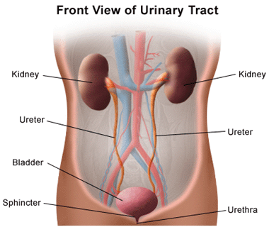
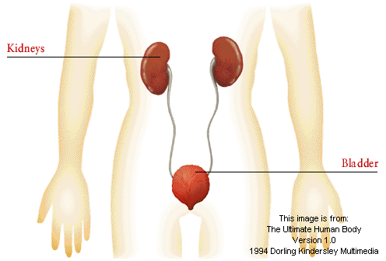
Excretory System

Slide 2
Respiration Waste
When respiration occurs, your body breaks down oxygen and glucose. The waste products are carbon dioxide and water. Carbon dioxide is exhaled out of your body, but other waste products remain. The excretory system aids in waste product removal.

Slide 3
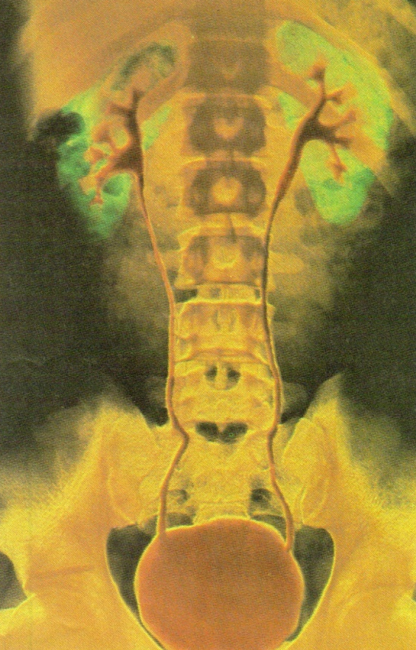
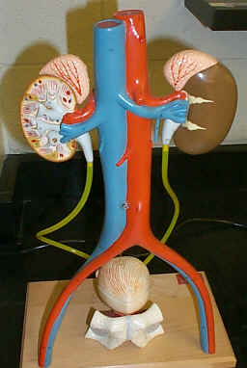
Urinary System
Rids the blood of waste produced by cells. It also controls blood volume by removing excess water produced by cells during respiration.

Slide 4
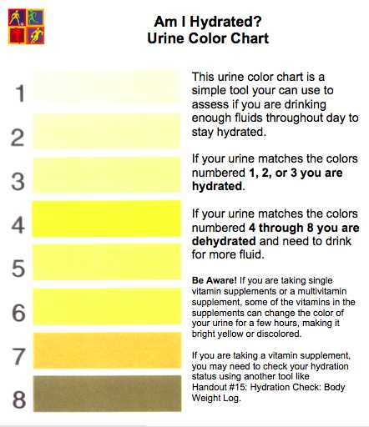
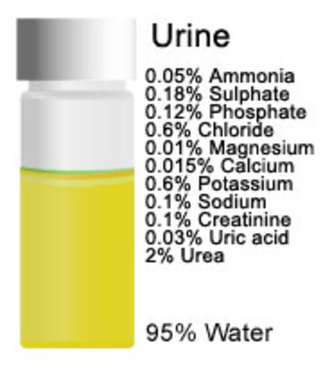
Urine
Waste water that the kidneys release

Slide 5
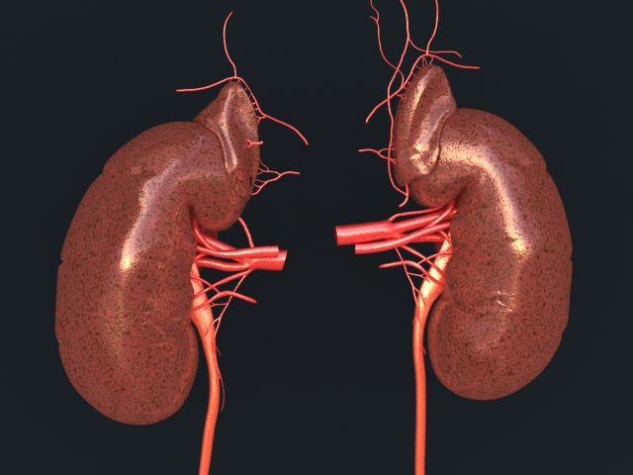
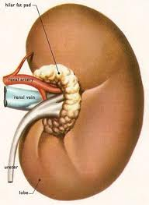
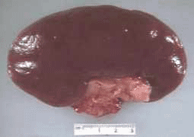
Kidney
Main organs of the urinary system. Kidneys filter blood that contains wastes from cells

Slide 6
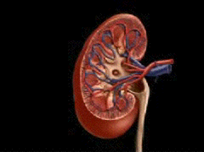
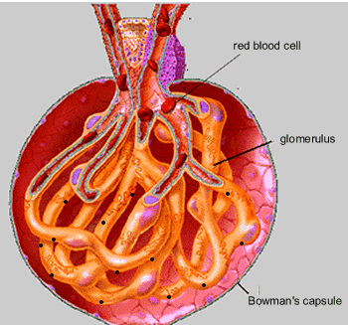
Nephron
Nephron
Video
Tiny filtering units of the kidney

Slide 7
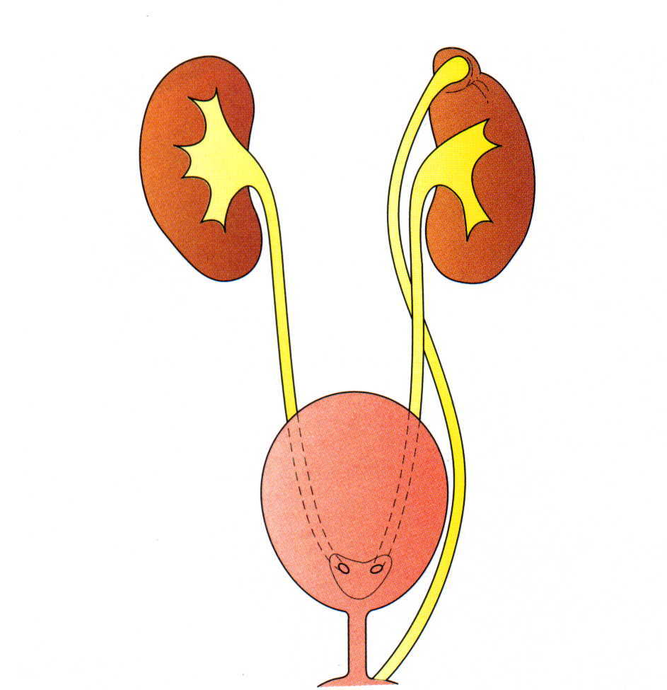
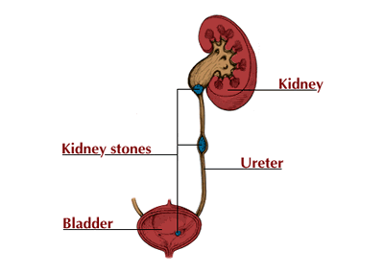
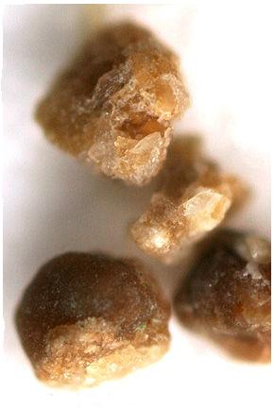
Ureter
Tubes that leads from the kidney to the bladder. (you have 2 ureters)

Slide 8
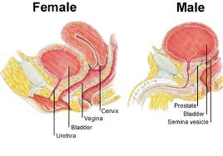
Bladder
Elastic organ that holds urine until it leaves the body

Slide 9
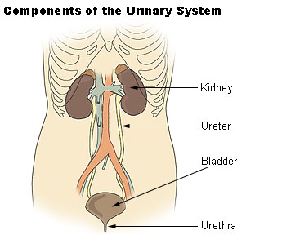
Urethra
Tube that carries urine from the bladder to the outside of your body.

Slide 10
DRAW IT
Flip your paper over!
Then we will draw
the excretory system

Slide 11
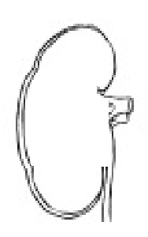
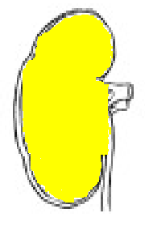
KIDNEYS

Slide 12
KIDNEYS
NEPHRONS

Slide 13
KIDNEYS
NEPHRONS
URETERS

Slide 14
KIDNEYS
NEPHRONS
URETERS
BLADDER

Slide 15
KIDNEYS
NEPHRONS
URETERS
BLADDER
URETHRA

