Slide 1

Human Impact
How do we influence the environment?

Slide 2
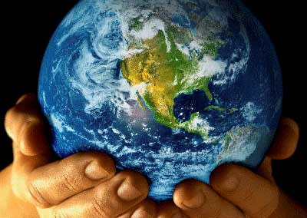

Changing Landscape
All organisms on Earth share limited resources.
To protect these resources and processes, we must know how humans interact with the biosphere.
Humans have become the most important source of environmental change.

Slide 3
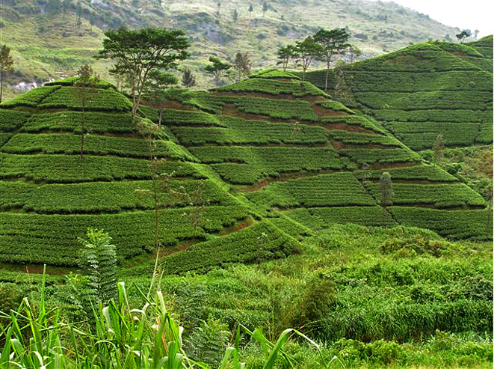
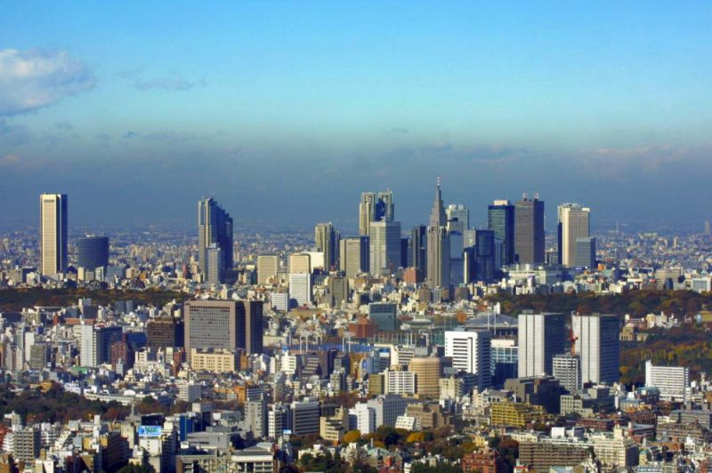
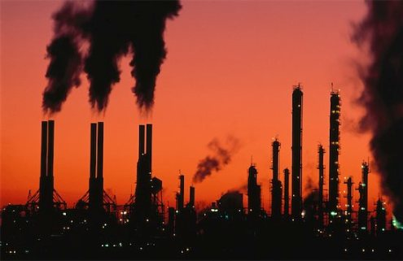
Changing Landscape
Humans affect the biosphere through hunting and gathering, agriculture, industry, and urban development.

Slide 4
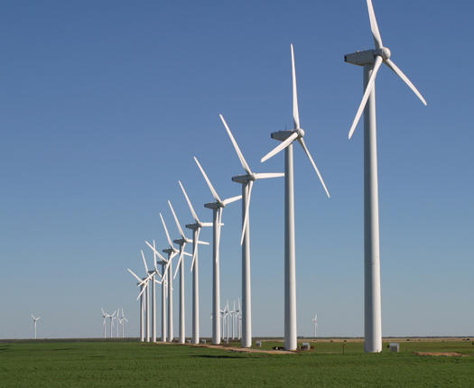
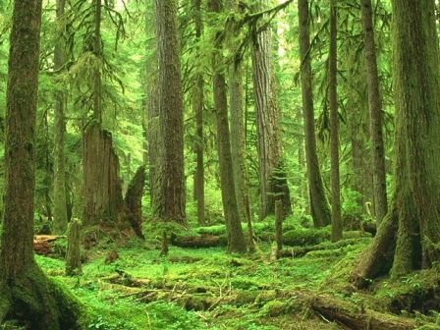

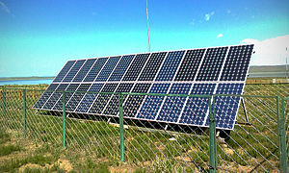
Renewable and Nonrenewable Resources
Humans use their environment for resources, just like other animals.
Environmental resources may be renewable or nonrenewable.
  Renewable resources can regrow if they are alive or be replaced by cycles if they are nonliving.

Slide 5
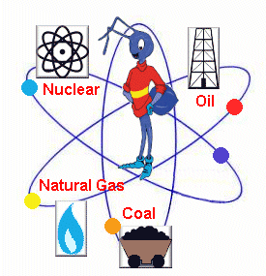
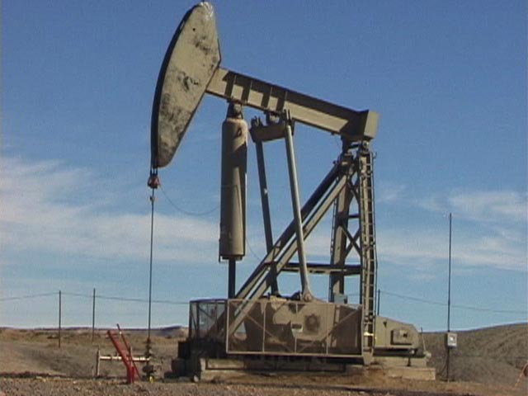
Renewable and Nonrenewable Resources
  Nonrenewable resources, such as fossil fuels, cannot be replaced by natural processes.
No, I don’t get the bug in the center either.

Slide 6
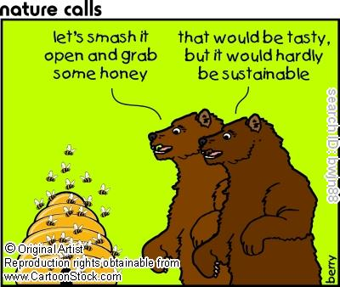

Renewable and Nonrenewable Resources
Sustainable development of renewable resources means using the resources without using them up.

Slide 7
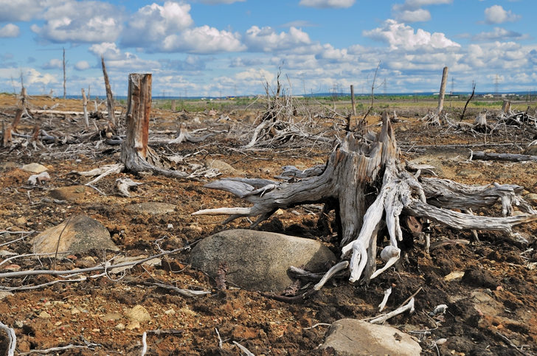

Don’t use up all the RESOURCES

Slide 8
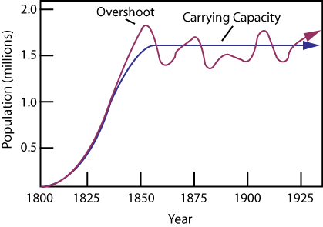
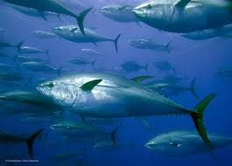
Renewable and Nonrenewable Resources
When we hunt/gather, it is important that we sustain animal/plant populations and do not cause extinction.
  To keep the population sustainable, you take half the carrying capacity of the population.
Blue Fin Tuna

Slide 9
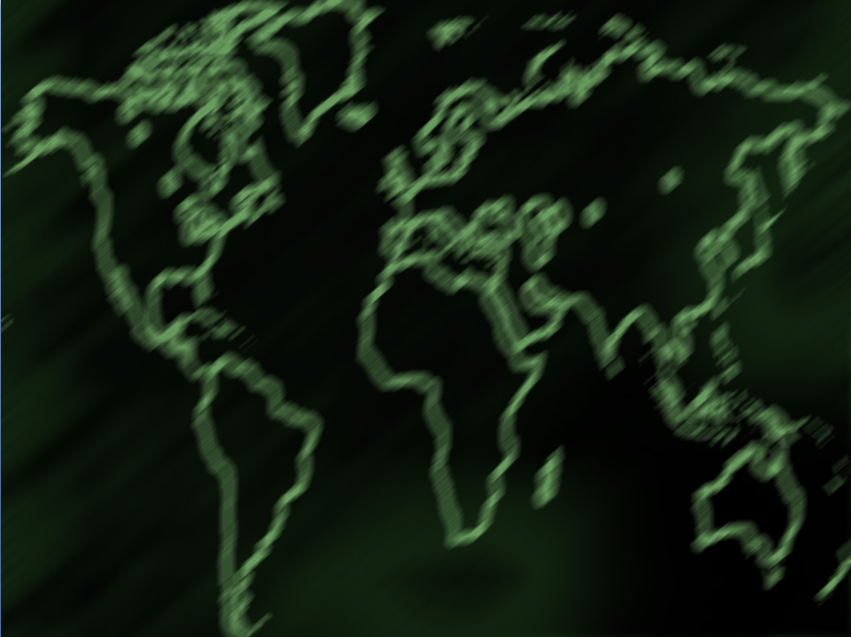
Pollution

Slide 10
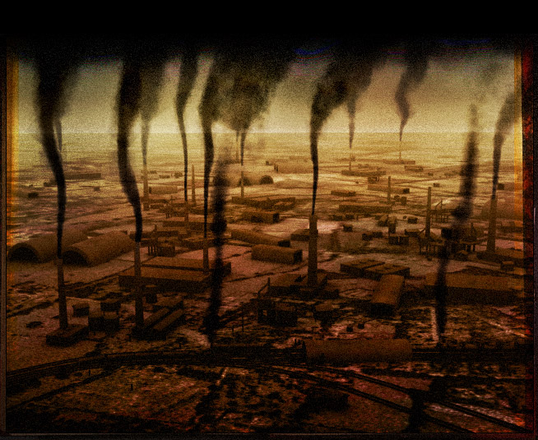

Pollution
Pollution – the contamination of the environment with substances that are harmful to life.

Slide 11

Air Pollution
Burning fossil fuels increases amount of CO₂ in atmosphere.
Having excess CO₂ causes the earth to trap heat.
  Global Warming
more
CO₂

Slide 12
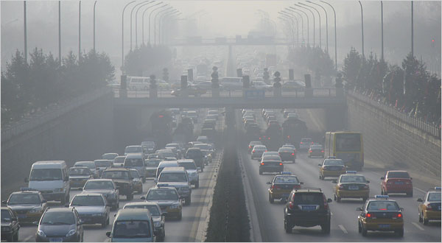
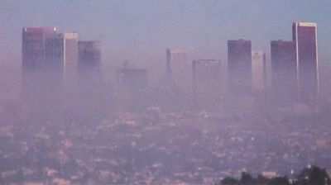
Air Pollution
Smog is a mixture of chemicals that forms a gray-brown haze in the air. It is mainly due to car exhausts and industrial emissions.
  Effects water cycle

Slide 13
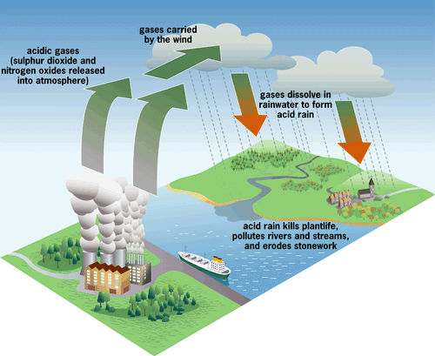
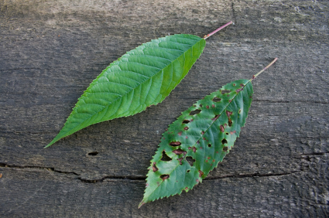
Water Pollution
Burning fossil fuels also releases compounds that combine with water vapor in air and produce acid rain.
Acid rain kills plants
and causes other damage.

Slide 14
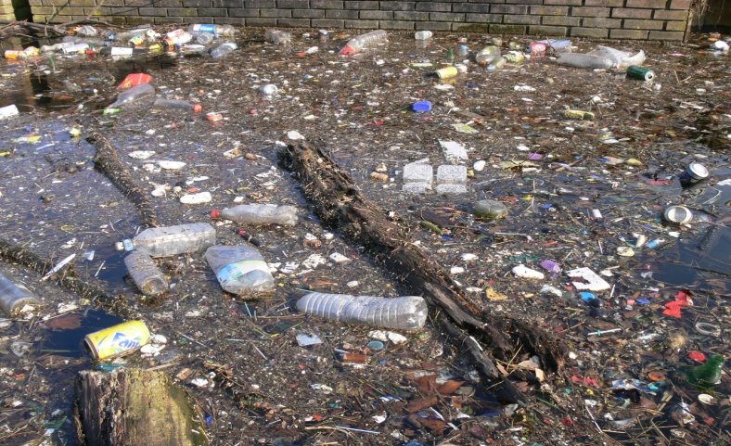
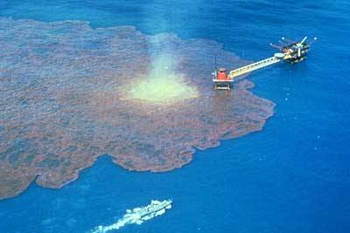
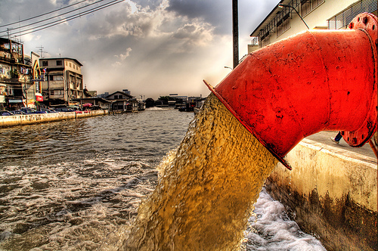
Water Pollution
Wastewater – holding area for pollution runoff
  Contains various discarded chemicals and pollution (herbicides, pesticides, harmful viruses and bacteria)
  CessPool

Slide 15
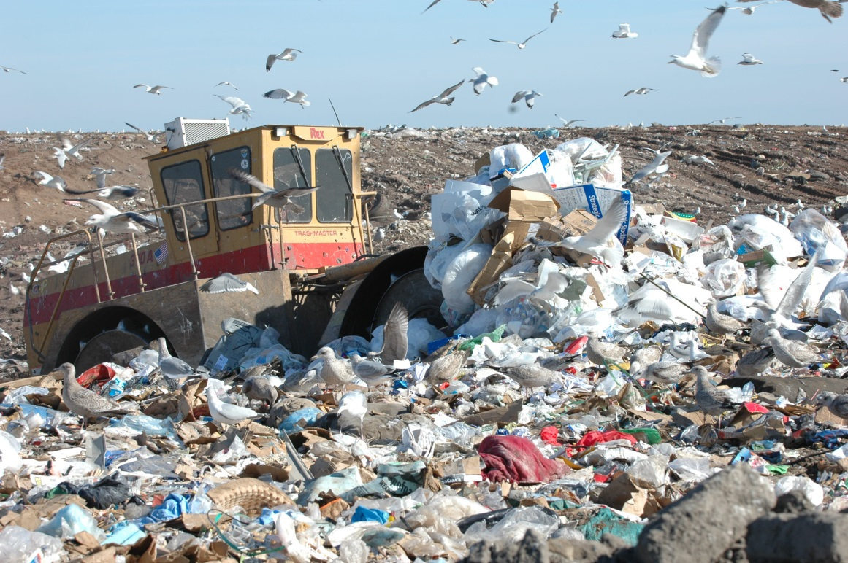
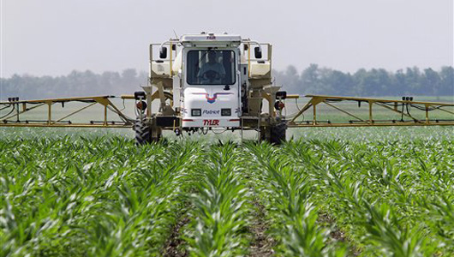
Land Pollution
Agriculture limits biodiversity and can introduce chemicals to the land
Industry and human consumption creates landfills.

Slide 16
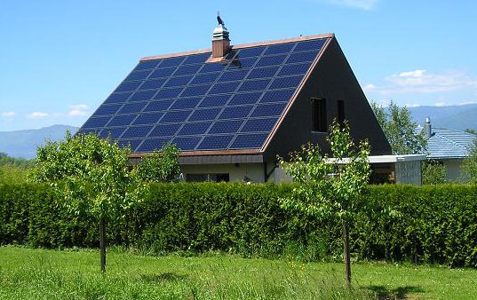

What Can You Do?
Limit industry – don’t consume so much stuff!
REDUCE – REUSE – RECYCLE
Look at alternate forms of energy:
  solar power
  nuclear power
  water power

