Slide 1
Fossil Evidence for Evolution
Unit 10 – Lesson 1

Slide 2
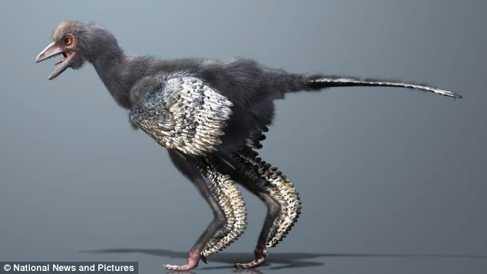
Think About It…
On your way to school, you may have seen an oak tree or a robin, but what would you have seen millions years ago?
NOT an OAK TREE
NOT a ROBIN

Slide 3
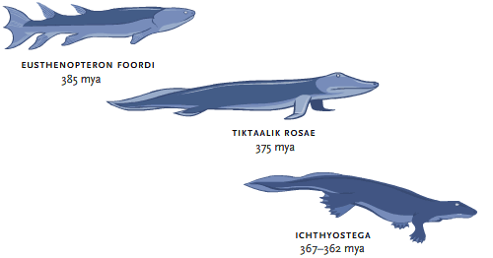
What Is Evolution?
Evolution
  changes in living organisms over time
  explains how modern organisms have descended from ancient organisms

Slide 4
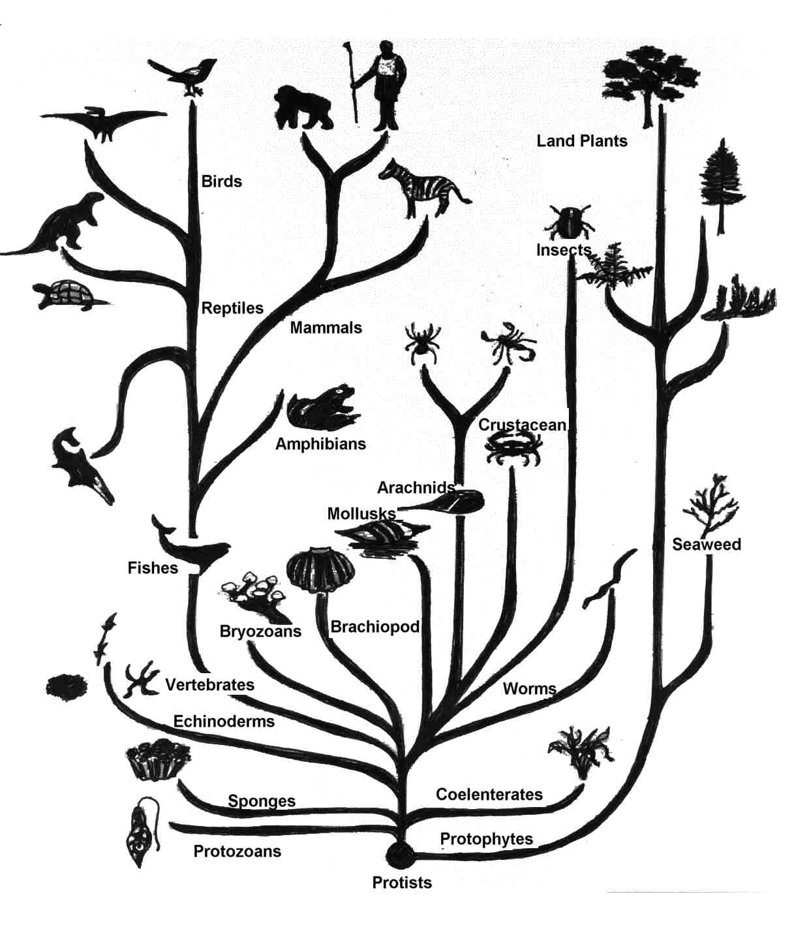

Slide 5
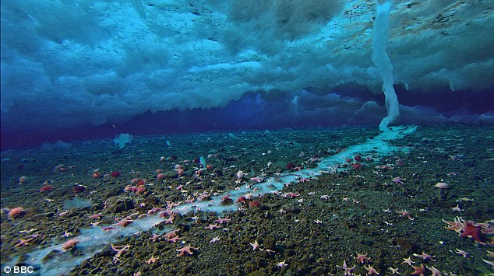
But What Started the
First Life?
People debate and reflect on how the first life was created.
Scientists use the natural world to find proof and evidence:
  Life started with a single cell
  Primordial soup
  Life was brought here from bacteria on a meteor

Slide 6

But What Started the
First Life?
Others use religious belief systems (supernatural) to explain how life started
  Science can not prove beliefs
  There are many belief systems – they are part of human culture

Slide 7
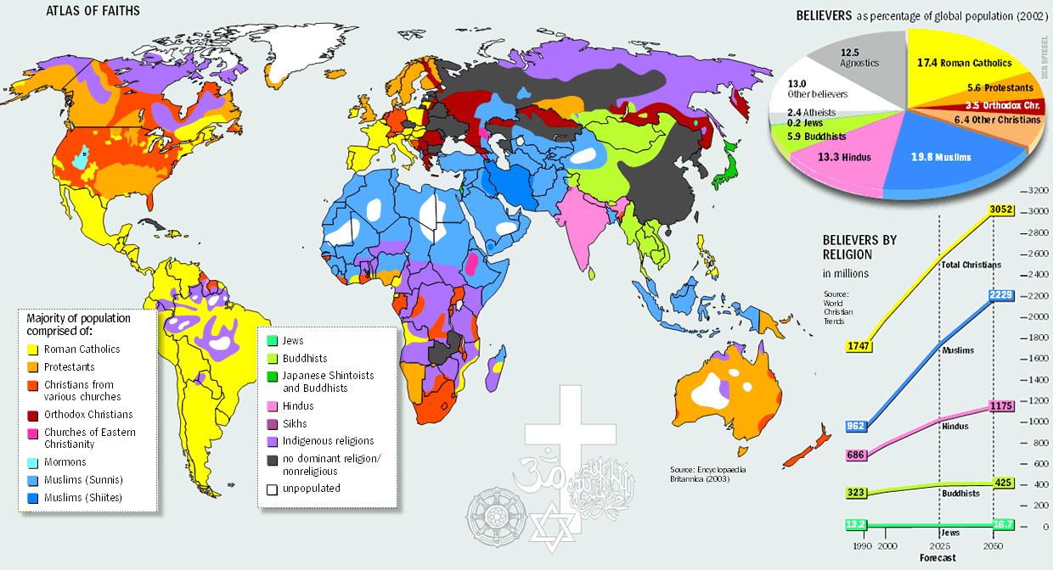

Slide 8
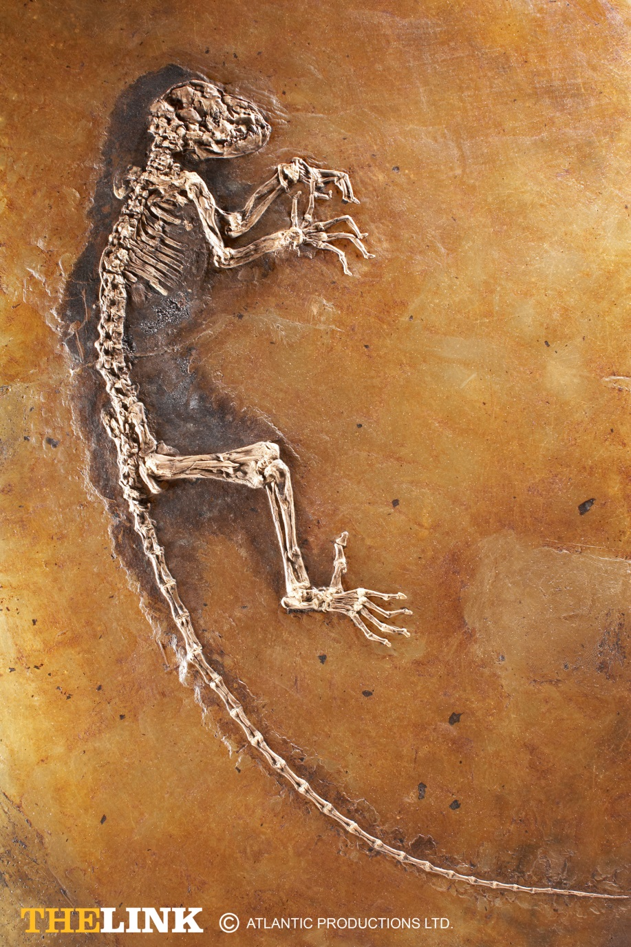
The Fossil Record
Fossils are the remains and evidence of once living things.
Fossil Record – made up of all the fossils ever discovered on Earth

Slide 9
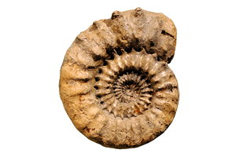
How are Fossils Formed?
There are 5 ways fossils are formed:
  Mineralization – inorganic material replaces organic material

Slide 10
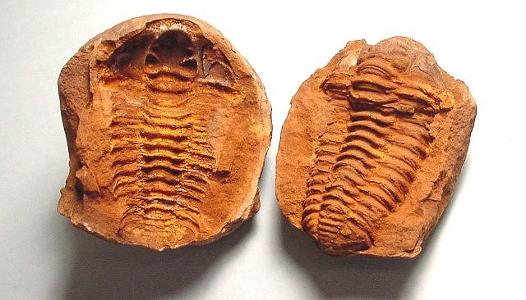
How are Fossils Formed?
  Carbonization – Compression removes all liquids and gases – carbon frame remains
  Molds and Casts – Impressions caused by mud and sand

Slide 11
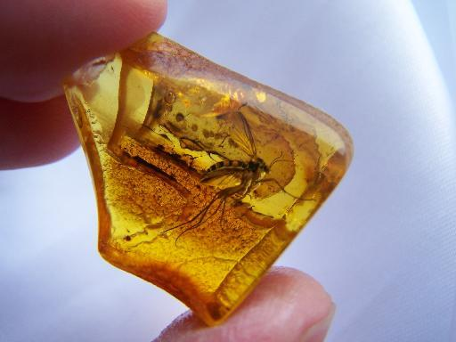
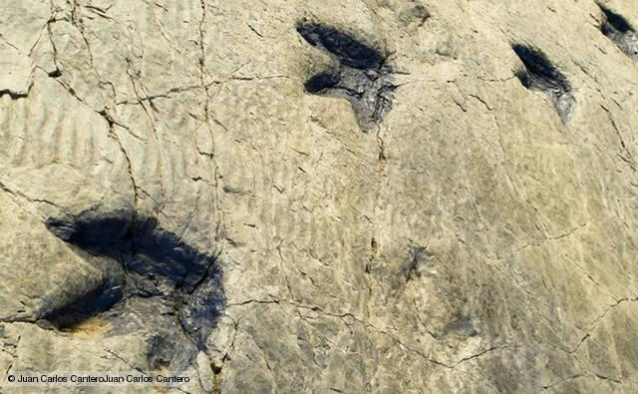
How are Fossils Formed?
  Trace Fossil – preserved evidence of an organisms activity
  Organic Material – organism has preserved tissue

Slide 12
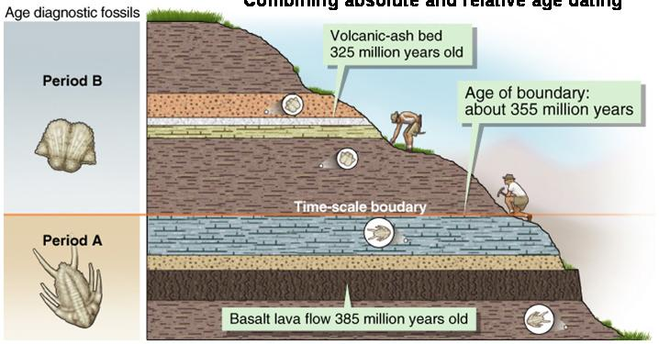
Finding Fossil Age
Scientists cannot date the fossils directly, instead they date the rocks the fossils are embedded inside.
  Relative Age Dating – comparison dating – not precise
  Absolute Age Dating – precise dating by studying chemical composition

Slide 13
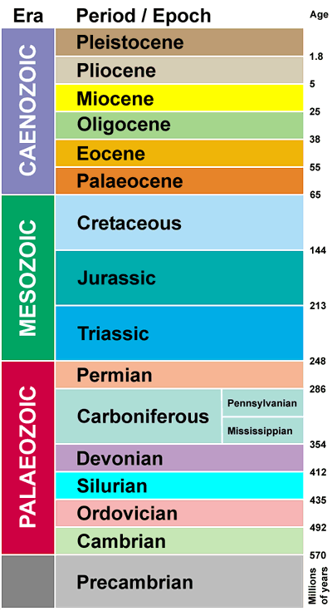
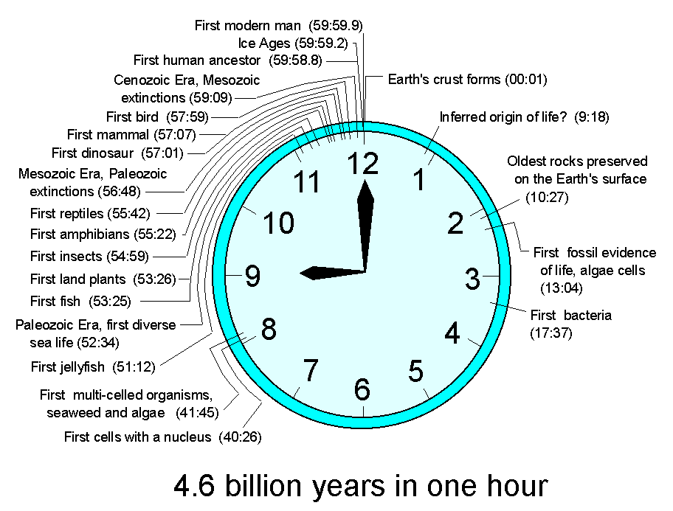
Tracking Fossils Over Time
How do we track the fossils we find?
The geological time scale charts Earths history into different time units.
  Eons
  Eras

Slide 14
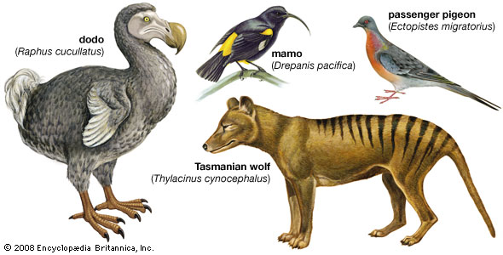
Extinctions
By observing the fossil record, you can see most species are extinct.
99% of all once living species on Earth are now extinct. New species replace them or they die out.

Slide 15
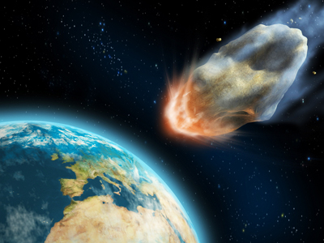
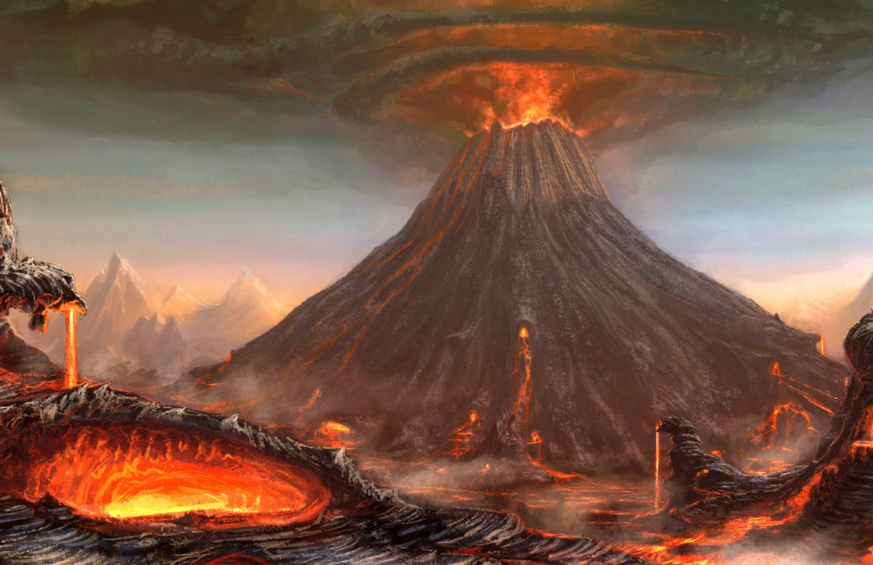
Extinctions
What causes mass extinctions?
  Sudden changes
    Meteorite
    UV radiation
    Volcano
  Gradual changes
    Climate change
    Environmental changes – plate tectonics

Slide 16
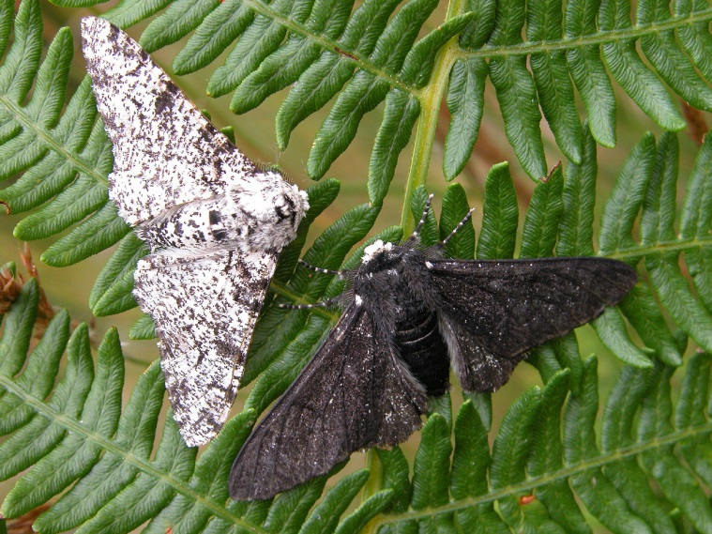
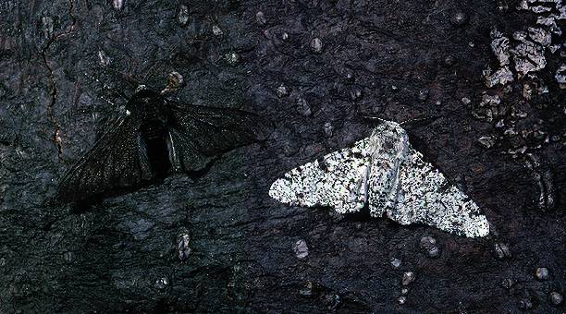
Extinctions
Over time, all these changes can favor one type of species over another.
Observing the change in a species over time is EVOLUTION.

