Slide 1
NUTRITION
believe it or not, you are what you eat…

Slide 2
Question:
What is a heterotroph? What does it mean to be HETEROTROPHIC?
Learning Target: I can list the six main sources of nutrition and describe what they do for the body.

Slide 3
Types of Nutrition
There are six types of nutrients for us heterotrophs:
  Water
  Carbohydrates
  Proteins
  Fats
  Vitamins
  Minerals
Learning Target: I can list the six main sources of nutrition and describe what they do for the body.

Slide 4

Types of Nutrition
Water makes up 60% to 65% of your body.
  involved in nearly every cell and body process
  need 2 liters (8 cups) a day to replace fluid lost
Learning Target: I can list the six main sources of nutrition and describe what they do for the body.

Slide 5
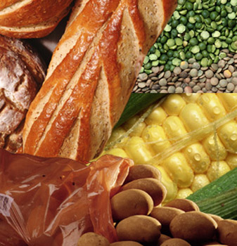
Types of Nutrition
Carbohydrates are the main source of energy for the body.
  simple and complex carbohydrates supply glucose
    simple sugars = instant energy
    complex carbs = long lasting energy, takes longer to get broken down
Learning Target: I can list the six main sources of nutrition and describe what they do for the body.

Slide 6


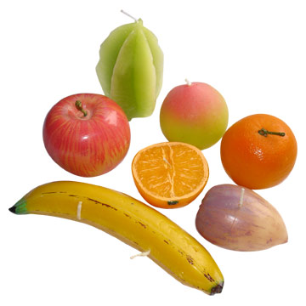
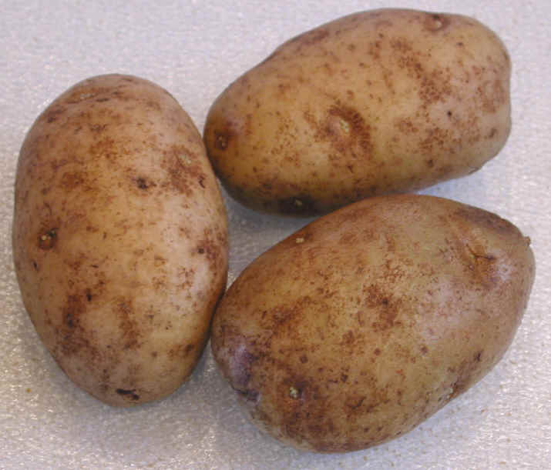
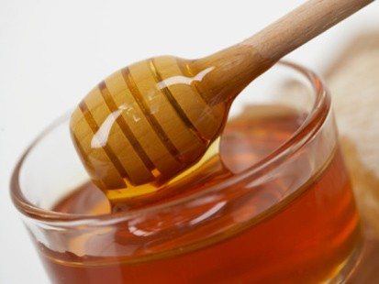
Learning Target: I can list the six main sources of nutrition and describe what they do for the body.
Starch
complex carbohydrate
Glucose
simple sugar
ENZYME

Slide 7
Learning Target: I can list the six main sources of nutrition and describe what they do for the body.
Glucose Starch

Slide 8
Learning Target: I can list the six main sources of nutrition and describe what they do for the body.
Glucose Starch

Slide 9
Learning Target: I can list the six main sources of nutrition and describe what they do for the body.
Glucose Starch

Slide 10
Learning Target: I can list the six main sources of nutrition and describe what they do for the body.
Glucose Starch

Slide 11
Learning Target: I can list the six main sources of nutrition and describe what they do for the body.
Glucose Starch

Slide 12
Types of Nutrition
Fiber from plant foods helps elimination (cellulose).
  These parts are not digested
  They scrape away and clean all the “gunk” from the intestines
    Lots of “gunk” hides in the creases of the villi
Learning Target: I can list the six main sources of nutrition and describe what they do for the body.

Slide 13
Types of Nutrition
Proteins are necessary for growth and repair of the body’s cells.
  body makes 12 out of 20 amino acids
  other eight essential amino acids come from food
Learning Target: I can list the six main sources of nutrition and describe what they do for the body.

Slide 14
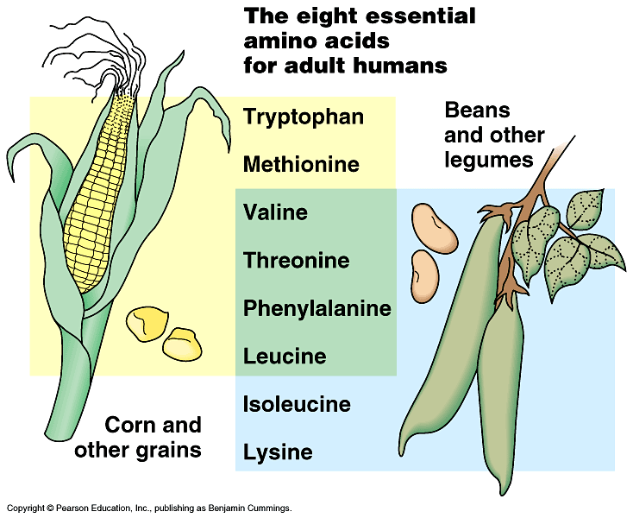
What About Vegetarians
  Grains (like corn) have 6 amino acids
    missing 2
  Beans (like soybean & red beans)
  have 6 amino acids
    missing different 2
  Mix beans & grains
  for complete group of
  amino acids
      rice & beans
      taco/tortilla & beans
      tofu & rice
      peanut butter & bread

Slide 15
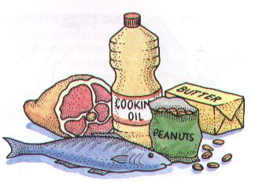
Types of Nutrition
Fats provide energy and key building components.
  fats are saturated and unsaturated
  essential fatty acids come from food
Learning Target: I can list the six main sources of nutrition and describe what they do for the body.

Slide 16
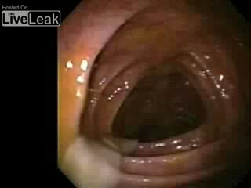
Types of Nutrition
Vitamins are organic molecules that work with enzymes.
  vitamins are fat-soluble and water-soluble
  regulate cell functions, growth, development
  replenished by eating variety of foods
Watch out for TAPEWORMS!
Learning Target: I can list the six main sources of nutrition and describe what they do for the body.

Slide 17
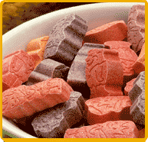
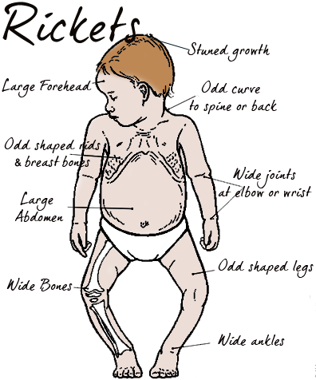
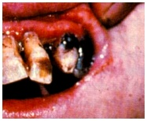
Missing Vitamins
What happens if an animal’s diet is missing an essential vitamin?
    scurvy — vitamin C (collagen production)
    rickets — vitamin D (calcium absorption)

Slide 18
Types of Nutrition
Minerals are inorganic materials that come from plants. They help metabolic reactions in the human body.
Learning Target: I can list the six main sources of nutrition and describe what they do for the body.

Slide 19
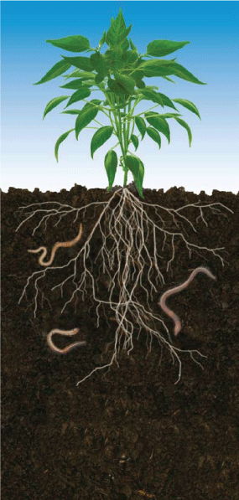
Missing Minerals
What happens if an animal’s diet is missing an essential mineral?
    anemia – missing iron (influences RBCs)
    goiter – missing iodine (influences thyroid)
Minerals are absorbed from the soil by plants!
Learning Target: I can list the six main sources of nutrition and describe what they do for the body.

Slide 20
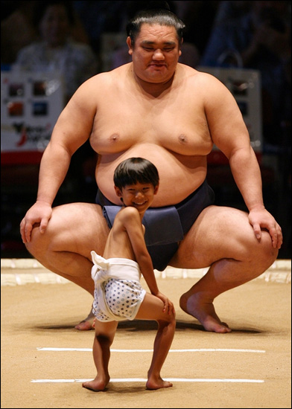
Nutritional Needs
During puberty, you require more nutrients and calories.
Different caloric amounts for different bodies!
Learning Target: I can list the six main sources of nutrition and describe what they do for the body.

Slide 21
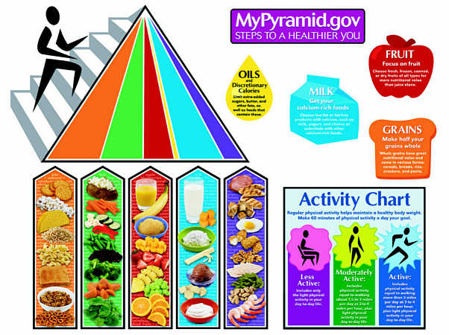
Nutritional Needs
A balanced diet of whole foods provides the best nutrients and calories.
Food and physical activity also need to be balanced.

Slide 22
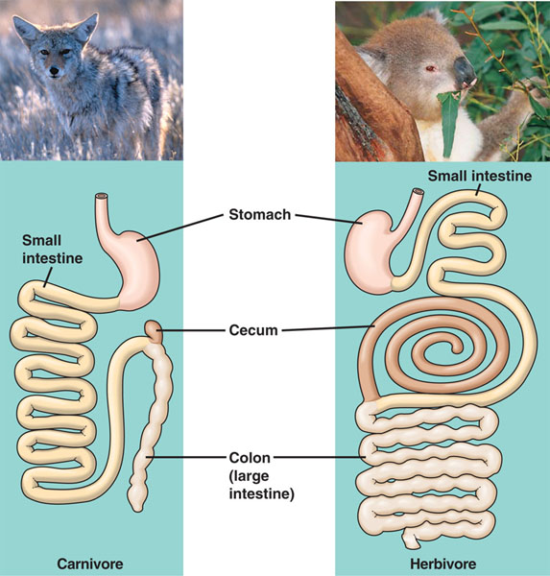
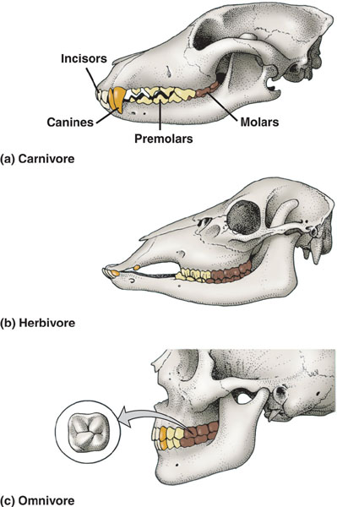

Science of Nutrition
Adaptations caused by nutritional needs:
  Herbivore vs. Carnivore
    teeth
    length of digestive system
    number & size of stomachs

Slide 23
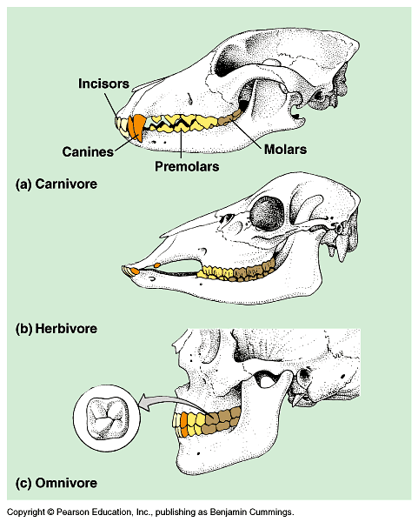
Science of Nutrition
Carnivore
  sharp ripping teeth
  “canines”
Herbivore
  wide grinding teeth
  molars
Omnivore
  both kinds of teeth
Learning Target: I can list the six main sources of nutrition and describe what they do for the body.

Slide 24
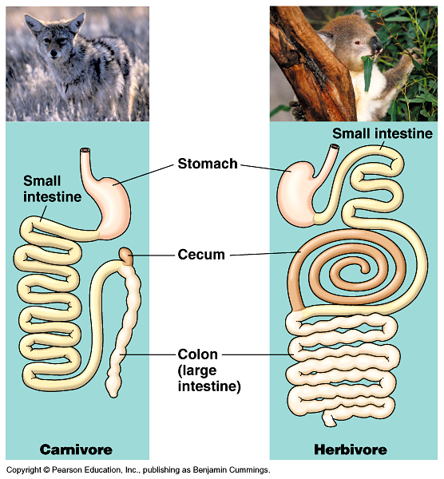
Science of Nutrition
Herbivores & Omnivores
  long digestive
  systems
  harder to digest cellulose (cell walls)
    bacteria in intestines help
Carnivores
  short digestive systems
  protein easier to
  digest than cellulose
appendix

