Slide 1
Properties of Water
I will define characteristics of polar and non-polar molecules. I can describe the characteristics of acids and bases.

Slide 2
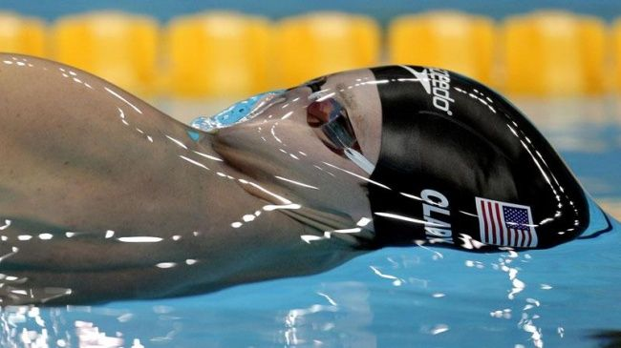
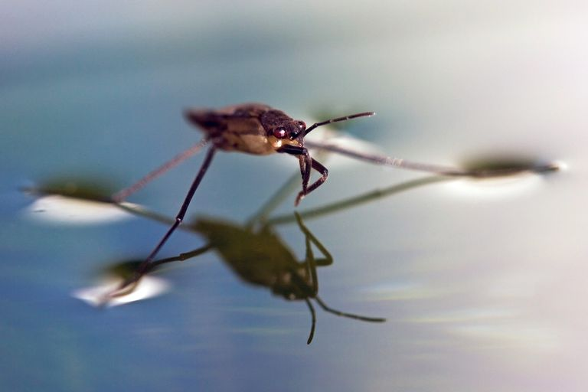
What’s happening here…

Slide 3
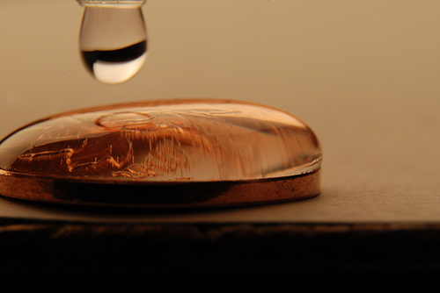
About Water
Life depends on hydrogen bonds in water
Water is a polar molecule.
  Polar molecules have slightly charged regions.
  Nonpolar molecules do not have charged regions.
  Hydrogen bonds form between slightly positive hydrogen atoms and slightly negative atoms.
I will define characteristics of polar and non-polar molecules. I can describe the characteristics of acids and bases.

Slide 4
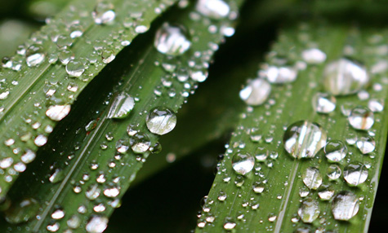
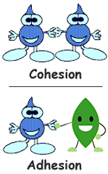
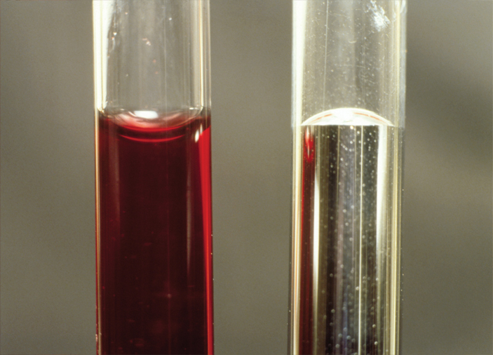
About Water
Hydrogen bonds are responsible for three important properties of water.
  high specific heat (how much heat to raise 1 degree)
  cohesion – similar together
  adhesion – different together

Slide 5
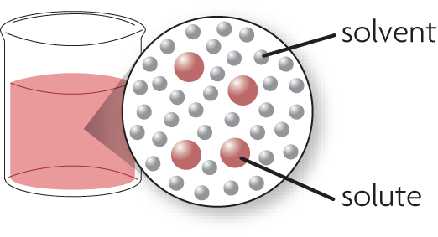
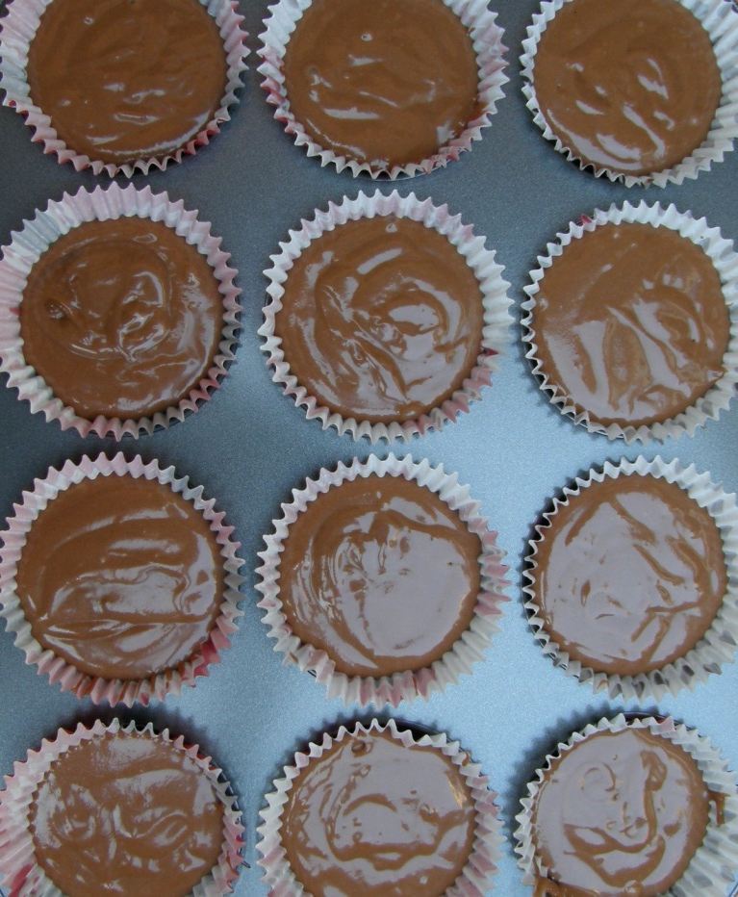
About Solutions
A solution is formed when one substance dissolves in another.
  A solution is a homogeneous (blended) mixture.
  Solvents dissolve other substances.
  Solutes dissolve in a solvent.
I will define characteristics of polar and non-polar molecules. I can describe the characteristics of acids and bases.

Slide 6
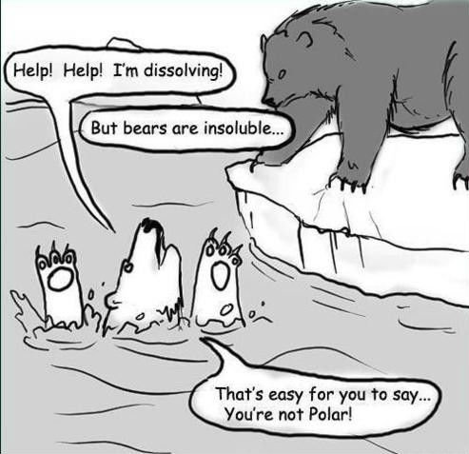
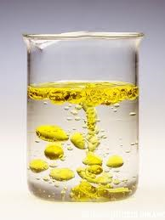
About Solutions
“Like dissolves like.”
  Polar solvents dissolve polar solutes.
  Nonpolar solvents dissolve nonpolar solutes.
  Polar substances and nonpolar substances generally remain separate.
    Ex) oil and water
I will define characteristics of polar and non-polar molecules. I can describe the characteristics of acids and bases.

Slide 7
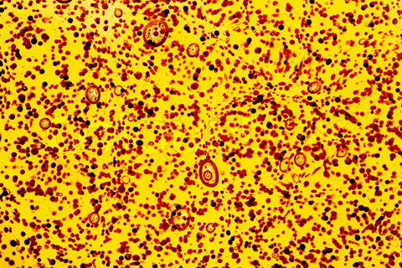
About Solutions
A suspension is a mixture of water and nondissolved material.
Some materials do not dissolve when placed in water but separate into pieces so small that they do not settle out.
  ex) ketchup
  ex) blood
I will define characteristics of polar and non-polar molecules. I can describe the characteristics of acids and bases.

Slide 8
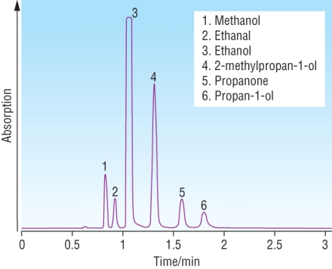
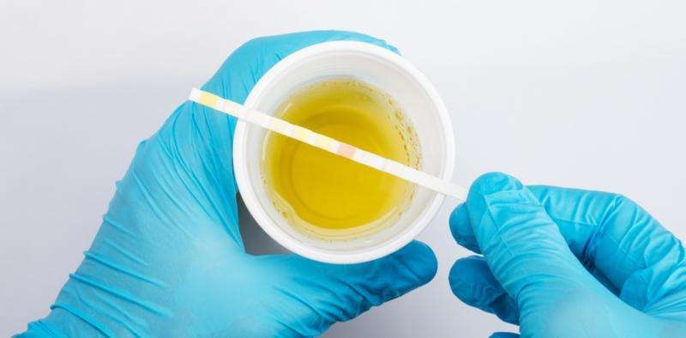
Chromatography
What is CHROMOTAGRAPHY? Technique used to separate a chemical mix into its parts based on their polarity.
Determine the presence of:
  Cocaine in urine
  Alcohol in blood
  PCB's in fish
  Lead in water
  Pregnancy Tests

Slide 9
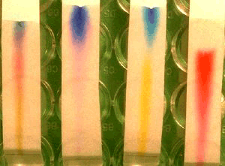
Chromatography
In PAPER CHROMATOGRAPHY, capillary action carries a solvent up the paper. (The solvent moves by polarity.)
  Molecules with tighter attraction to the paper will not go as far
  Molecules with a tighter attraction to the solvent.
I will define characteristics of polar and non-polar molecules. I can describe the characteristics of acids and bases.

Slide 10
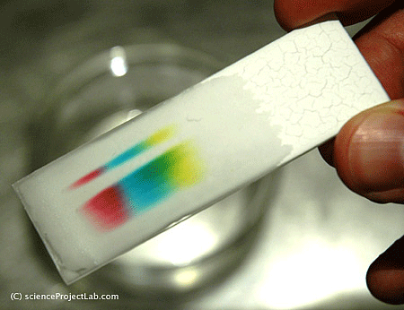
Chromatography
If water is the solvent:
  The molecules that are more polar (like water) will be carried farthest by water.
  The molecules that are least polar will go the shortest clinging tight to the paper
Demo with Markers
and pH paper
http://www.youtube.com/watch?v=3ZP_E0eTmMU

Slide 11
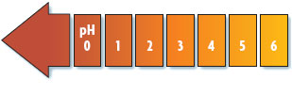
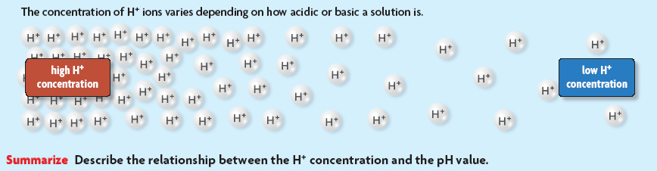
Acids and Bases
Some compounds form acids or bases.
An acid releases a hydrogen ion when it dissolves in water.
  high H⁺ concentration
  pH less than 7
More Acidic!
Acidic!

Slide 12
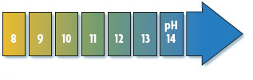
Acids and Bases
A base removes hydrogen ions from a solution.
  low H+ concentration
  pH greater than 7
More Basic
Basic!

Slide 13
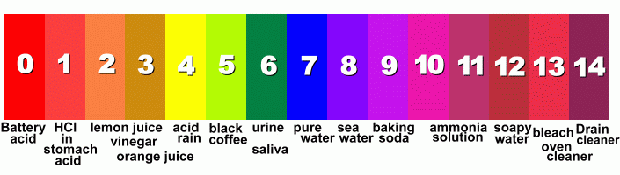
Acids and Bases
A neutral solution has a pH of 7.
  water
ACIDIC
NEUTRAL
BASIC
NEUTRAL

Slide 14
Acids and Bases
How can you tell if something is acidic or basic?
  USE INDICATORS
Litmus Paper
  Turns red in the presence of acids
  Turns blue in the presence of bases
I will define characteristics of polar and non-polar molecules. I can describe the characteristics of acids and bases.

Slide 15
Acids and Bases
Buffers are weak acids or bases that can react with strong acids or bases to prevent sharp, sudden changes in pH.
http://www.youtube.com/watch?v=WnPrtYUKke8
I will define characteristics of polar and non-polar molecules. I can describe the characteristics of acids and bases.

