Slide 1
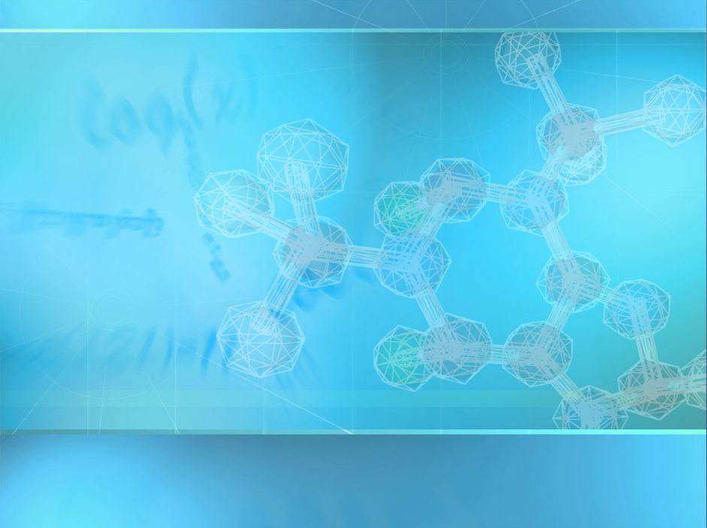

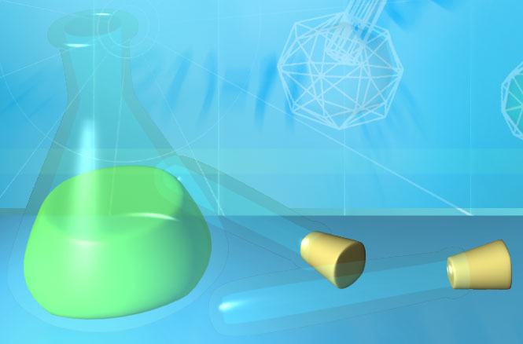
Intro to Chemistry
It’s the building blocks for life!
I can list the components of atoms and describe how they are organized.
I will distinguish between organic and inorganic molecules.

Slide 2

How does this happen?

Slide 3

Why Study Chemistry?
Chemistry if the foundation of Biology!
Everything is made of matter.
Matter is made of atoms. Atoms consist of:
  Protons (+)
  Neutrons (0)
  Electrons (-)
-
+
+
+
-
cHaRgEs
-
I can list the components of atoms and describe how they are organized.
I will distinguish between organic and inorganic molecules.

Slide 4

http://www.youtube.com/watch?v=yQP4UJhNn0I
http://www.youtube.com/watch?v=yQP4UJhNn0I

Slide 5
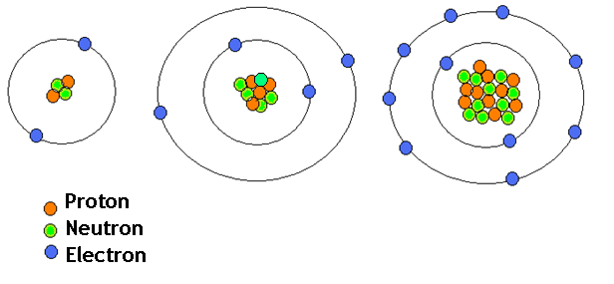
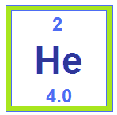
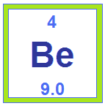
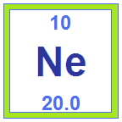
Why Study Chemistry?
The number of protons in an atom will determine what element it is!

Slide 6
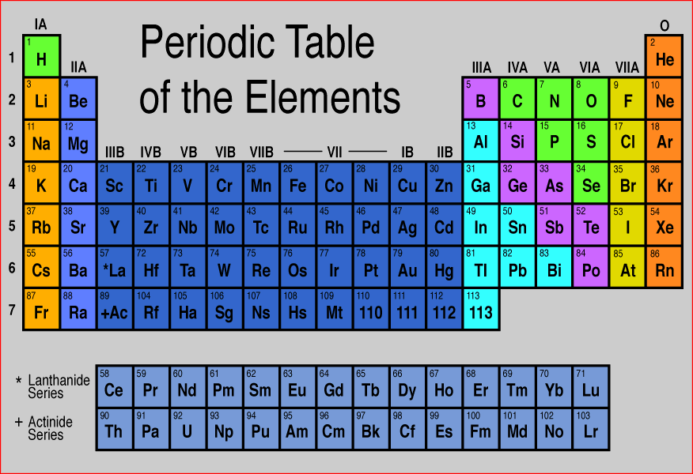
The World of Elements
H
C
N
O
Na
Mg
P
S
Periodic Song
K
Ca
Different kinds of atoms = elements

Slide 7
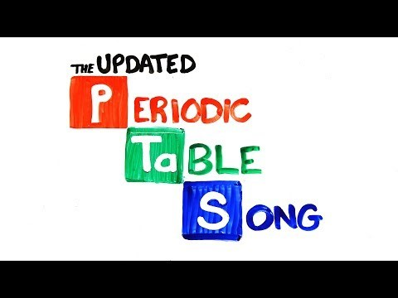

Slide 8
Life Requires Elements
About 25 elements are essential for life
  Four elements make up 96% of living matter:
    • carbon (C) • hydrogen (H)
    • oxygen (O) • nitrogen (N)
  Four elements make up most of remaining 4%:
    • phosphorus (P) • calcium (Ca)
    • sulfur (S) • potassium (K)
I can list the components of atoms and describe how they are organized.
I will distinguish between organic and inorganic molecules.

Slide 9
Bonding Properties
Effect of electrons
  electrons determine the chemical behavior of atom
  depends on number
  of electrons in atom’s outermost shell
    valence shell
How does this
atom behave?

Slide 10
Bonding Properties
  The inner most shell needs 2 electrons to be stable
  The rest of the shells need 8 electrons to be stable
How will these atoms behave?
unstable…reactive
needs to take 2 electrons
unstable…reactive
needs to give 2 electrons
Notes:
Sulfur on the LEFT
Magnesium on the RIGHT

Slide 11
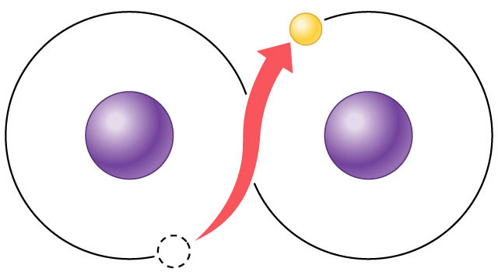
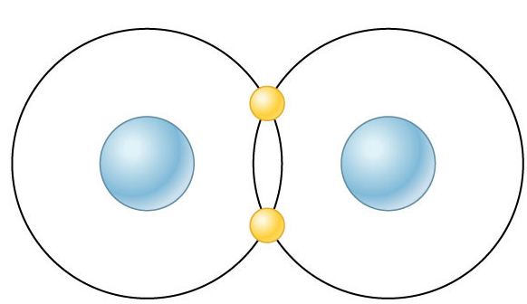
Chemical Reactivity
Atoms tend to
  complete a partially filled valence shell
  or
  empty a partially filled valence shell
This tendency drives chemical reactions…
and creates bonds
–
–
–
ionic bond
covalent bond

Slide 12
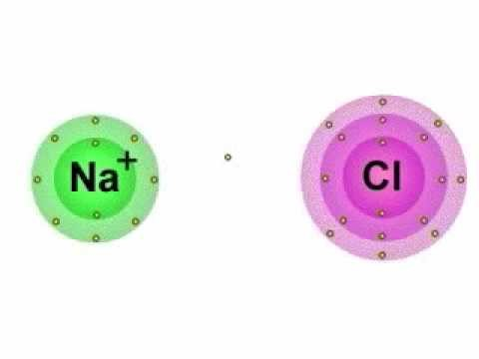

Slide 13
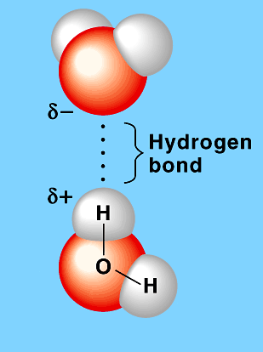
Bonds in Biology
Bonds in Biology
Hydrogen bond
Weak bonds
  hydrogen bonds
  Ionic
Strong bonds
  covalent bonds
H₂O
Covalent bond
H₂O
–
–
H₂ (hydrogen gas)
I can list the components of atoms and describe how they are organized.
I will distinguish between organic and inorganic molecules.

Slide 14
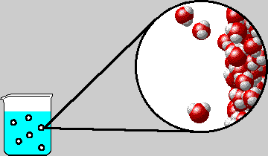
Hydrogen Bonds
Polar water creates molecular attractions
  attraction between positive H in one H₂O molecule to negative O in another H₂O
  also can occur wherever
  an -OH exists in a larger
  molecule
Weak bond
H
H
O
I can list the components of atoms and describe how they are organized.
I will distinguish between organic and inorganic molecules.
Notes:
APBio/TOPICS/Biochemistry/MoviesAP/03_02WaterStructure_A.swf

Slide 15
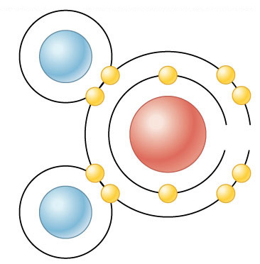
Covalent Bonds
Why are covalent bonds strong bonds?
  two atoms share a pair of electrons
  both atoms holding onto the electrons
  very stable
Forms molecules
H
–
H
H — H
O
Oxygen
H
–
H
H₂ (hydrogen gas)
H₂O (water)

Slide 16
Molecules You Need To Know
CO₂ = Carbon Dioxide
CO = Carbon Monoxide ← this will kill you
H₂O = Water
C₆H₁₂O₆ = Sugar (glucose)
O₂ = Oxygen
NH₂ = Ammonia
N₂ = Nitrogen

Slide 17
Bonds Determine Shape!
Bonds can determine the shape of a molecule. Draw bonds for the following molecules:
  Carbon Dioxide
  Water
  Sugar
I can list the components of atoms and describe how they are organized.
I will distinguish between organic and inorganic molecules.
Notes:
APBio/TOPICS/Biochemistry/MoviesAP/03_02WaterStructure_A.swf

Slide 18
Carbon Dioxide
carbon
oxygen
I can list the components of atoms and describe how they are organized.
I will distinguish between organic and inorganic molecules.

Slide 19
Water
hydrogen
oxygen
I can list the components of atoms and describe how they are organized.
I will distinguish between organic and inorganic molecules.

Slide 20
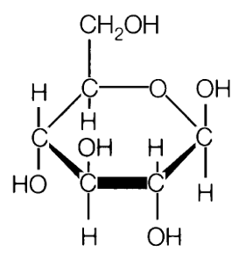
Sugar
carbon
hydrogen
oxygen
I can list the components of atoms and describe how they are organized.
I will distinguish between organic and inorganic molecules.

Slide 21
Organic Molecules
Organic molecules are the building blocks found in ALL LIVING THINGS.
To be organic, the molecule contains the elements C and H together.
Inorganic molecules do NOT contain carbon and hydrogen together.
O₂
CH₄
CO₂
C₆H₁₂O₆
H₂O

