Slide 1
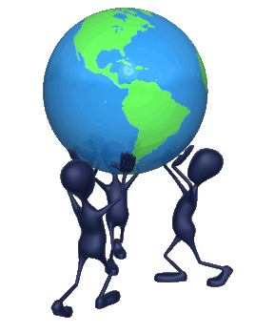
Human Impact
How do we influence the environment?

Slide 2

Changing Landscape
All organisms on Earth share limited resources.
They also depend on ecological processes, such as the water cycle, that sustain the resources.
To protect these resources and processes, we must know how humans interact with the biosphere.
Humans have become the most important source of environmental change.

Slide 3
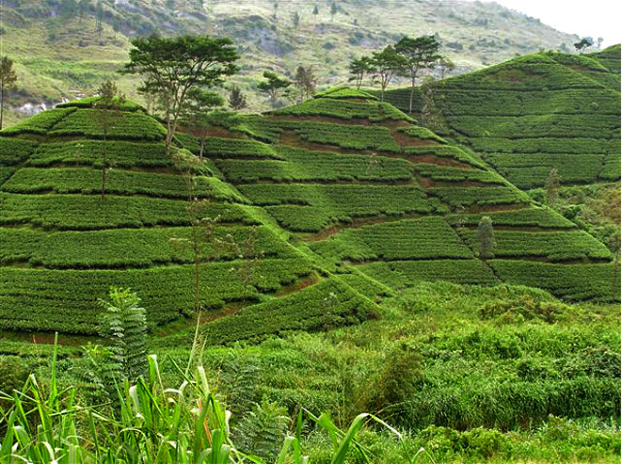
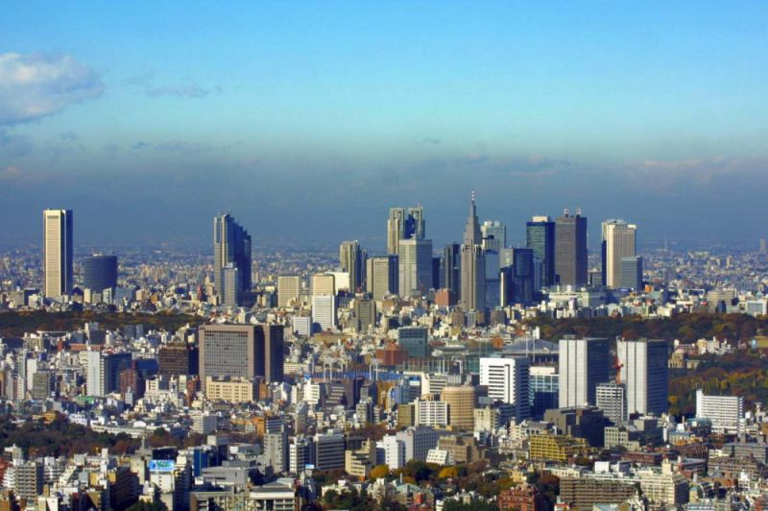
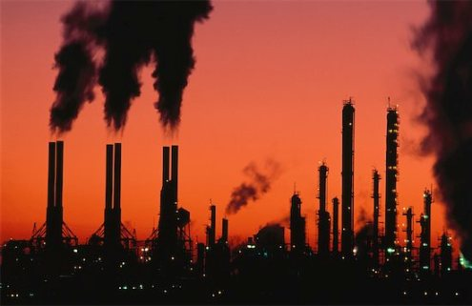
Changing Landscape
They affect the biosphere through hunting and gathering, agriculture, industry, and urban development.

Slide 4
Changing Landscape
Advances in agriculture included the development of pesticides and monoculture—the planting of large fields with the same crop year after year.
  DDT

Slide 5
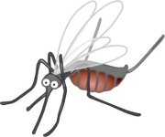




low concentration of DDT
medium concentration
of DDT
high concentration
of DDT

Slide 6
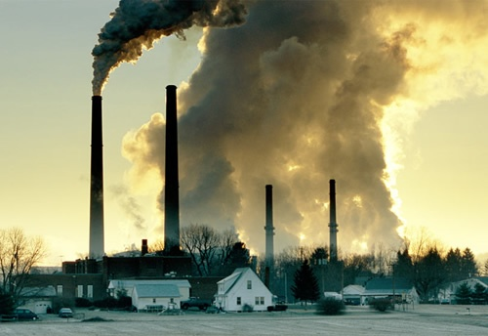
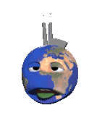
Changing Landscape
After the Industrial Revolution, machines and factories increased the human impact on the biosphere.
Industry used more resources and produced more pollution than ever before.

Slide 7
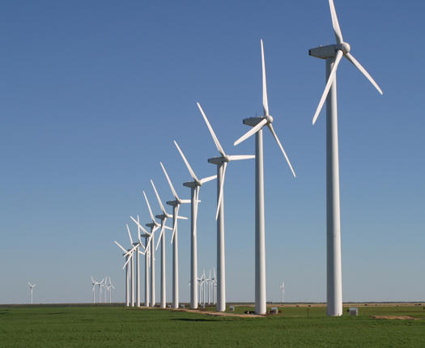
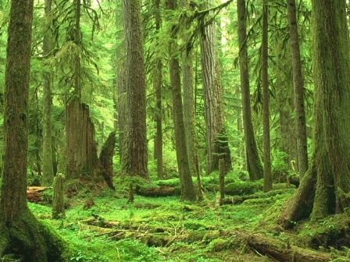

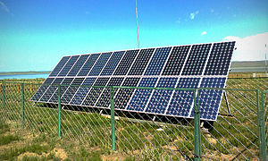
Renewable and Nonrenewable Resources
Environmental resources may be renewable or nonrenewable.
  Renewable resources can regrow if they are alive or be replaced by biochemical cycles if they are nonliving.

Slide 8
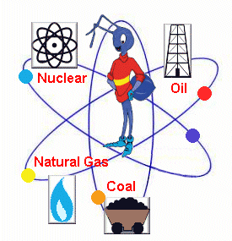
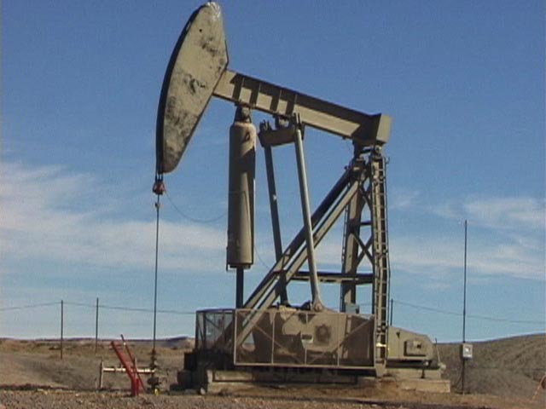
Renewable and Nonrenewable Resources
  Nonrenewable resources, such as fossil fuels, cannot be replaced by natural processes.
No, I don’t get the bug in the center either.

Slide 9
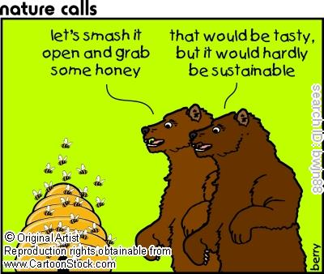

Renewable and Nonrenewable Resources
Sustainable development of renewable resources means using the resources without using them up.

Slide 10
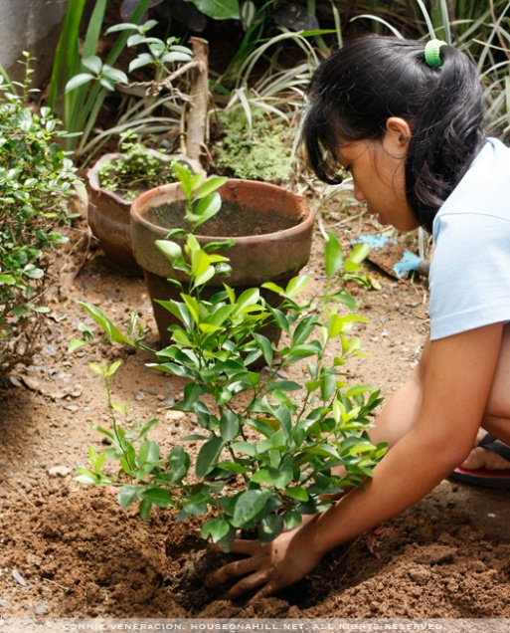
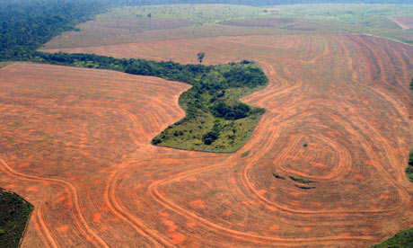

Renewable and Nonrenewable Resources
Forests provide wood, oxygen, and other important resources. Forests are being used up rapidly.
Loss of forests is called deforestation.
Sustainable development of forests includes planting trees to replace those that are cut down.

Slide 11
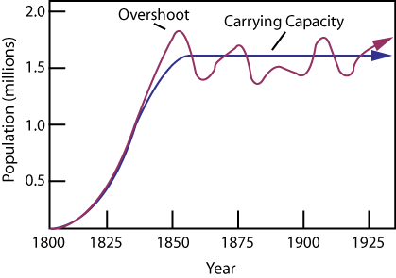
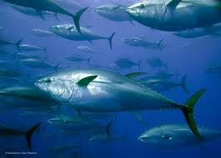
Renewable and Nonrenewable Resources
When we hunt/gather, it is important that we sustain animal/plant populations and do not cause extinction.
  To keep the population sustainable, you take half the carrying capacity of the population.
Blue Fin Tuna

Slide 12
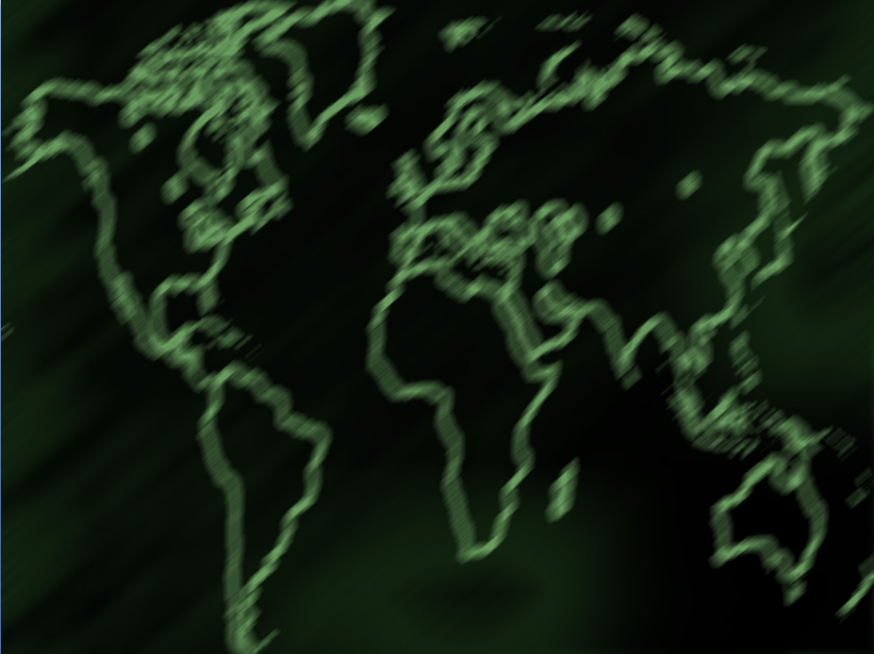
Pollution

Slide 13
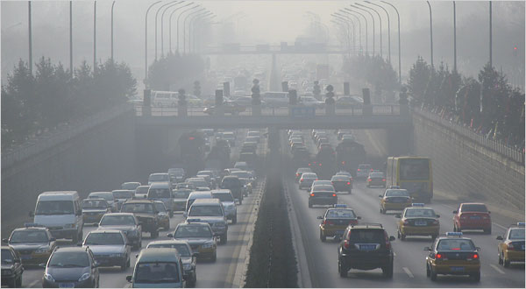
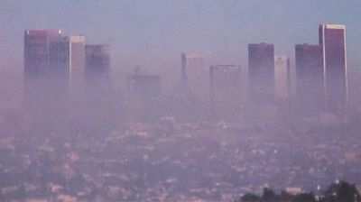
Pollution
Smog is a mixture of chemicals that forms a gray-brown haze in the air. It is mainly due to car exhausts and industrial emissions.
Smog is considered a pollutant.
A pollutant is a harmful material that can enter the biosphere through land, air, or water.

Slide 14
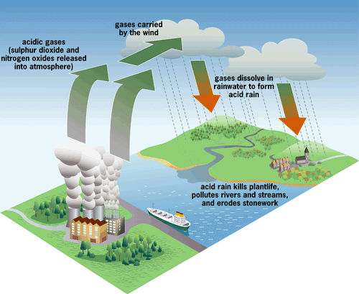
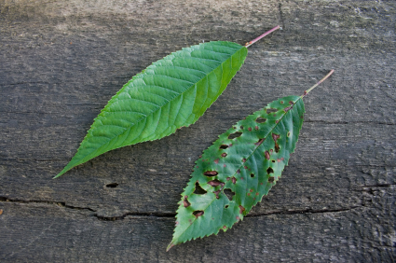
Pollution
Burning fossil fuels also releases compounds that combine with water vapor in air and produce acid rain.
Acid rain kills plants
and causes other
damage.

Slide 15
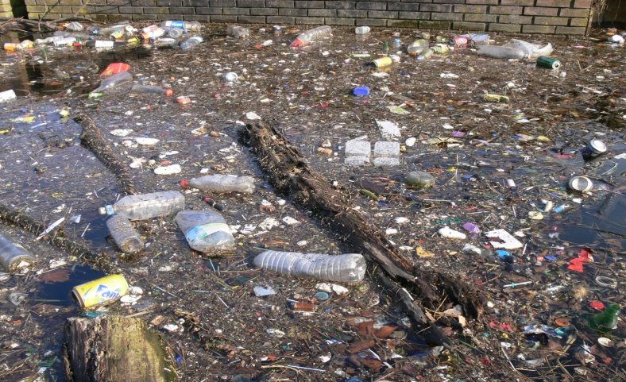
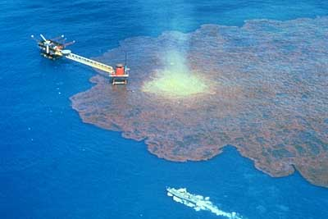
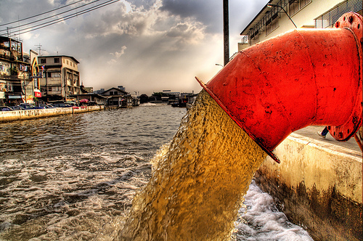
Pollution
Water supplies can be polluted by sewage, oil spills, or discarded chemicals.

Slide 16
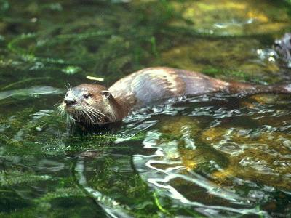
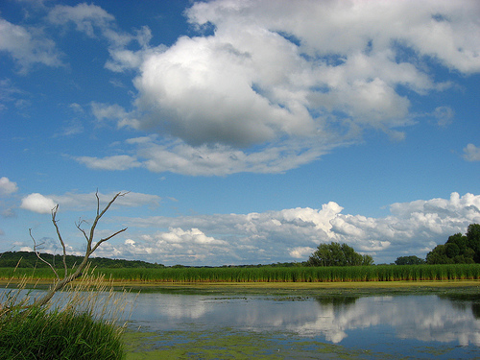
Pollution
Sustainable development of water includes protecting the water cycle.
Wetlands play an important role in the water cycle. Thus, protecting wetlands is one way to sustain water resources.

Slide 17

Biodiversity

Slide 18
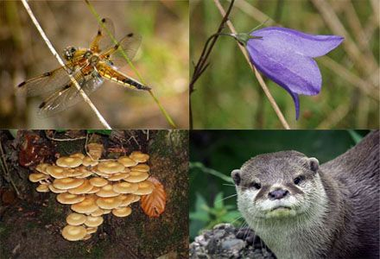
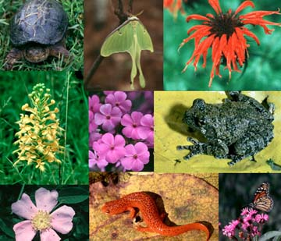
Biodiversity
Biological diversity, or biodiversity, is the sum of the genetically based variety of all organisms in the biosphere.

Slide 19
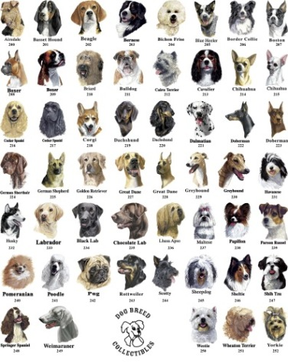
Biodiversity
Genetic diversity refers to all the different forms of genetic information carried by all organisms living on Earth today.
Biodiversity is one of Earth’s greatest natural resources.

Slide 20
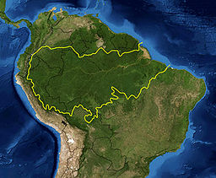
Biodiversity
Diverse species have provided humans with foods, industrial products, and medicines.
Humans reduce biodiversity by destroying habitats, hunting species to extinction, introducing toxic compounds into food webs, and introducing foreign species into new environments.

Slide 21
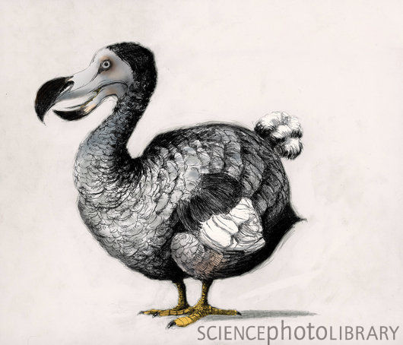
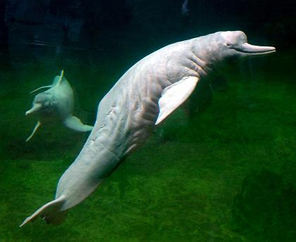
Biodiversity
Extinction occurs when a species disappears from all or part of its range.
An endangered species is a species whose population size is declining in a way that places it in danger of extinction.

Slide 22
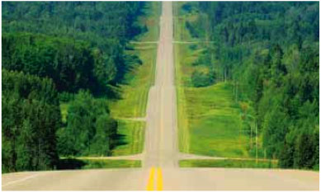
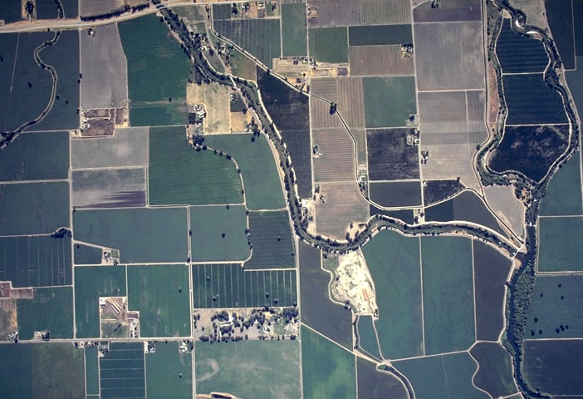
Biodiversity
As humans destroy habitats, the species that once lived in the habitats die out.
The smaller the pieces of habitat, the less likely that their species will be able to survive.

Slide 23
Biodiversity
Pollution can seriously threaten biodiversity.
Toxic compounds build up in the tissues of organisms.
Concentrations of toxins increase in organisms at higher trophic levels in a food chain or food web.
This is called biological magnification.

Slide 24
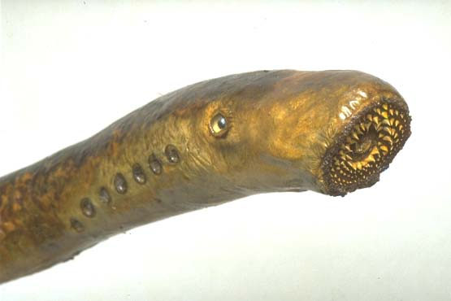
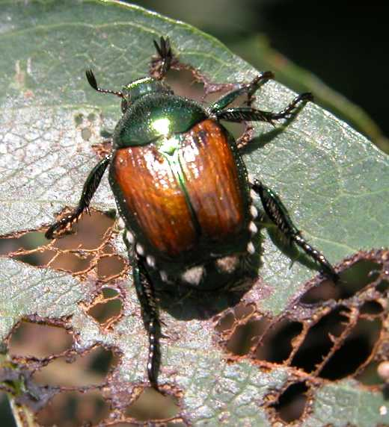
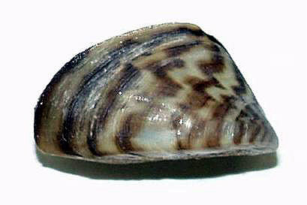
Biodiversity
Plants and animals introduced from other areas are an important threat to biodiversity.
Introduced organisms often become invasive species.
Invasive species increase rapidly because their new habitat lacks the parasites and predators that control their population “back home.”

Slide 25
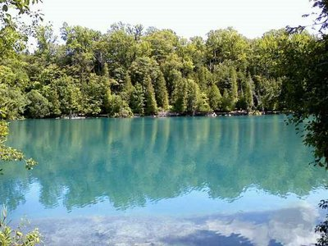
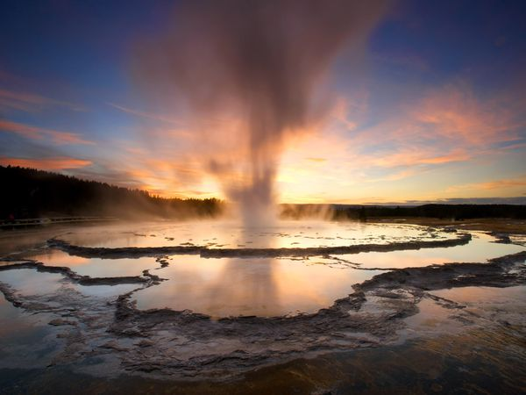
Biodiversity
Conservation focuses on protecting entire ecosystems as well as single species.
Protecting entire ecosystems ensures that many species are preserved.

Slide 26
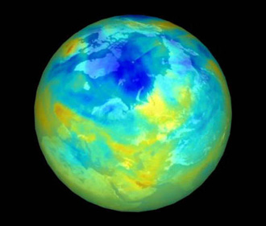
Charting a Course for the Future
The ozone layer is an area of relatively great concentration of ozone gas high in the atmosphere.
The layer protects Earth from harmful radiation.
The ozone layer has been damaged by compounds in certain products.
The compounds have now been
banned.

Slide 27
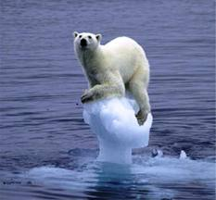
Charting a Course for the Future
Global warming refers to the increase in average temperature of the biosphere.
  It is mainly due to humans burning fossil fuels.
  Burning adds gases to the atmosphere, causing the atmosphere to retain more heat.
  Continued global warming may lead to rising sea levels and coastal flooding, among other environmental changes.

Slide 28

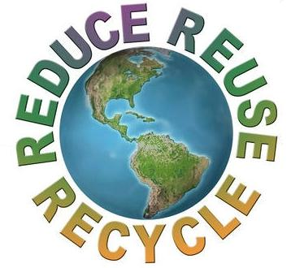
Charting a Course for the Future
People can help maintain the health of the biosphere by conserving resources.
For example, they can avoid using more water than necessary.
They can also reuse or recycle trash.
    Three R’s
        REDUCE
        REUSE
        RECYCLE

