Slide 1
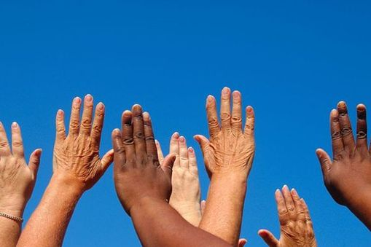
Human Body Systems
The Skin

Slide 2
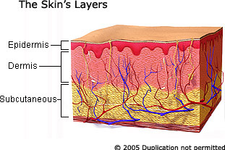
Three Layers of Tissue
The skin is made up of three layers of tissues.
  Epidermis, dermis, fatty layer (subcutaneous)

Slide 3
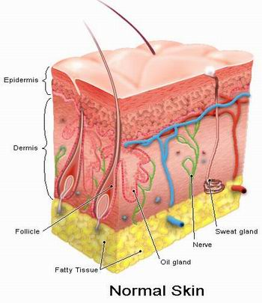
Epidermis
  Epidermis – outer, thinnest layer.
      a. The outermost cells are dead and water repellent.
      New cells are produced at the base and move up to replace ones rubbed off.

Slide 4
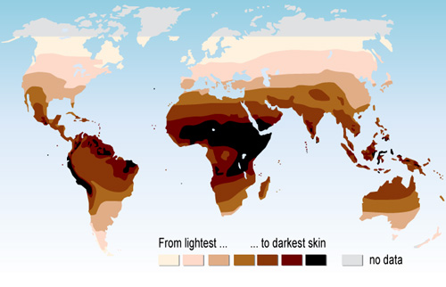
Epidermis
      c. Melanin – a pigment that protects your skin and gives it color (located in the epidermis). When skin is exposed to UV rays, melanin production increases and your skin becomes darker.

Slide 5
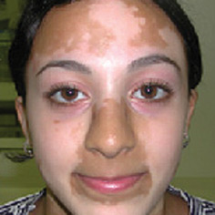
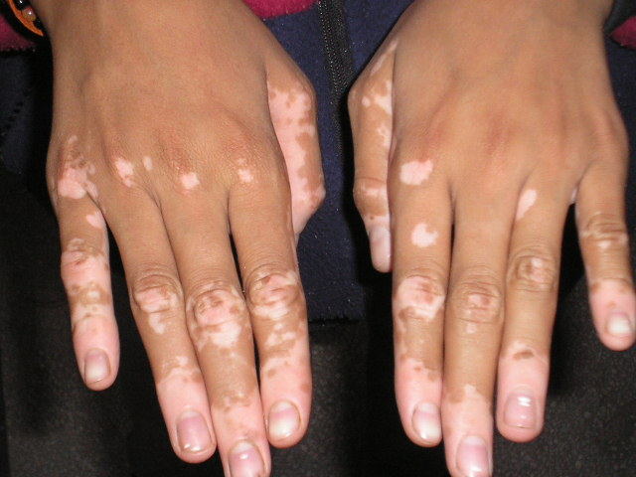
Vitiligo
When melanocytes die, or do not function properly.

Slide 6
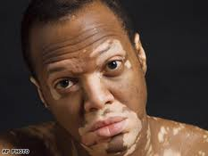
Vitiligo
YouTube / Video Link

Slide 7
Epidermis
Your skin is the largest organ of your body. It is also your largest sensory organ.
STOP, PAUSE….
Take a DEEP BREATH
You just breathed in dead skin cells from your neighbor! Dead dermis cells make up a large portion of ‘dust’.

Slide 8
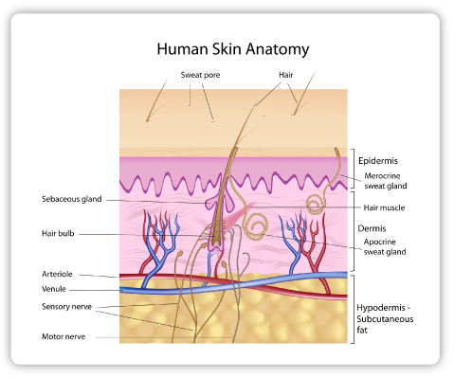
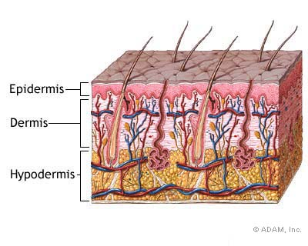
Dermis
  Dermis – Located directly below the epidermis.
      Contains blood vessels, nerves, muscle, oil, sweat glands, and other structures.

Slide 9
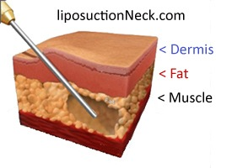
Fatty Layer
  3. Fatty Layer – insulates body
    → Think babies and sumo wrestlers….

Slide 10
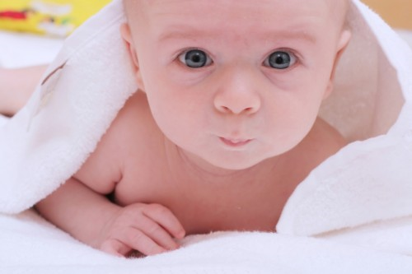
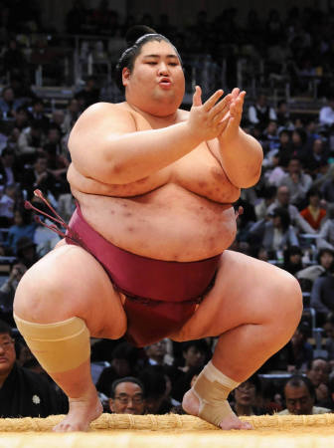

Slide 11
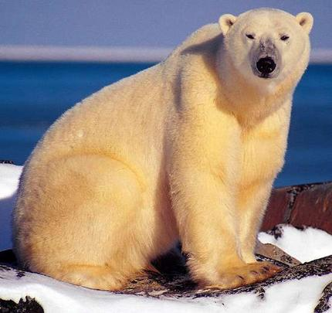
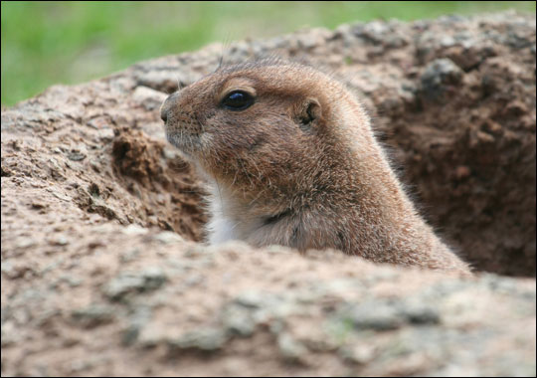
More Fatty Layers…
Fatty layers are key in terms of animal hibernation…

Slide 12
Types of Burns
1st Degree
2nd Degree
3rd Degree

Slide 13
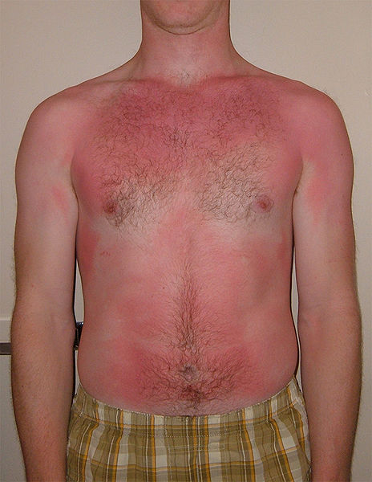
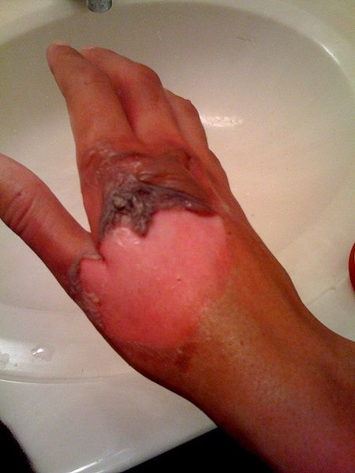
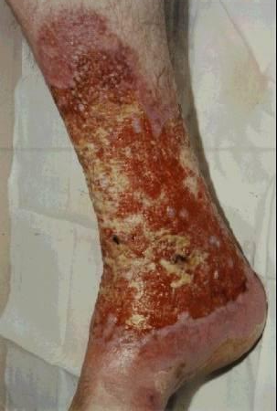
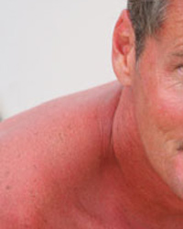
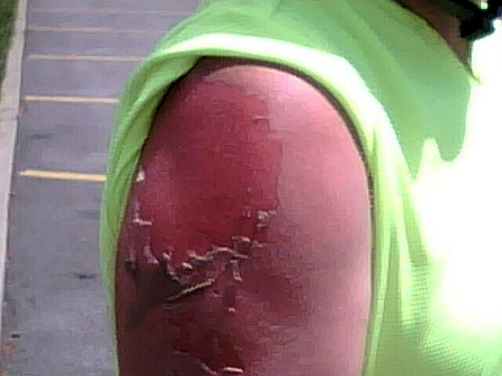
1st Degree
2nd Degree
3rd Degree

Slide 14

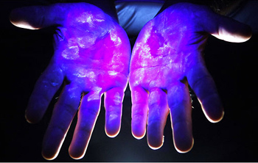
Major Functions
Your skin carries out several major functions.
  Protection

Slide 15
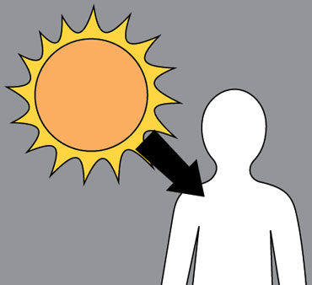
Major Functions
  2. Sensory organs
  3. Formation of Vitamin D
      Produced in presence of UV light.
      Essential for good health.
      Helps body absorb calcium into blood.

Slide 16
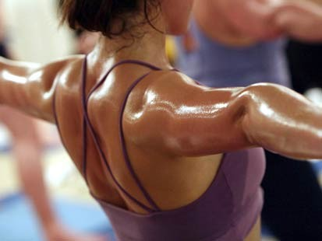
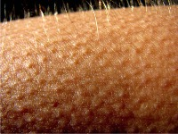
Major Functions
  Regulation of body temperature
  Ridding the body of wastes

Slide 17
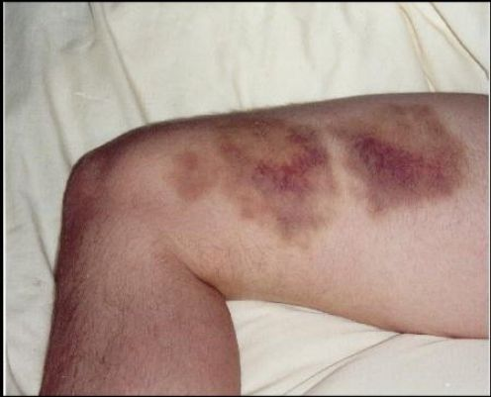
Injuries and Repair
Bruises
    Tiny blood vessels below the skin burst.
    Color goes away after pigments breakdown and reenter the blood stream.

Slide 18
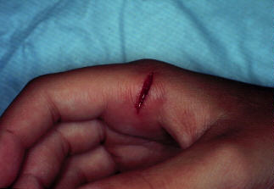
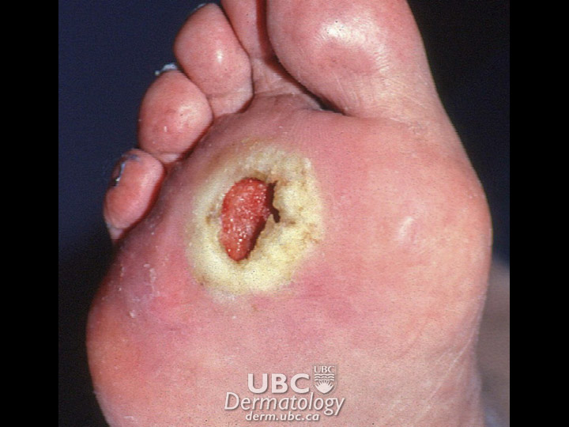
Injuries and Repair
2. Cuts
    Any tear in the skin.
    Blood flows until a clot forms and then a scab forms.
    Skin cells divide and grow under scab until healed.
WARNING:
Behind this box
Is a really
gross picture.

Slide 19
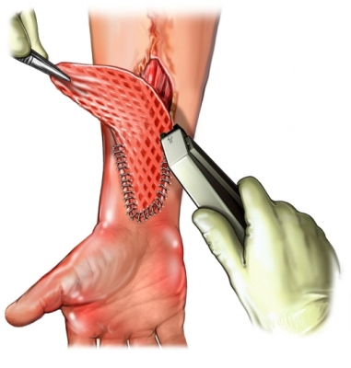
Injuries and Repair
3. Skin Grafts
    Pieces of skin are cut from one part of a person’s body and moved to the injured or burned area where there is no skin.
    Must be from own body or identical twin.
SKIN GRAFT
You Tube / Video Link

Slide 20
REINFORCEMENT
SKIN VIDEO

