Slide 1
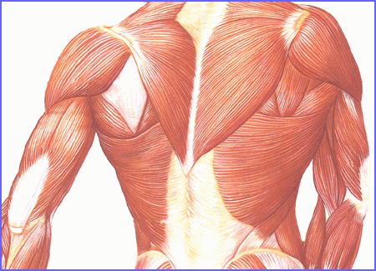
Human Body Systems
The Muscular System

Slide 2
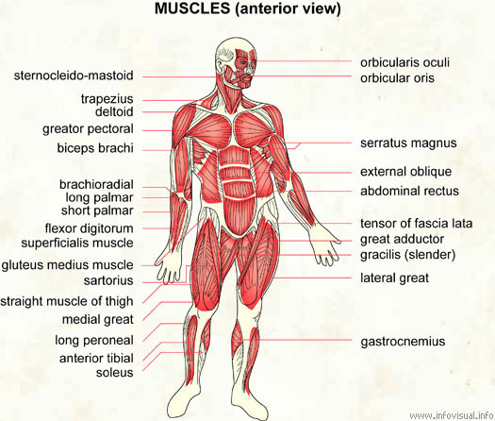
Around 600 Muscles in Human Body

Slide 3
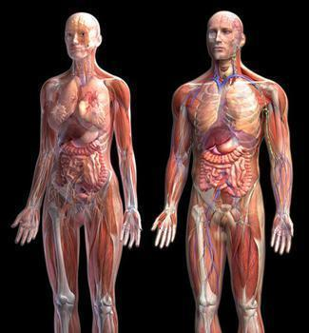

Slide 4
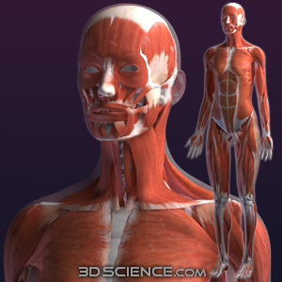
The Muscular System
A muscle is an organ that can relax, contract, and provide the force to move your body parts. There are more than 600 muscles in the human body. Muscles are always moving when your body is perfectly still.

Slide 5
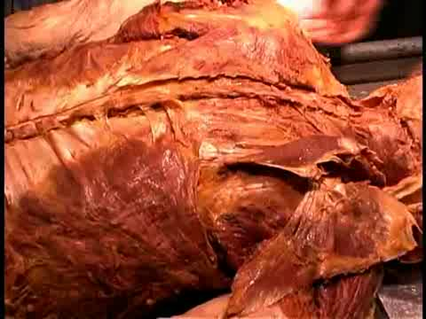
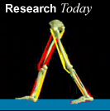
Voluntary vs. Involuntary
Muscles can be either voluntary or involuntary.
Voluntary Muscles – Muscles you are able to control.
    Hand, arm, leg, face

Slide 6
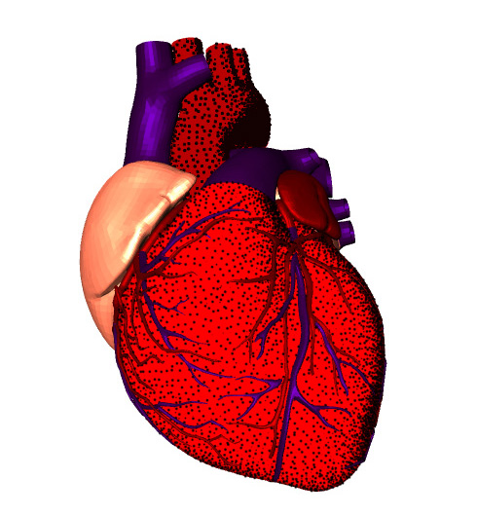
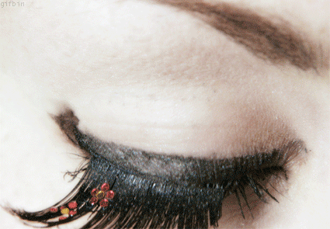
Voluntary vs. Involuntary
Involuntary Muscles – Muscles that you cannot control consciously.
    Heart, digestive system
Beating Heart Surgery

Slide 7
Types of Muscle
YOU are made up of 3 kinds of muscles…
  Skeletal
  Cardiac
  Smooth
DID YOU KNOW…
The strongest muscle (according to size) is your tongue!

Slide 8
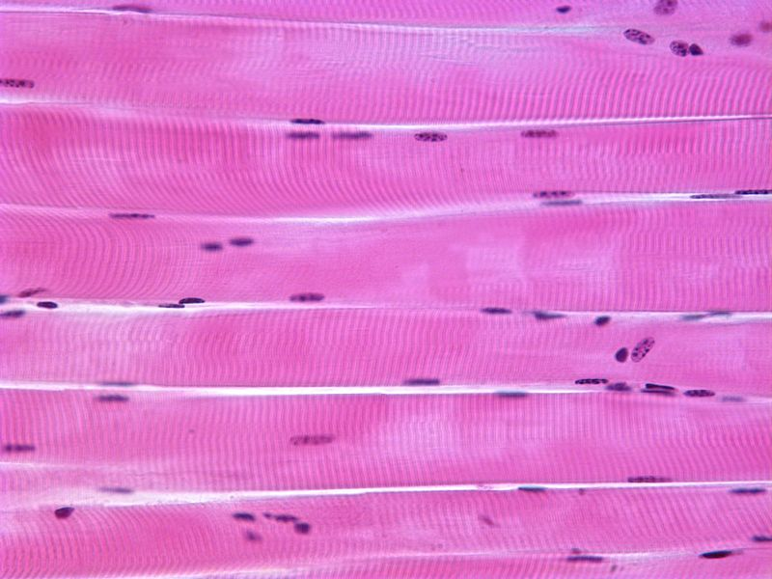
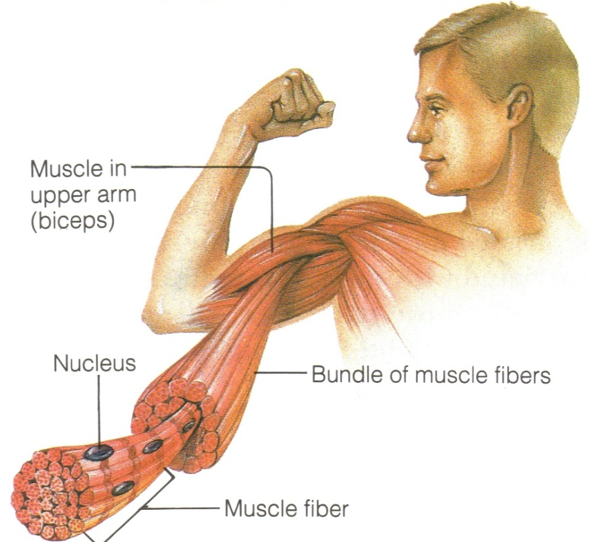
Skeletal Muscle
Skeletal Muscle –
    Muscles that move bones.
    They are the most common.
    They are attached to bone by thick bands of tissue called tendons.
    Skeletal muscles are striated.
    They contract quickly and tire more easily than involuntary muscle.

Slide 9
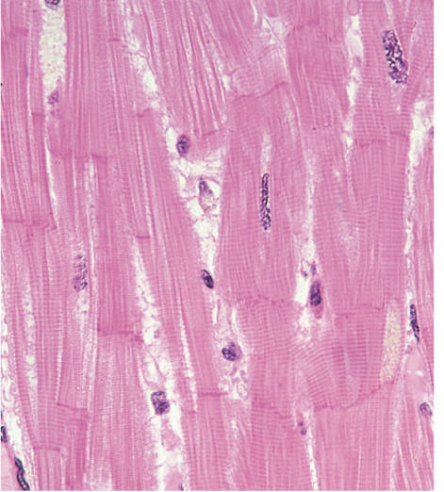
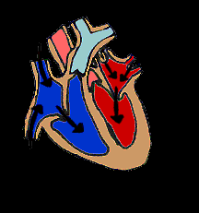
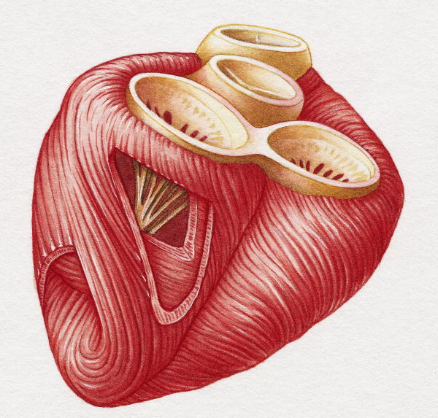
Cardiac Muscle
Cardiac Muscle –
    Muscle found only in the heart.
    Contracts about 70 times per minute everyday of your life.
    Cardiac muscle has striated bands.

Slide 10
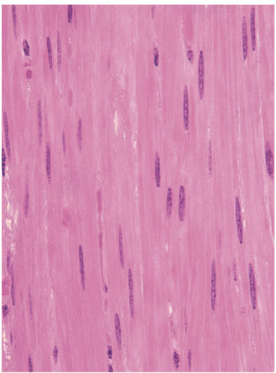
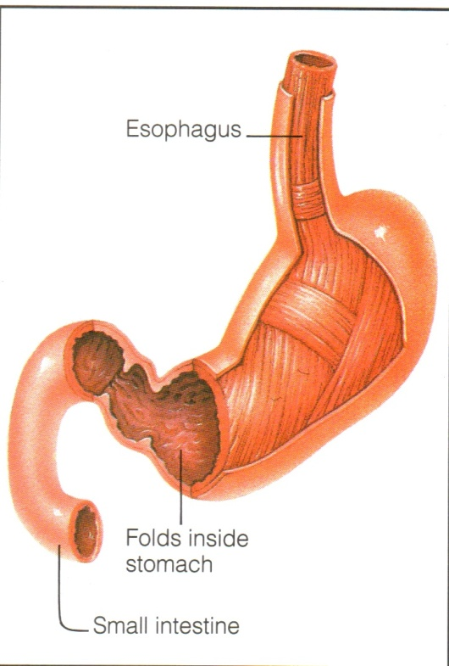
Smooth Muscle
Smooth Muscle –
    Muscle found in your intestines, bladder, blood vessels, and other internal organs.
    They slowly contract and relax.

Slide 11
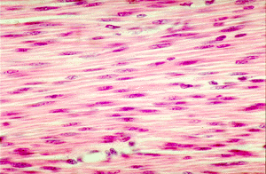
Mix N Match
Smooth Muscle
Skeletal Muscle
Cardiac Muscle

Slide 12
Working Together
In order for your body to move, it requires your skeletal system and muscular system to work together. These systems work together like simple machines called levers.
Muscles work in pairs to allow movement. When one contracts, the other relaxes.
    Biceps and triceps
    Quadriceps and hamstring

Slide 13
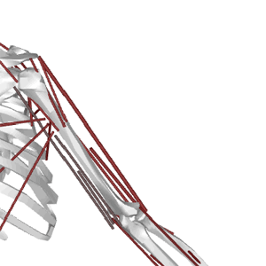
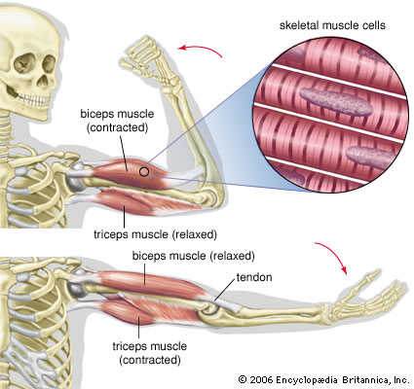

Slide 14

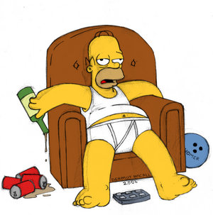
Exercise Much?
Muscles can change in size over time. A person who exercises frequently can have noticeably defined muscles compared to a person who participates in non-active pastimes such as watching TV or playing video games.

Slide 15
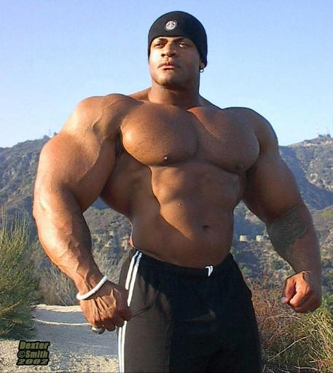
Fun Facts About Muscles
A muscle weighs more than a pound…
The stronger your muscles are, the more they work, the more they work the more calories you burn!
All NFL players are considered “obese” by BMI charts – but their heavy weights comes from muscle mass.

Slide 16
Physiology
Your muscles need energy to contract and relax.
During activity chemical energy supplied by food is changed into mechanical energy (movement) and thermal energy (heat).
When the chemical energy gets used up, the muscles become tired and need rest.
Food = Energy

Slide 17
Muscle Diseases
Dystonia
YouTube / Video Link

