Slide 1
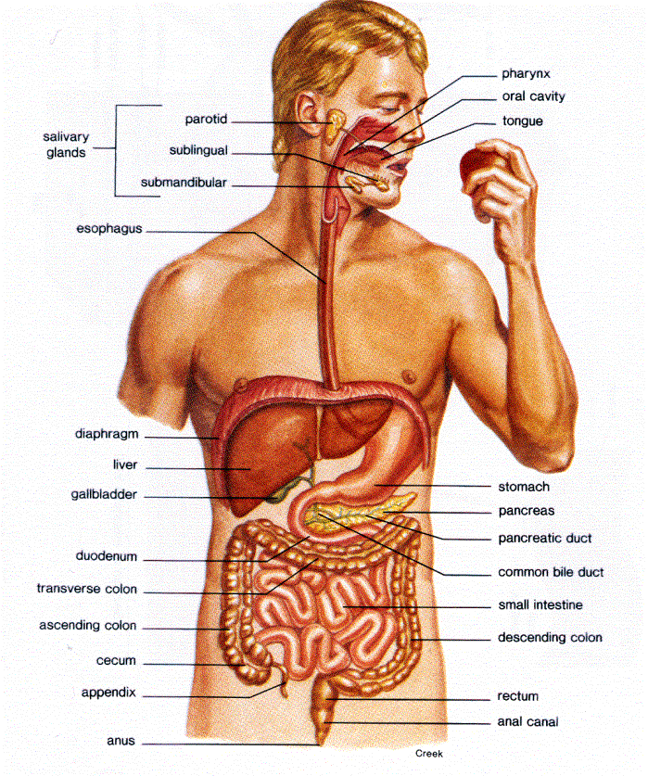
Human Body Systems
The Digestive System

Slide 2
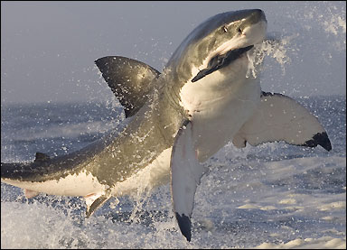

Slide 3
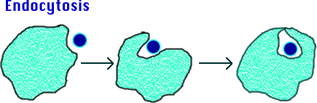
Digestion
The process that breaks down food into small molecules so that they can be absorbed and moved into the blood.
From the blood, food molecules are transported across the cell membrane to be used by the cell.
Unused molecules pass out your body as wastes.

Slide 4
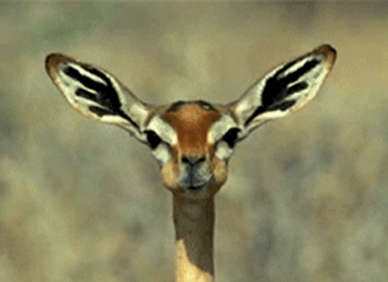
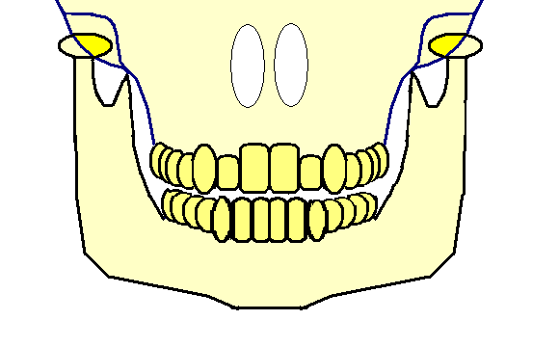
Two Kinds of Digestion
Mechanical Digestion – takes place when food is chewed, mixed, or churned.
Chemical Digestion – occurs when chemical reactions break down large food molecules into smaller ones.

Slide 5
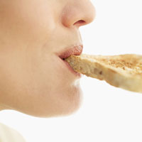
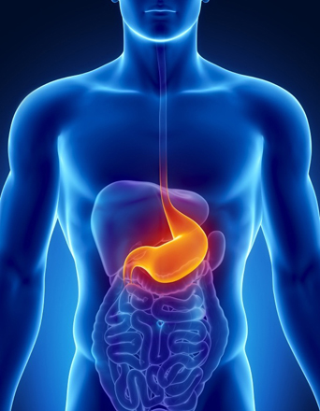
Enzymes
Makes chemical digestion possible. They are proteins that speed up the rate of a chemical reaction in your body. They reduce the amount of energy needed to begin a reaction.
  Amylase (mouth) – break down complex carbohydrates into simpler sugars (starch → sugar).
  Pepsin (stomach) – break down proteins.

Slide 6

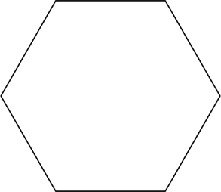
Chemical Digestion
ENZYME

Slide 7
Chemical Digestion

Slide 8
Chemical Digestion

Slide 9
Chemical Digestion

Slide 10
Chemical Digestion

Slide 11
Chemical Digestion

Slide 12
Chemical Digestion

Slide 13
Chemical Digestion

Slide 14
Chemical Digestion

Slide 15
Chemical Digestion

Slide 16
Chemical Digestion

Slide 17
Chemical Digestion

Slide 18
Chemical Digestion

Slide 19
Chemical Digestion

Slide 20
Chemical Digestion

Slide 21
Chemical Digestion

Slide 22
Chemical Digestion

Slide 23
Chemical Digestion

Slide 24
Chemical Digestion

Slide 25
Chemical Digestion

Slide 26
Chemical Digestion

Slide 27
Chemical Digestion

Slide 28
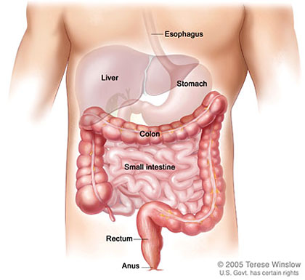
Organs

Slide 29
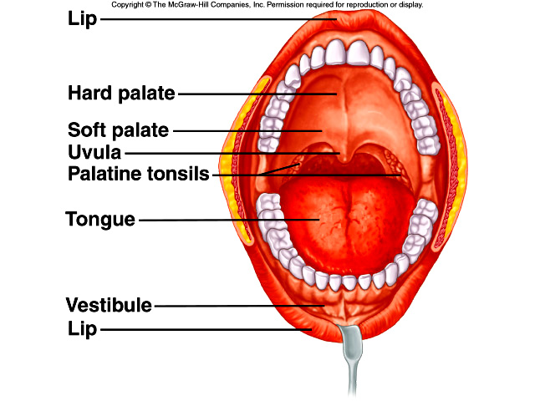
The Mouth
Mechanical and chemical digestion begin in the mouth.

Slide 30
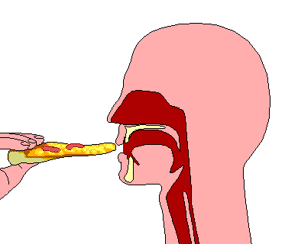
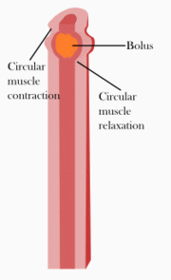
The Esophagus
Muscular tube that connects the mouth to the stomach.
  Epiglottis – covers windpipe so food cannot enter.
  Smooth muscles squeeze to move food – peristalsis.

Slide 31
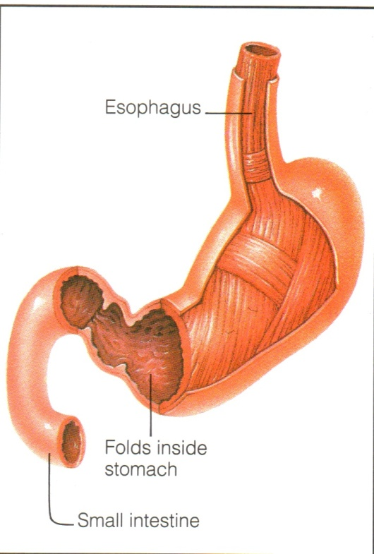
The Stomach
Muscular bag.
  Mechanical and chemical digestions occur.
  Hydrochloric acid is produced in the stomach and works with the enzyme pepsin to digest proteins.
  Hydrochloric acid also destroys bacteria in foods.
Brainiac – Stomach Acids
YouTube / Video Link

Slide 32
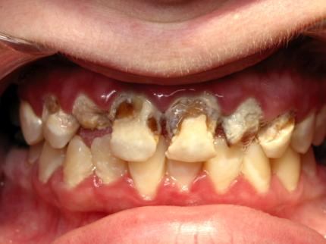
HYDROCHLORIC ACID can also
harm your teeth…

Slide 33
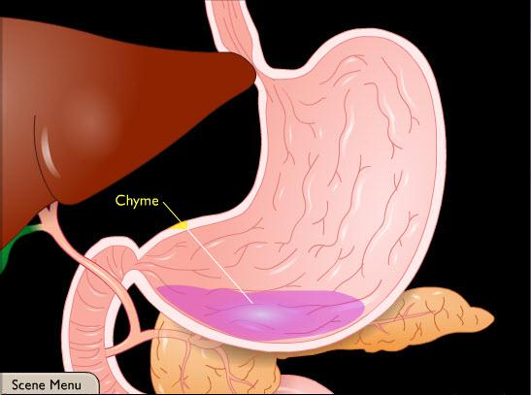
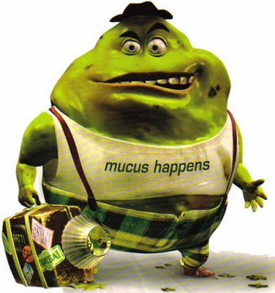
The Stomach
  Mucus makes food slippery and protects stomach from digestive juices.
  Food moves through the stomach in 2-4 hours.
  Chyme – When food is changed into a thin watery liquid.

Slide 34
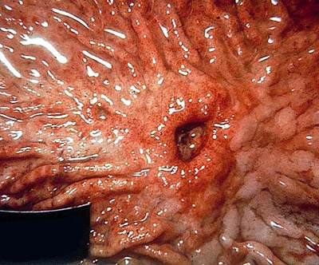
The Stomach
When the mucus is compromised, hydrochloric acid can make ULCERS in a persons stomach.

Slide 35
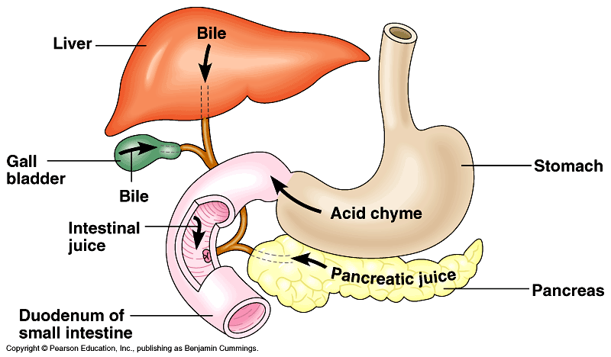
Liver/Gall Bladder/Pancreas
The small intestine picks up chemicals from these organs to help with digestion…

Slide 36
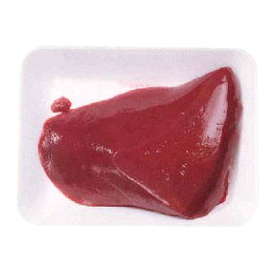
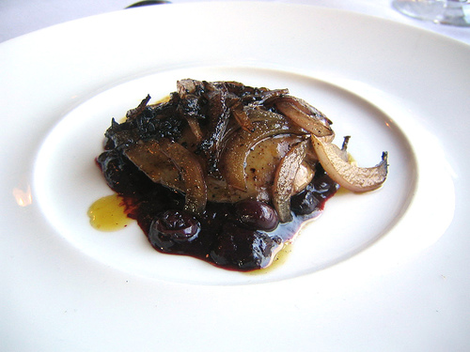
Liver
Liver – Largest organ, it is a chemical factory that produces bile and removes toxins.

Slide 37
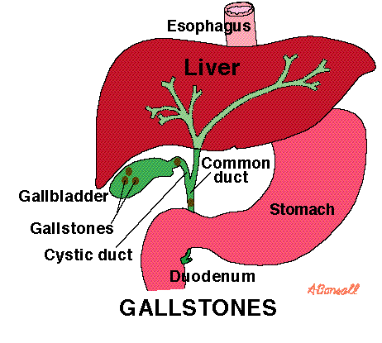
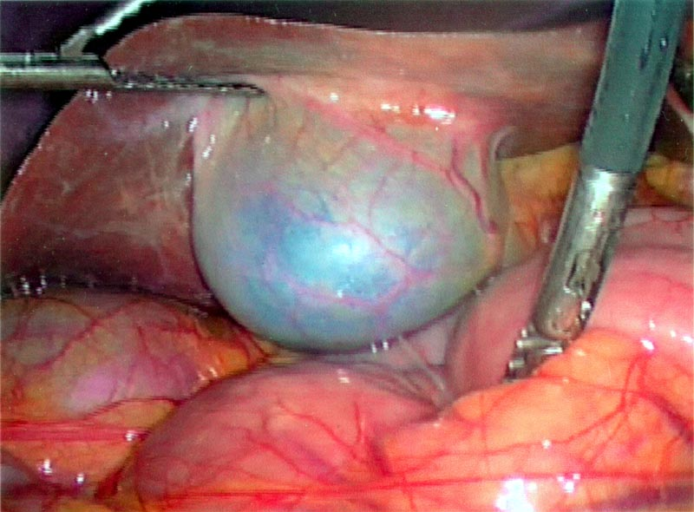
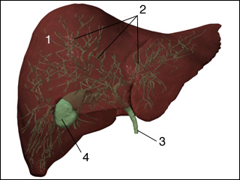
Gall Bladder
Gall Bladder - Stores bile, the bile breaks down fats into smaller pieces.

Slide 38
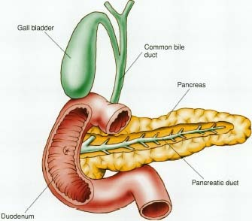
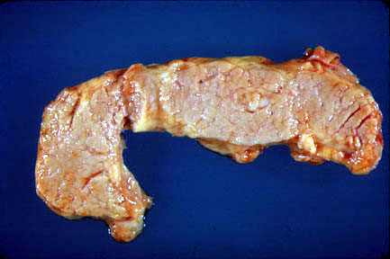
Pancreas
Pancreas - produces insulin. A hormone that helps digest sugars.

Slide 39
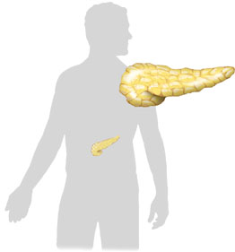
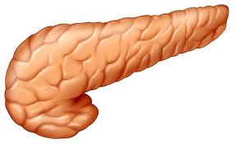
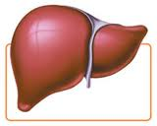
Regulation of Blood Sugar
Anatomy Example
insulin
body
cells take
up sugar
from blood
liver stores
sugar
reduces
appetite
Pancreas
high
blood sugar level
(90mg/100ml)
Liver
low
liver
releases
sugar
triggers
hunger
Pancreas
Liver
glucagon

Slide 40
The Small Intestine
4-7 meters in length, small diameter.
  Duodenum – where most digestion takes place.
  Absorption of food takes place with help of villi – fingerlike projections on wall of small intestine and increases surface area so nutrients in chyme have more places to absorb.
  Peristalsis continues to force undigested and unabsorbed materials into large intestine.
duodenum

Slide 41
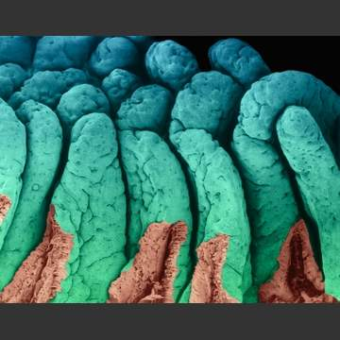
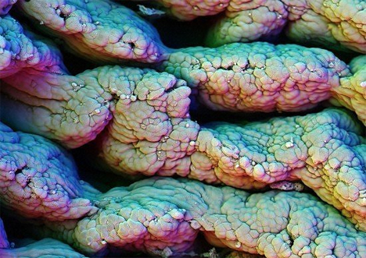
Villi in The Small Intestine

Slide 42
The Large Intestine
Absorbs water from undigested mass.
  Peristalsis slows down.
  Remaining undigested material becomes solid.
  Muscles of the rectum and anus control the release of wastes from body in form of feces.
Large Intestine

Slide 43
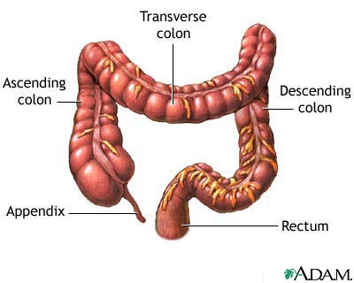

Slide 44
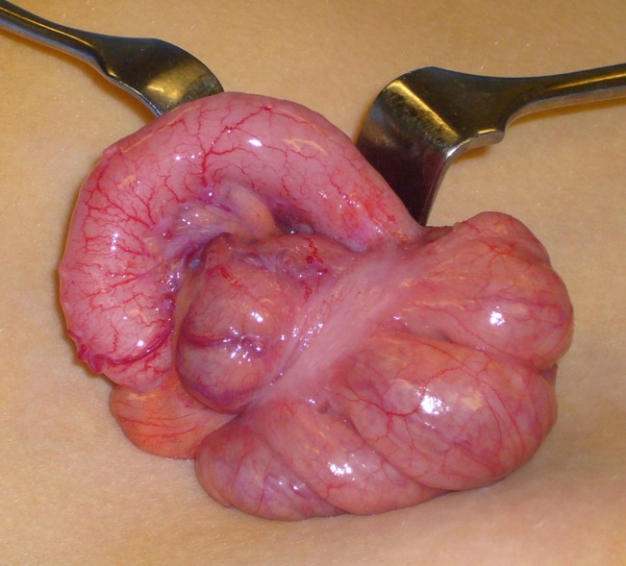
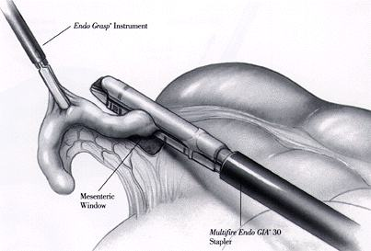

Slide 45
The Digestive System
YouTube / Video Link

Slide 46
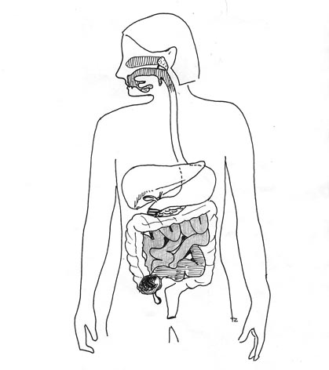
ESOPHAGUS
STOMACH
LIVER
PANCREAS
SMALL
INTESTINE
GALL
BLADDER
LARGE
INTESTINE

