Slide 1
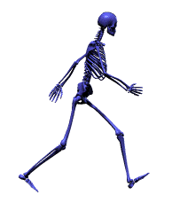
Human Body Systems
The Skeletal System

Slide 2
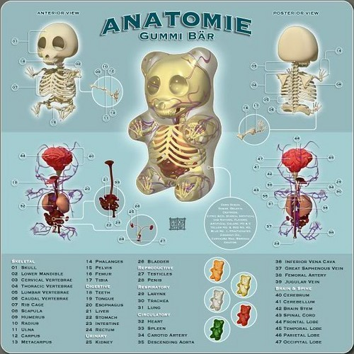

Slide 3
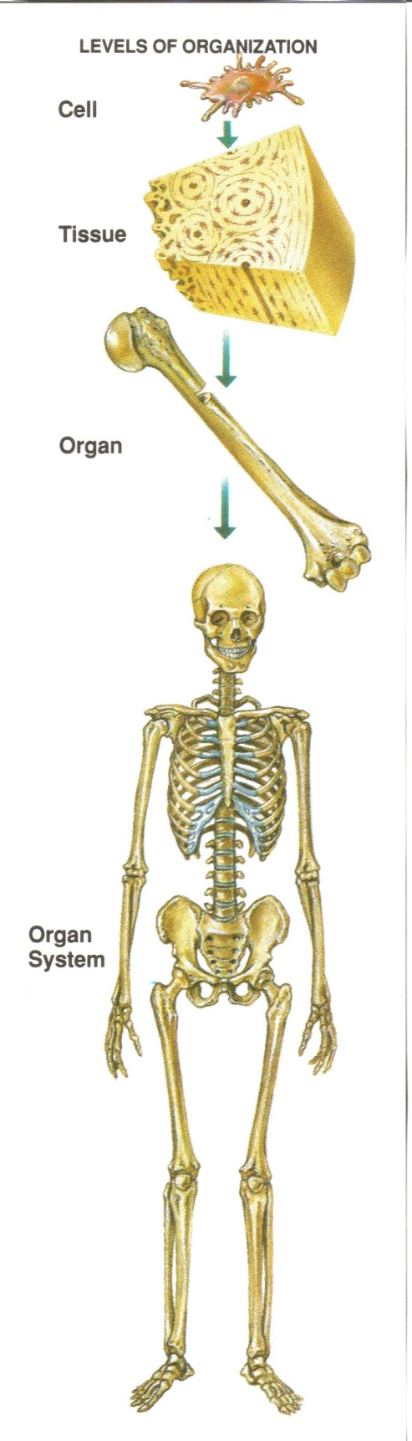
The Skeletal System
The bones in a human body are living organs made of several different tissues.

Slide 4
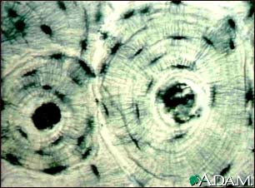
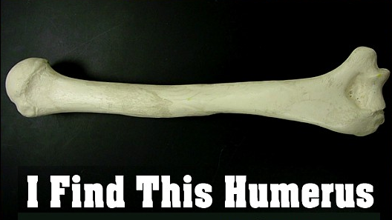
Bone Tissue
There are 206 bones in a human body
Bone tissue is made of cells that take in nutrients and use energy.

Slide 5
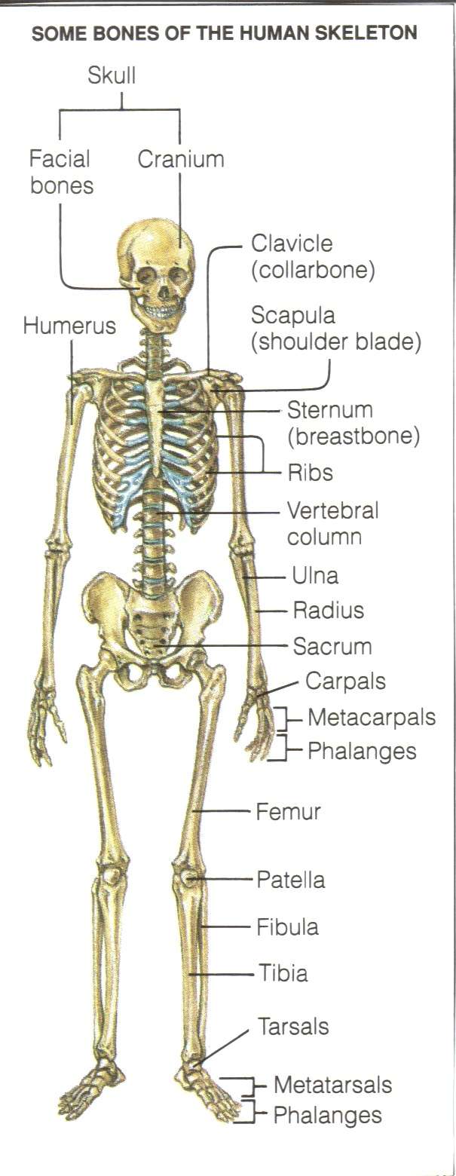
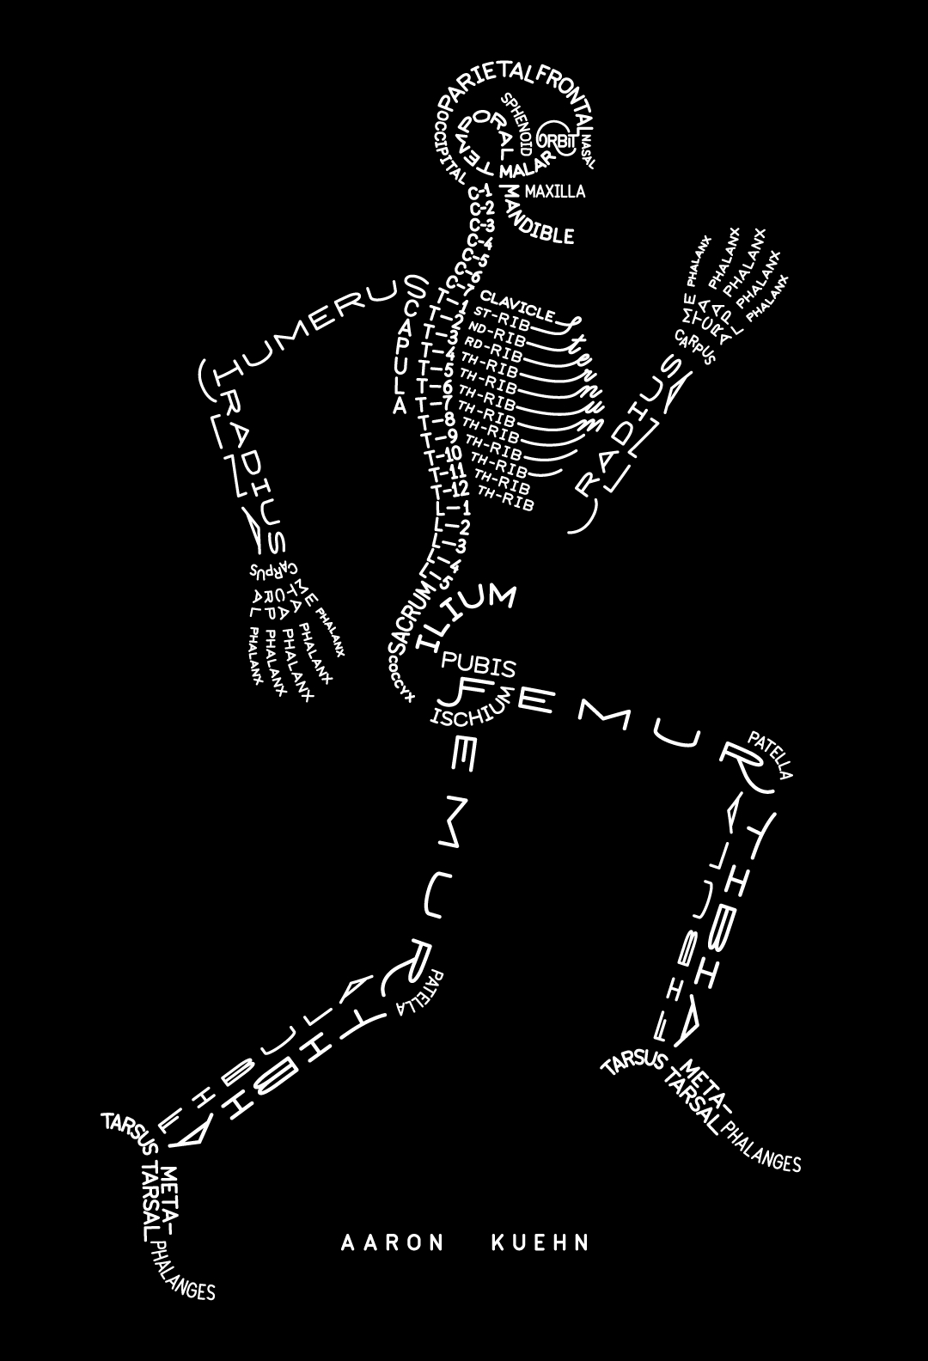
Skeletal System

Slide 6
Stanley the Skeleton
YouTube / Video Link
don’t hate me…

Slide 7
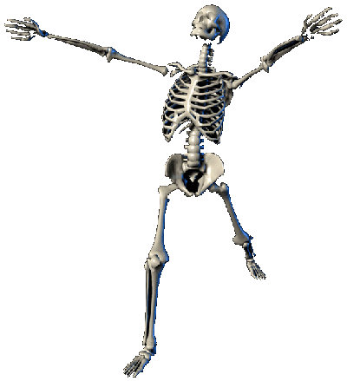
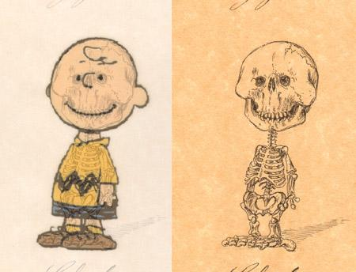
5 Major Functions
The skeletal system is the framework of your body and has five major functions.
  The skeleton gives shape and support to your body.

Slide 8
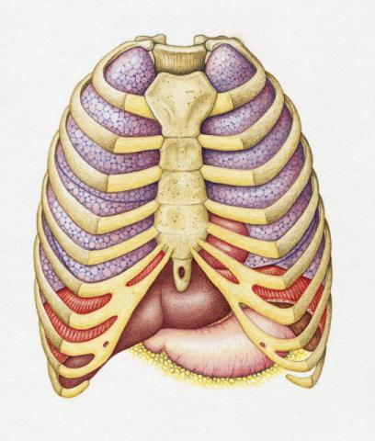
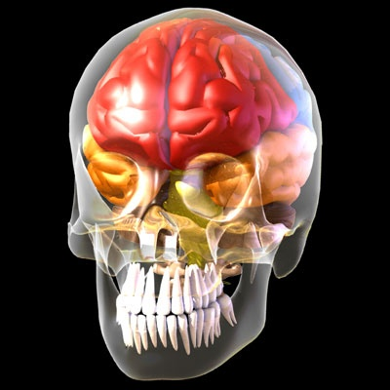
  2. Bones protect your internal organs.
      Rib cage protects your lungs and heart.
      Skull protects your brain.

Slide 9
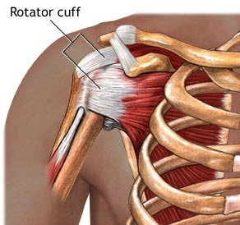
  3. Major muscles are attached to bone to help them move.

Slide 10
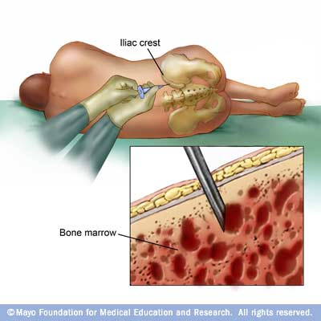
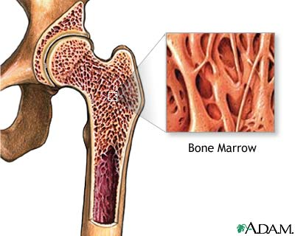
Bone Marrow Extraction
  4. Blood cells are formed in the center of many bones in soft tissue called red marrow.

Slide 11
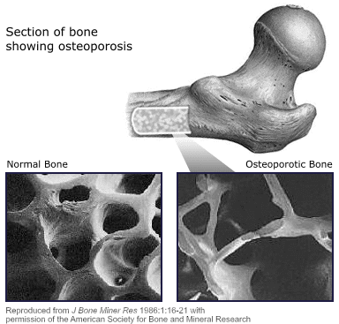
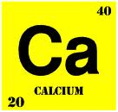
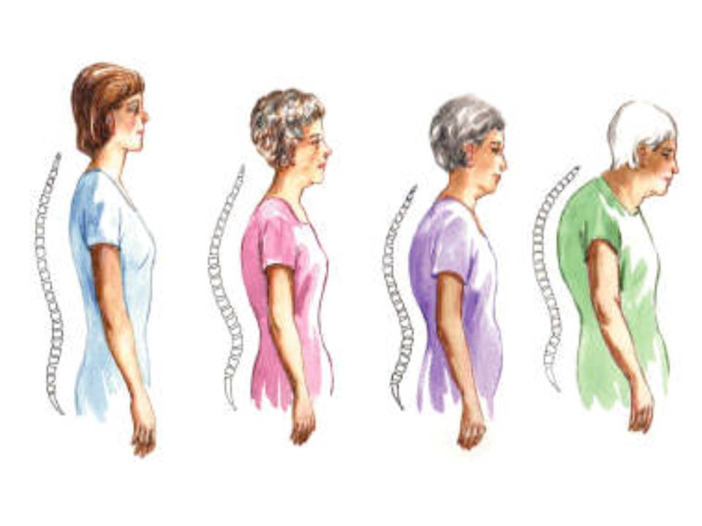
  5. Major quantities of calcium and phosphorous compounds are stored in the skeleton for later use.
      a. Calcium and phosphorous make bones hard.
not enough Ca
= osteoporosis

Slide 12
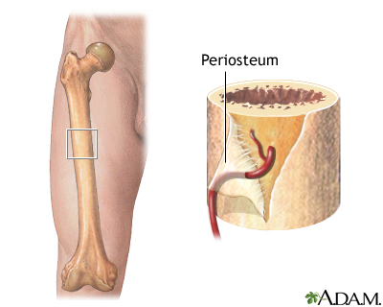
Structure of Bone
A living bone’s surface is covered with a tough, tight-fitting membrane called the periosteum.
The periosteum contains small blood vessels to carry nutrients and cells for growth and repair.

Slide 13
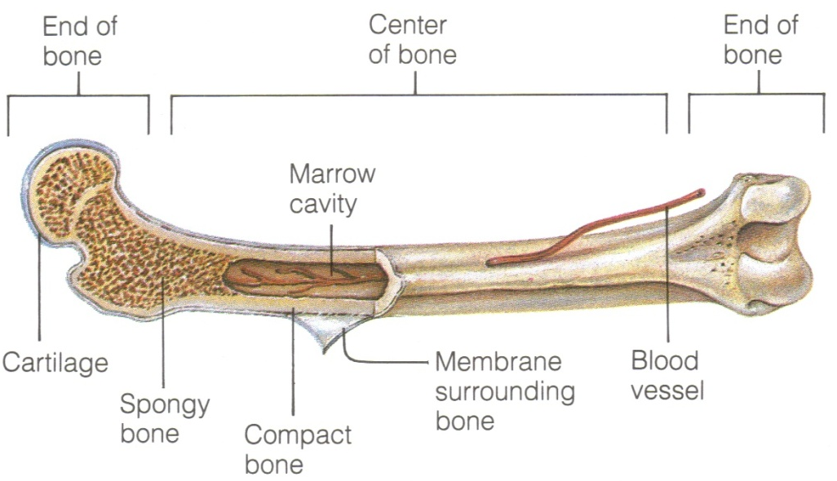
Structure of Bone

Slide 14
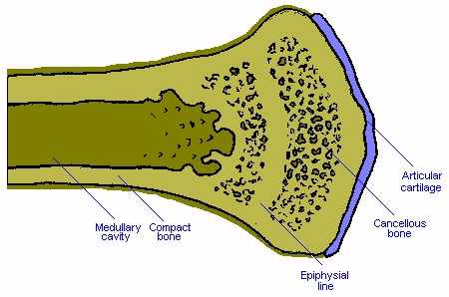
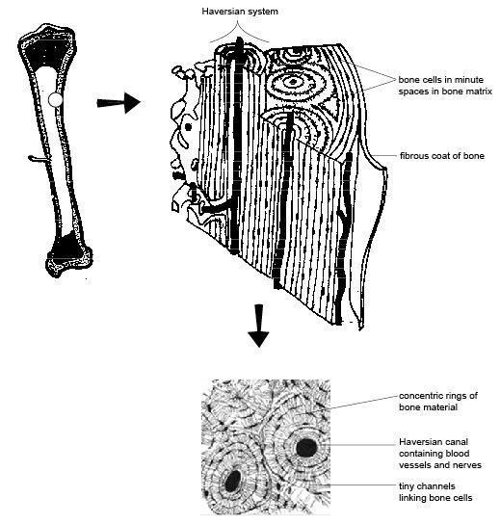
Compact Bone
Hard, strong layer of bone found directly under the periosteum.
Contains bone cells and blood vessels.

Slide 15
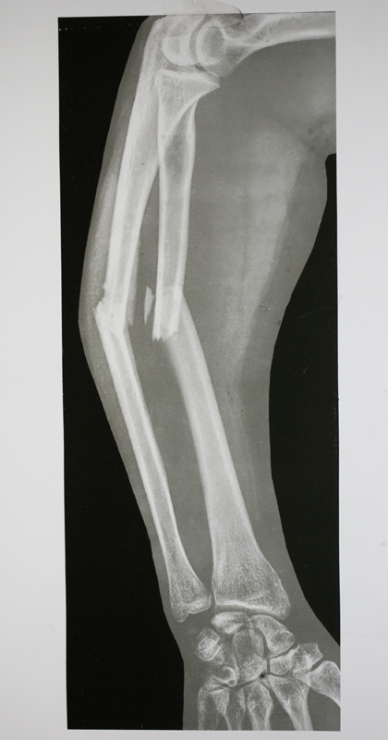
Compact Bone
Keeps bone from being too rigid, brittle, or easily broken.
DID YOU KNOW???
Pound for pound…BONE is as strong as STEEL.

Slide 16
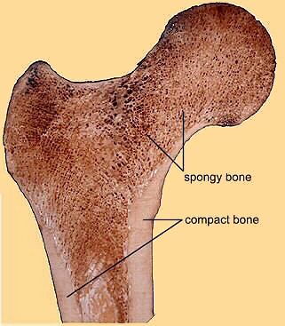
Spongy Bone
Located toward the ends of long bones such as those in your thigh and upper arm.
Has many small, open spaces that make bones lightweight.

Slide 17
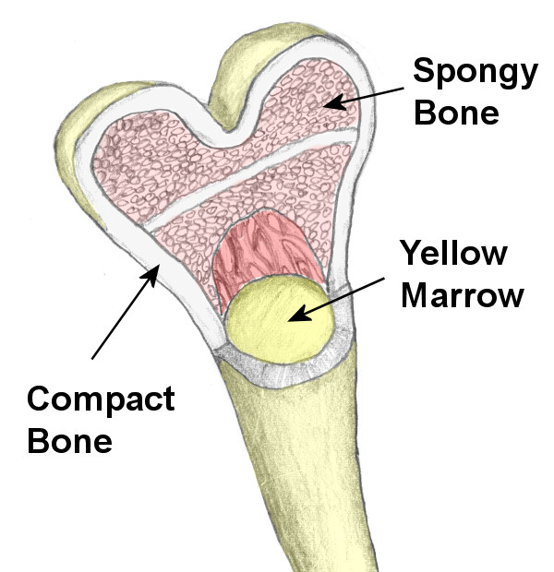
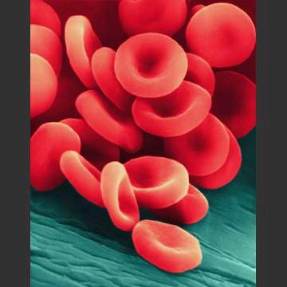
Spongy Bone
Also found in the center of cavities of long bone. The spaces are filled with marrow. Yellow marrow contains fat cells and red marrow produces red blood cells.

Slide 18
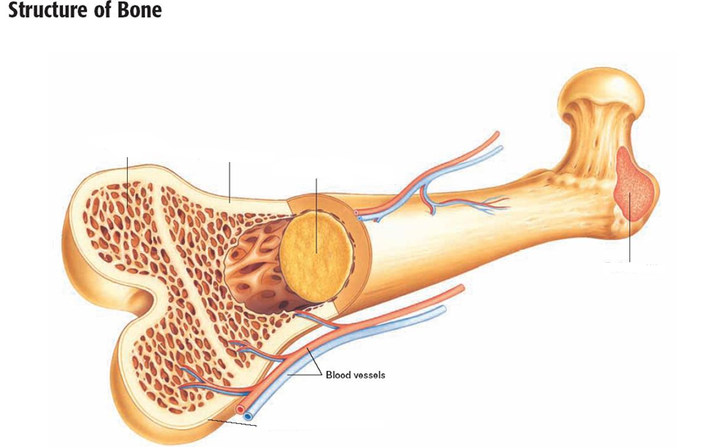
Spongy Bone
Compact Bone
Yellow Marrow
1.______
2.______
3.______
Red Marrow
4.______
5.______
Periosteum
Spongy Bone Yellow Marrow Periosteum
Red Marrow Compact Bone

Slide 19
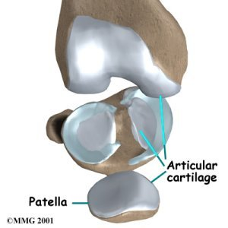
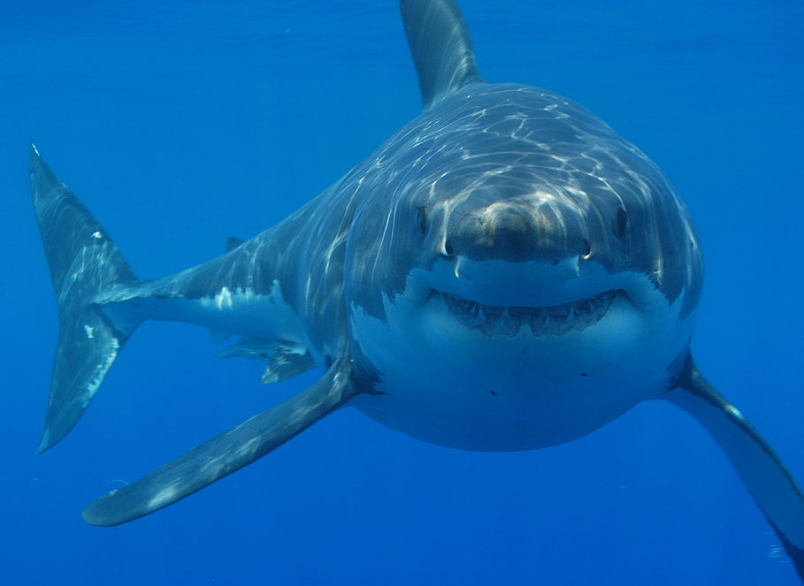
Cartilage
Smooth, slippery, thick layer of tissue located at the ends of bones.

Slide 20
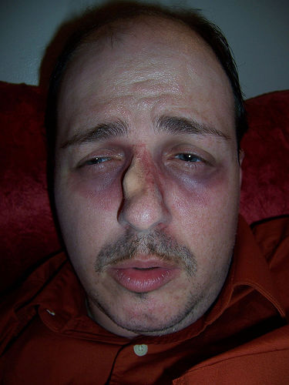
Cartilage
Yes, cartilage can be damaged.

Slide 21
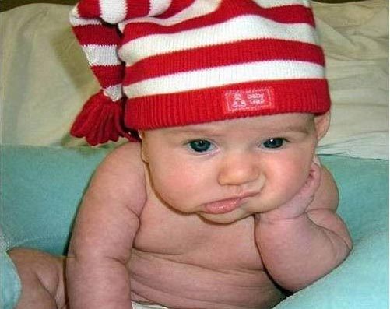
Cartilage
There are no blood vessels or minerals present.
Acts as shock absorber (cushion to prevent injury), reduces friction from movement.
Babies are born with 300 bones! Most of these are actually carilage!
Why is this good for a newborn baby?

Slide 22
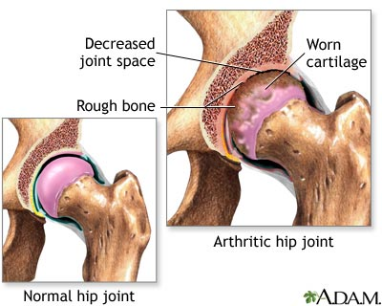
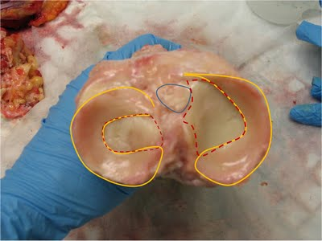
Cartilage

Slide 23
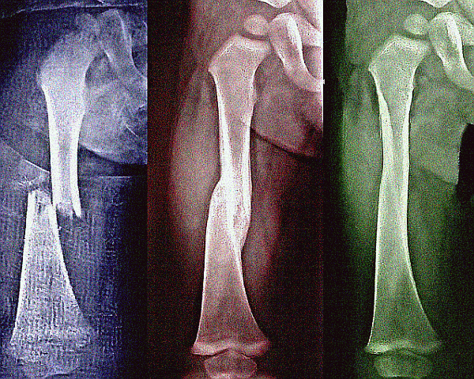
Bone Formation
Healthy bone tissue is always being formed and reformed.
  Osteoblasts
  Osteoclasts

Slide 24
JOINTS where two bones meet

Slide 25
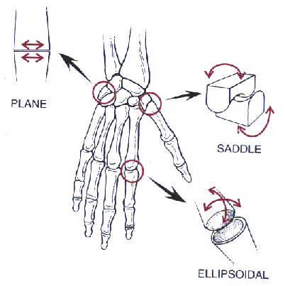
Joints
A joint is any place in the body where two or more bones come together.

Slide 26
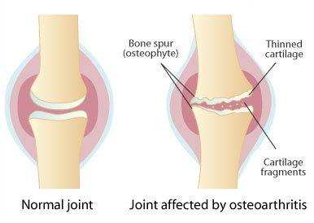
Joints
A layer of cartilage is between healthy joints to keep the bones from rubbing against one another.
Warning: Graphic Content
YouTube / Video Link

Slide 27
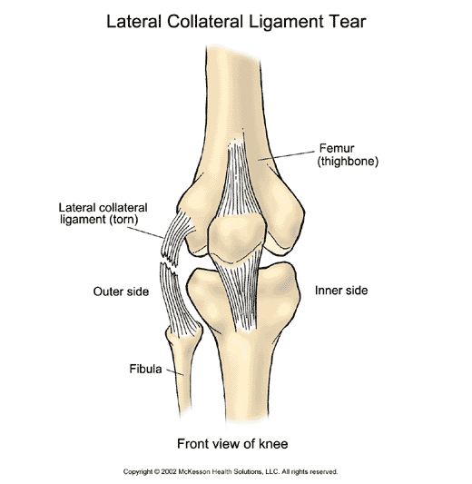
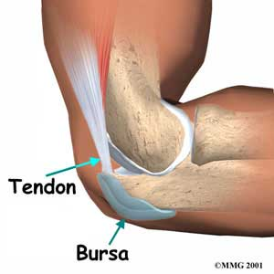
Joints
Ligaments are tough bands of tissue that hold bones together at joints.
Tendons attach bone to muscle to allow movement at the joint.

Slide 28
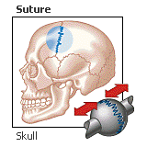
Types of Joints
Immovable Joints – Allow little to no movement. Bones in your skull and pelvis are examples of immovable joints.
QUESTION: Why would your skull have immovable joints?

Slide 29

Types of Joints
Moveable Joints – Allows your body to make a wide range of movements. There are various types of moveable joints.
    Pivot Joint
    Hinge
    Ball and Socket
    Gliding

Slide 30

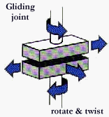
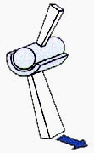
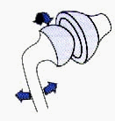
Moveable Joints
Ball and
Socket
Hinge
Gliding
Pivot

Slide 31
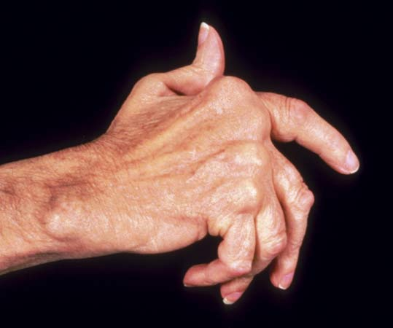
Joint Problems
Arthritis –
    Most common joint problem.
    Describes more than 100 different diseases that can damage the joints.
    1 in 7 people suffer from arthritis.
    Begins with symptoms of pain, stiffness, and swelling of the joints.

Slide 32
Joint Problems
Common Types of Arthritis –
    Osteoarthritis – Common in older aged individuals where cartilage breaks down.
    Rheumatoid arthritis – Can occur in young and old adults. The body’s immune system tries to destroy its own tissues.
DID YOU KNOW?
Bee stings may help cure arthritis…
Bee Therapy
You Tube / Video Link

