Slide 1
GENETIC DISEASE
BROCHURE

Slide 2
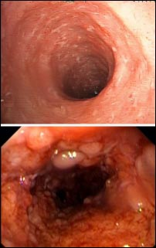
Crohns Disease
Inflammatory disease of the bowl

Slide 3

ALS
Progressive neurodegenerative disease that affects nerve cells in the brain

Slide 4

Angelman Syndrome
A neuro-genetic disorder characterized by severe intellectual and developmental disability

Slide 5

Alzheimer's
Memory problems and forgetfulness

Slide 6
Chromosomal Diseases

Slide 7

Down Syndrome
Mental delay due to extra chromosome

Slide 8
Dominant/Recessive Genetic Diseases

Slide 9

Acondroplasia
Type of dwarfism

Slide 10

Marfan Syndrome
Connective tissue disease, excessive limb growth

Slide 11
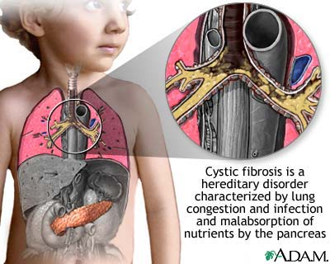
Cystic Fibrosis
Fluid buildup in the respiratory system

Slide 12

PKU
Unable to digest proteins

Slide 13
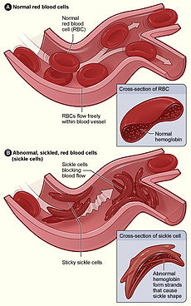
Sickle-Cell Anemia
Abnormally shaped blood cells

Slide 14

Tay-Sachs
Disease destroys nerve, brain, and spinal cord.

Slide 15
Sex-Linked Genetic Diseases

Slide 16

Duchennes Muscular Dystrophy
Muscle wasting disease

Slide 17
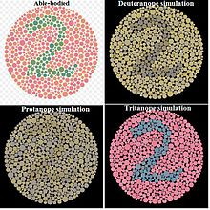
Color Blindness
Unable to articulate various colors

Slide 18

Hemophilia
Blood clotting disorder. Paper cuts are deadly.

