Slide 1
EVOLUTION and NATURAL SELECTION
Explaining the UNITY and DIVERSITY of LIFE

Slide 2
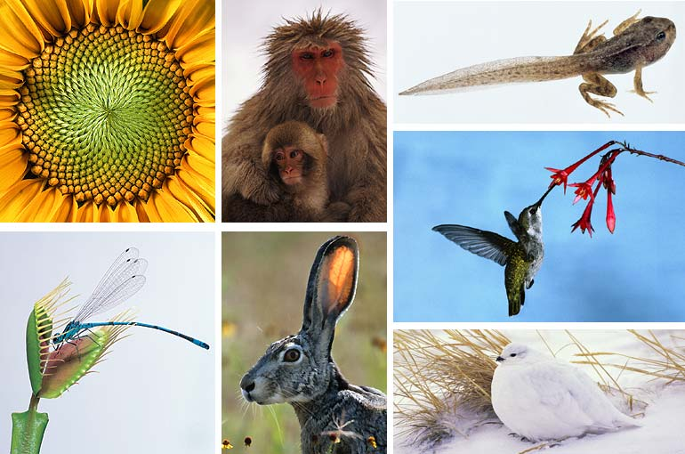
What Is Evolution?
Evolution explains why life is so unified and diverse.
Evolution studies the natural world using the scientific method:
  OBSERVATION
DIVERSITY
UNITY

Slide 3
Charles Darwin
Charles Darwin was one of the first scientists to develop a theory about how evolution works.
Why do birds have different beaks? Why do different beaks allow them to eat certain seeds?

Slide 4
Charles Darwin
Darwin became convinced that organisms with similar characteristics has common ancestors.
The fossil record proves this! By WHY did the organisms change?

Slide 5
Reasons for Change

Slide 6
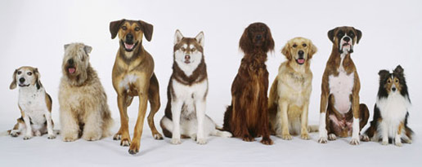
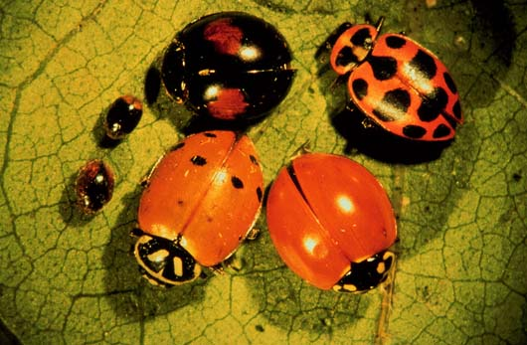
Variation
Gene differences in a species
Populations are a mix of different individuals

Slide 7
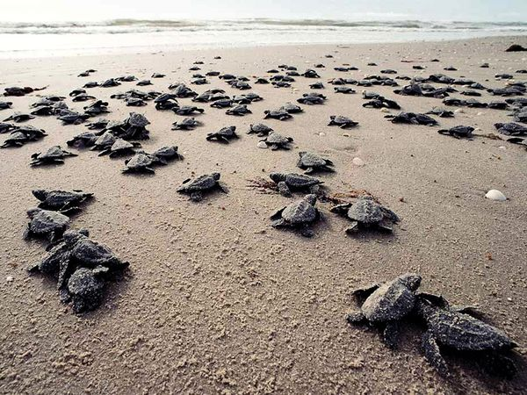
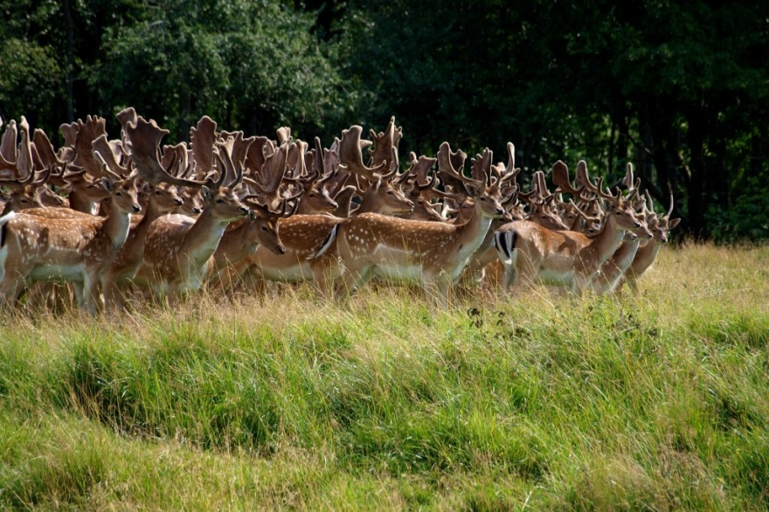
Competition
Overproduction
  Organisms have more offspring than the environment can support
Competition
  Not everyone survives
  THIS LEADS TO SURVIVAL OF THE FITTEST
  The fit individuals have babies and pass on their genes

Slide 8
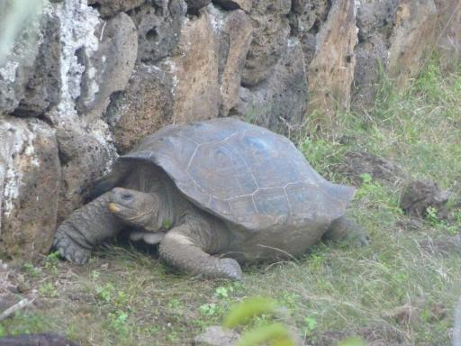
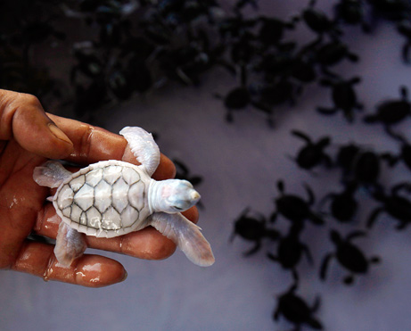
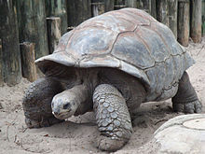
Adaptation
Organisms best “fit” for a specific environment
An organism is born with these features, it is random if sexual reproduction provides the organism with desirable traits
Which tortoise will
reach higher leaves?

Slide 9
How Does That Work?
Variation
Over-Production & Competition
Adaptation
Nature selects the ones that “fit” the environment better … survive & reproduce
Natural Selection
Notes:
`

Slide 10
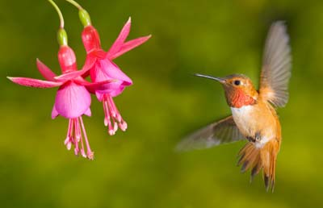
Natural Selection
  traits that help individuals survive
    survive predators
    survive disease
    compete for food
    compete for territory
  traits that help individuals reproduce
    attracting a mate
    compete for nesting sites
    successfully raise young
best fit to get food
(because of beak)
likely to survive and
reproduce

Slide 11
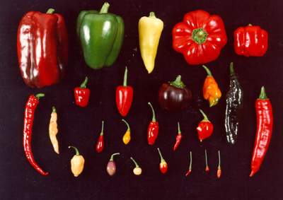
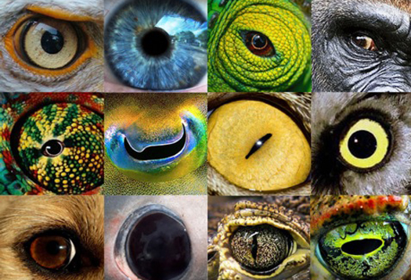
Evolution Explains Unity & Diversity
Only evolution explains both
  Unity of life
    similarities between all living things
  Diversity of life
    wide variety of different creatures on Earth
DIFFERENT
because of variation
SAME
common ancestor

Slide 12

HOMER EVOLUTION

